Slide 1
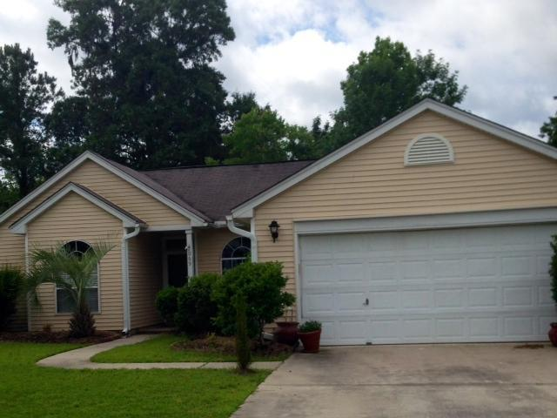
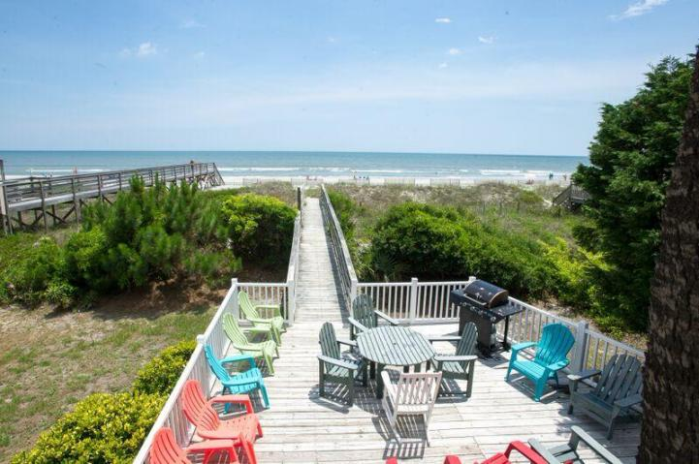
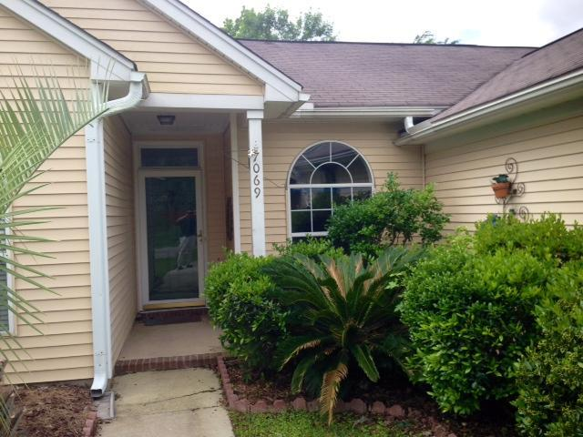
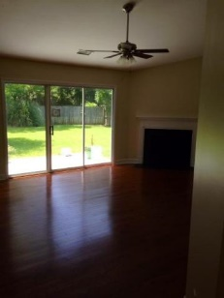
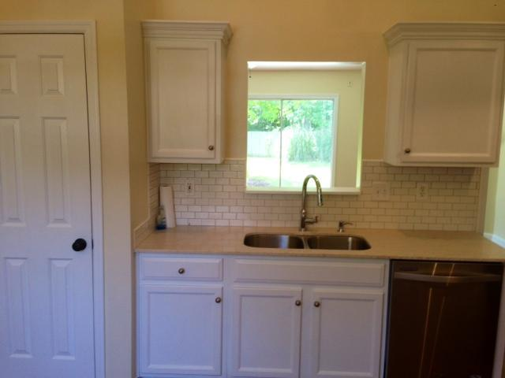
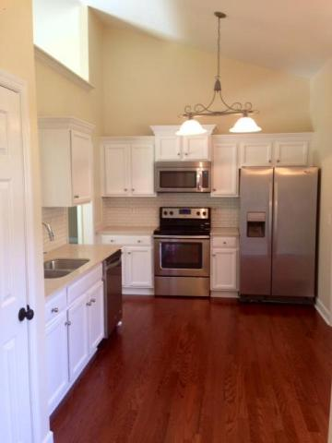
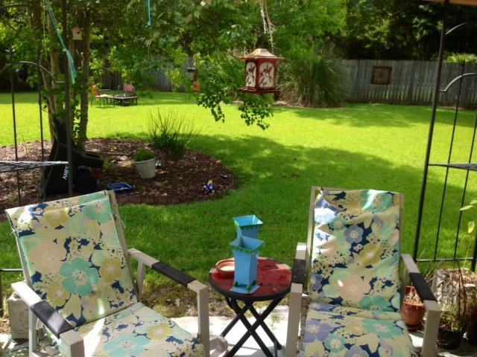


Best Value In Village Green ~ Move-in Ready!
7069 Windmill Creek Rd
Village Green
Charleston, SC 29414
MLS# 15014233
$215,500
3 Bed | 2 Bath
****$10,000 worth of brand new kitchen upgrades including appliances and, the inside of this home has been COMPLETELY RENOVATED****
Best upgraded home available in the neighborhood. All new interior renovation, hardwood floors, granite counters great flow of space and an amazing backyard which is fenced.
***LOOKS FANTASTIC***
Master bathroom shows more like a spa and the large fenced in backyard is incredible. Lots of windows, vaulted ceiling. One of the most private spots in the neighborhood and well done interior renovation. Master bedroom is separate from other bedroom. Must see to believe how pretty this home is. Wait til you visit the large fenced in private backyard.
Bryan Thompson
Office - (843) 769-5100
Mobile - (843) 452-1686
bryan.thompson@agentownedrealty.com
www.bryanthompsonrealestate.com
AgentOwned Charleston Group | 902 Savannah Hwy | Charleston, SC 29407-7802

