Slide 1


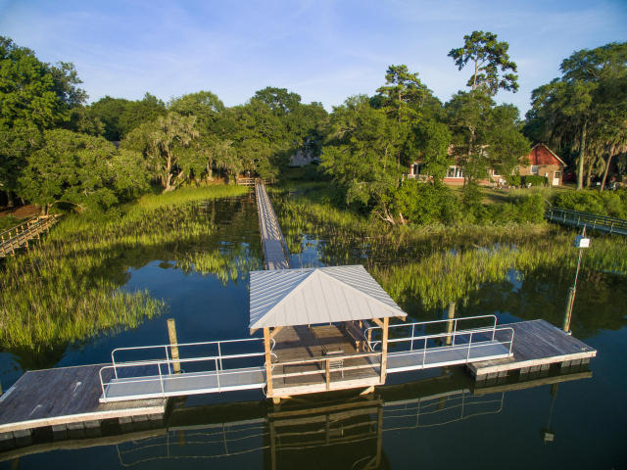
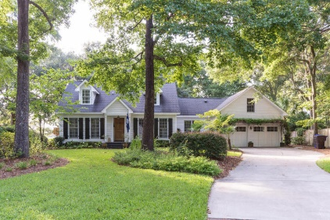
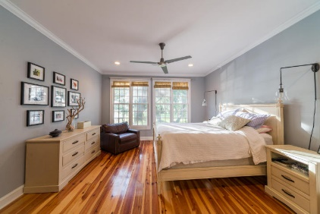
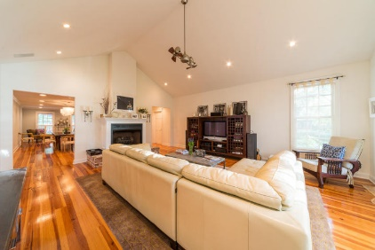
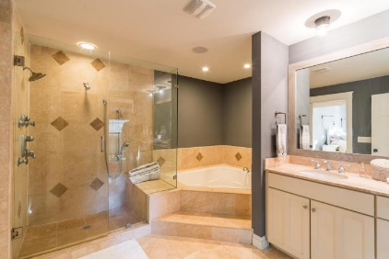
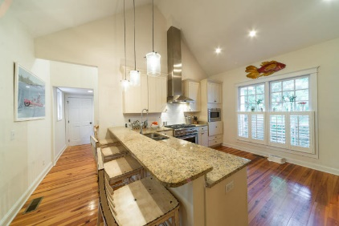
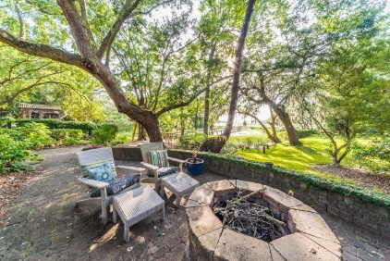
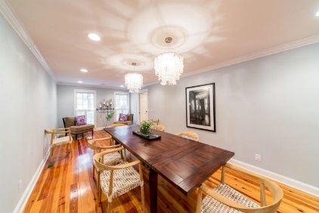
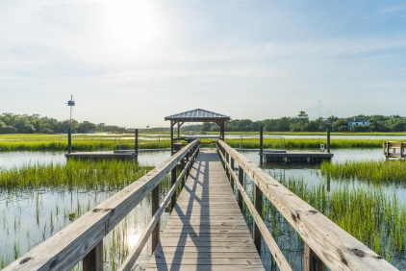

Agent Open House Thursday 08/06 11:30am-2:00pm
706 Ashburn Lane
Point Pleasant ~ Mount Pleasant ~ MLS# 15020644 ~ $1,185,000
Beautiful home on Hobcaw Creek with shared dock. Wide open floor plan with Heart of pine floors throughout the first floor. The Kitchen has a vaulted ceiling with granite counter tops and a gas range. The Great Room also has a vaulted ceiling and a view that looks out through a live oak canopy over the marsh in to Hobcaw Creek. The Master Bedroom is downstairs and it shares the same view as the Great Room. The Master Bath has a separate glassed in shower and a garden tub. There is a Guest Room downstairs which has a bath with shower. Upstairs are two Bedrooms that share a full bath. The FROG is finished and also has full bath attached. There is a screened in Porch off the Kitchen for dining or relaxing. Attached to the Screened Porch is a Deck that flows to a Patio with fire pit. This house underwent a complete renovation in 2005 and has had many upgrades since. In 2005 all the roof, HVAC system, electrical, plumbing and windows were all replaced. Since 2005 the seller's replaced the shared dock and it now has a floating dock for each owner. The yard underwent extensive renovations with the addition of Landscaping, a Patio with fire pit and a new Driveway. The exterior of the home has been repainted along with adding an arbor above the garage doors. The Wet Bar with refrigerator was also added along with the cabinets in the Laundry Room and built ins in the FROG. The home has had numerous other upgrades including light and plumbing fixtures, carpet in upstairs bedrooms as well as window treatments throughout the home.
Edmund Major
843-343-6666 C
edmund@flywaysc.com
www.flywaysc.com
Flyway Real Estate, LLC
1630 Meeting St.
Bldg 1
Ste 302
Charleston, SC 29405
Visit www.1609poinsettaroad.com for more info and photos

