Slide 1
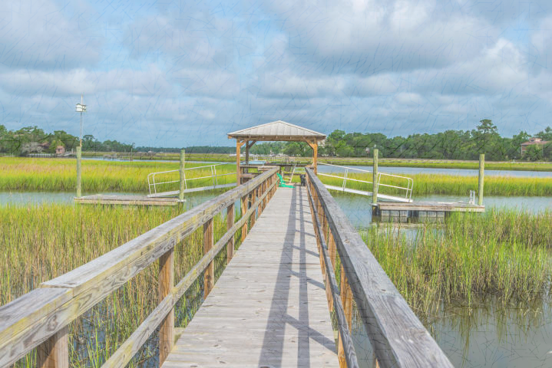
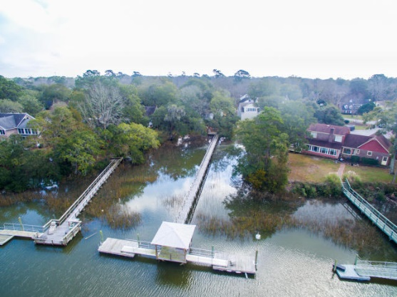
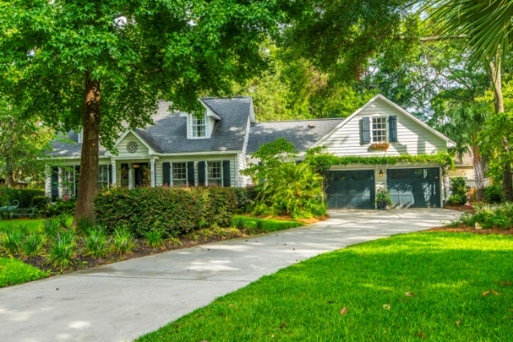
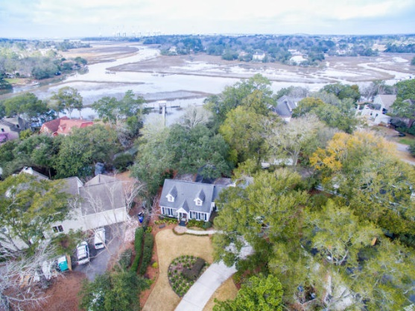
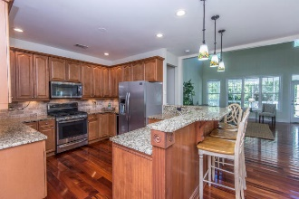
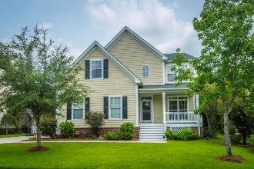
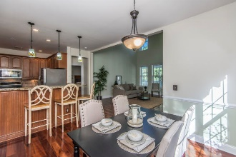
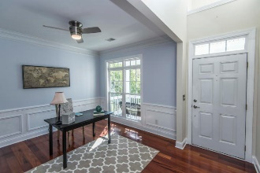
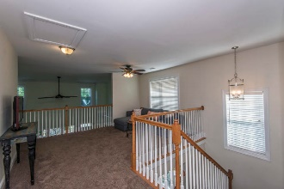
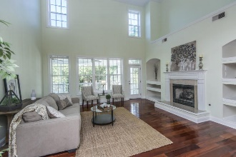
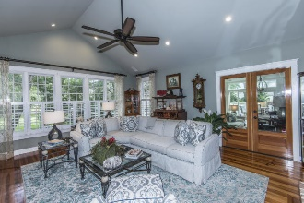
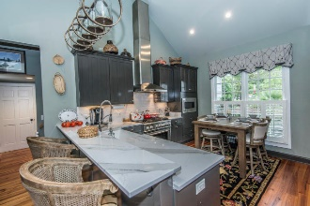
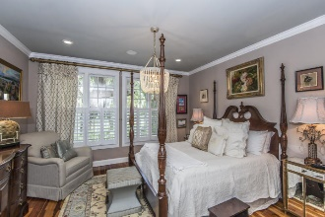
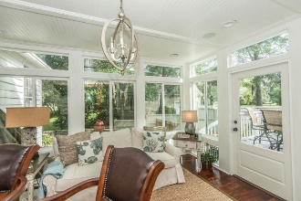
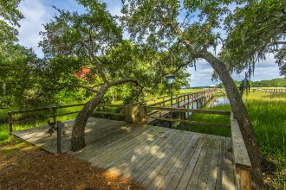


706 Ashburn Lane Mount Pleasant, SC 29466 | MLS# 19005432 | $1,295,000
Major Price Reduction in Point Pleasant
Asking $1,200,000
MLS# 17023051
3,692 SqFt
4 Bed/3½ Baths
Short Drive to Historic Downtown Charleston & Beaches
Nestled among the Live Oak trees, on the banks of Hobcaw Creek, this storybook cottage possesses a timeless character that marries coastal charm with casual elegance. Tucked away in one of Mount Pleasant's most established and sought after neighborhoods, those with even the most discerning taste will appreciate the modern updates and conveniences that accent, but do not replace, the original character of this home. The long paver accented driveway, Palmettos, and Live Oaks beckon you to enter this charming cottage. A more stunning Lowcountry setting couldn't be painted to better perfection! Rustic natural meets manicured landscape in this backyard paradise. The serene marsh and waters of Hobcaw Creek are framed by the moss-draped Live Oak trees and a semi-private pier leads down to your own private dock. The unique beauty of this home and its show-stopping setting on Hobcaw Creek truly must be seen to be fully appreciated! Located in one of southern Mount Pleasant's most established and highly sought-after neighborhoods, this location is convenient to all that Mount Pleasant has to offer, including the dining and entertainment of the Coleman Blvd corridor, all of the outdoor activities such as Shem Creek, Waterfront Park, Patriot's Point and Sullivan's Island and is approximately ten minutes to the world-class shopping and dining of historic downtown Charleston!
Don Dawson 843-514-0452 ddawson@carolinaone.com Carolina One Real Estate • 2713 Highway 17 North • Mount Pleasant, SC 29466
www.TeamDawsonSC.com

