Slide 1
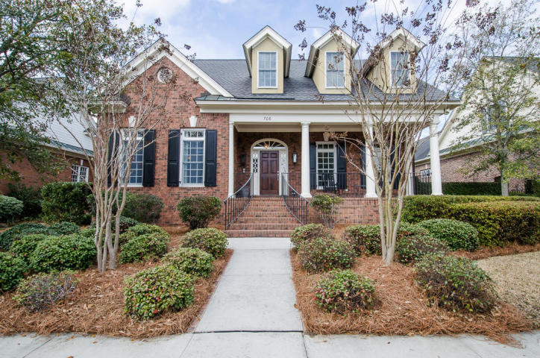
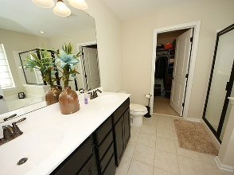
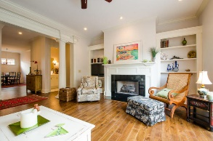
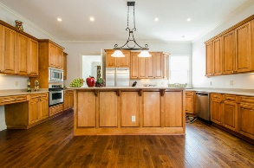
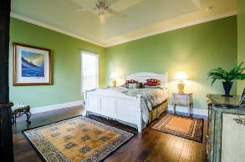
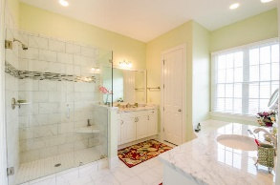
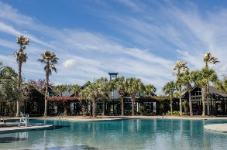
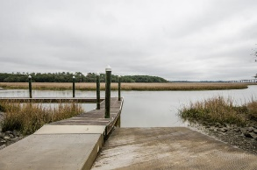


706 Cunningham Street Daniel Island Park ~ Charleston ~ MLS# 15006267 ~ $875,000
Just Listed
~ Join Me For An Open House ~ Wednesday, August 17th ~ 11:00-2:00
Built by one of the island's finest builders, JD Smith Custom Homes. A perfect retirement home located in the golf oriented neighborhood “Daniel Island Park”. It’s an island town within the city of Charleston. This beautiful, brick low country Charleston garden style home features a full front porch and lusciously landscaped courtyard. Mahogany front door! Enter through the foyer to a formal dining room on your left and a study or 4th bedroom on your right. Beautiful brand new hard wood floors throughout the first floor and up the stair case. Huge island kitchen with Corian countertops, stainless steel appliances, plenty of cabinets, pantry and breakfast nook. Cozy family room with gas fireplace that looks out onto a patio to entertain on. Master suite is on the first floor. Luxurious master bathroom features a newly tiled shower, garden tub, and his and her vanities. Laundry is on the first floor with lots of cabinets and utility sink. Powder room is a full bathroom in case someone wants to use the study as a fourth bedroom. The second floor has two guest rooms each with private bathrooms. One of the guestrooms on the second floor is huge, enough for a separate sitting area. Storage galore, walk-in attic space. Recently renovated with $130,000 worth of work just completed! Some items completed include new wood floors, sheet rock and paint, etc. Call for details. Two car attached garage entered through a quaint alleyway. This property includes Daniel Island Club social membership privileges, with the opportunity to upgrade to a Sport membership, or purchase a re-callable golf membership.
Debbie Wall-Smith, BIC, CRS, SRS, ABR Realtor/Owner
(843) 345-1095
debbie@charlestonmetrohomes.com
www.charlestonmetrohomes.com
Charleston Metro Homes, LLC
652 Coleman Blvd Suite 102
Mt. Pleasant, SC 29464

