Slide 1
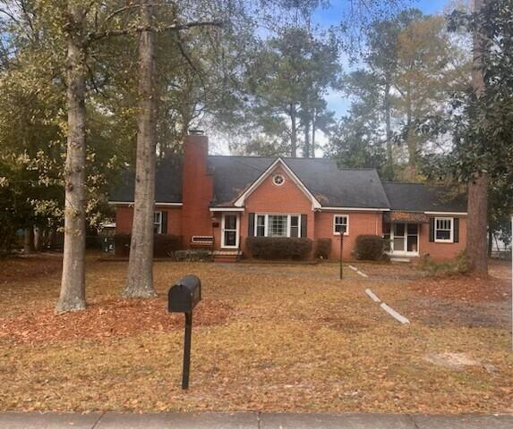
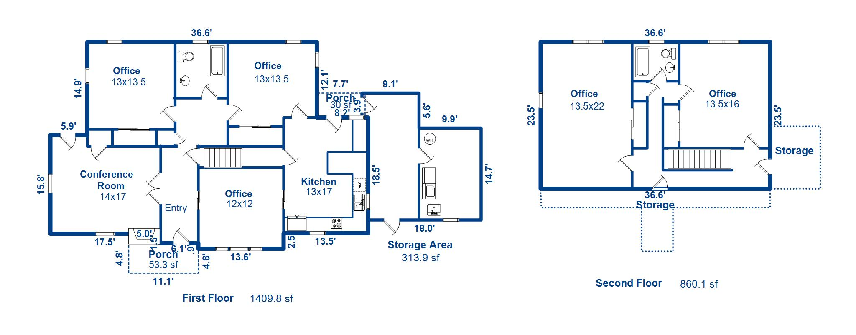
Unique
Commercial
Property
706 N Cedar Street
Summerville, SC 29483
MLS# 31002389
$825,000
Rare opportunity for this commercial site and building * 2777 sqft in this all-brick structure * the building is currently being used as a real estate office and there are tenants' rights * tenancy is month-to-month * current monthly rent is $2775 - 24-hour notice on all showings - see private remarks* please check documents tab for important information & floor plan.
SHOWINGS ONLY MONDAY - FRIDAY, 10:30 to 3:30
Fudgy Brabham
(843) 568-1241
fudgy@hbrtwn.com
www.hbrtwn.com
Harbourtowne Real Estate
672 Marina Drive, Ste 110
Daniel Island, SC 29492
Harbourtowne Real Estate | 672 Marina Drive, Ste 110 | Daniel Island, SC 29492

