Slide 1
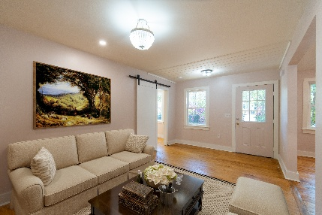
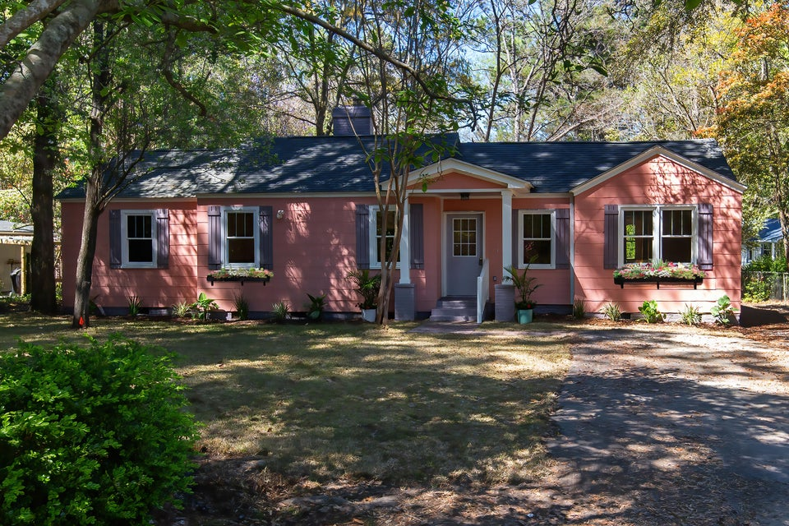
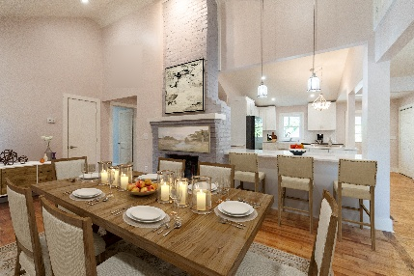
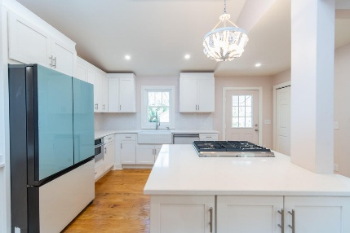
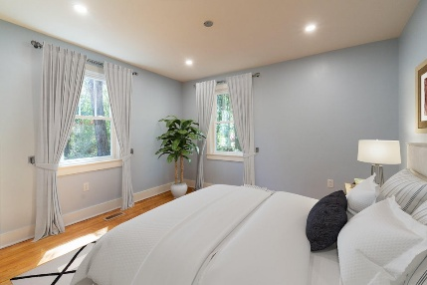
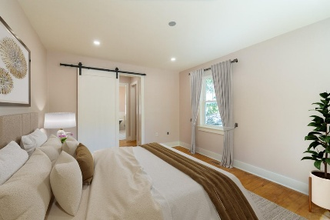
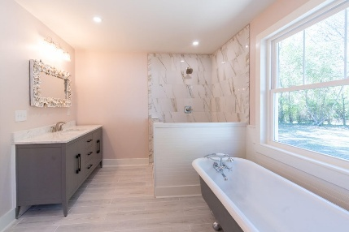
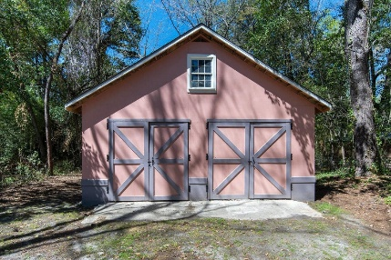


Historic Downtown Summerville
708 S Laurel Street
MLS# 25008370 | Now Offering at $624,900
708 S. Laurel Street is a charming 3-bedroom, 2-bathroom home that beautifully blends timeless character with modern updates. This beautiful home showcases some of the original hardwood floors, a fireplace with bricks that is believed to date back to World War II. The family room and kitchen area feature vaulted ceilings that extend upward from the walls. The new kitchen with Carrara White Marble countertops, stainless-steel appliances, gas stove, drawer microwave, custom kitchen cabinetry, farmhouse undermount sink, and stylish tile backsplash, making it perfect for everyday living. This beautifully crafted home offers the perfect blend of historic charm and modern convenience. Open concept floor plan, 5.5 inches tall wooden baseboards, barn style doors, tankless water heater, underground power line with all new electrical & plumbing, new internet and TV wiring, new air conditioning duct system, new roof on main house & detached garage, amazing natural light and layout along with a custom wall color selection.
A primary bedroom with 2 closets, and a private bathroom that features a standing shower with a semi-frameless hinged glass door enclosure for an elegant look, a cast iron clawfoot tub with a pair of freestanding faucet and supply lines, his and her vanities combine with a countertop along with convenient storage in the form of sliding drawers offering a luxurious and functional bathroom experience.
A detached modern two floors carriage house/workshop/ garage with over 700 SqFt and big garage style doors that provides ample storage and workspace allowing the new homeowner to maximize his/her space according to their personal needs.
It is conveniently located within walking distance of The Timrod Library, local parks, town square, tennis and fantastic restaurants.
Summerville is one of the fastest growing towns in the state. Don't miss the opportunity to own a piece of Summerville's rich history.
Quick Settlement Available! Come see this magnificent home today! Call your Realtor and reserve your showing appointment.
Gil Aviles
843-697-5535
gil@aviles-realestate.com
www.Aviles-RealEstate.com
Aviles Real Estate Brokerage
Charleston, SC / Miami, FL

