Slide 1
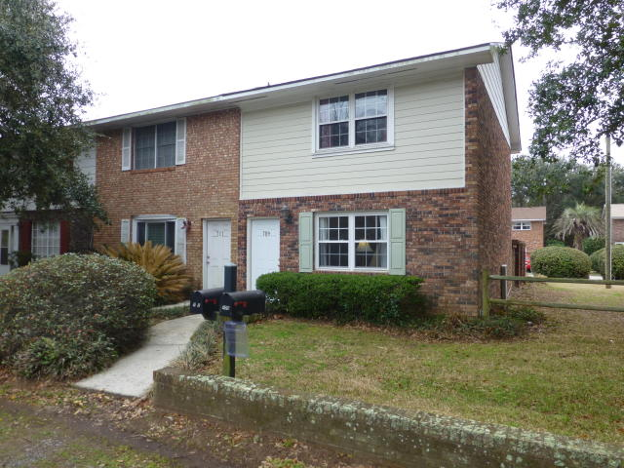
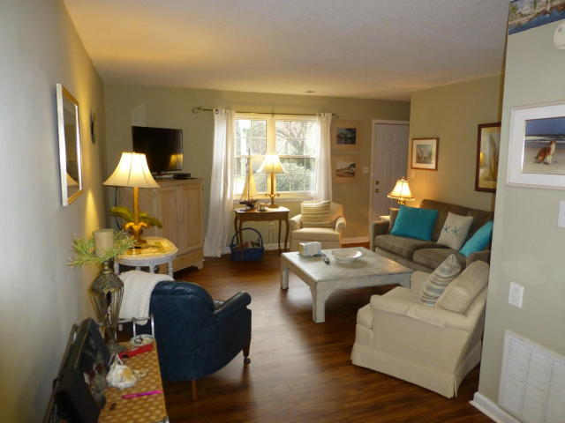
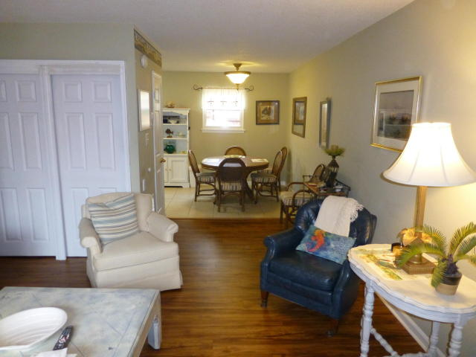
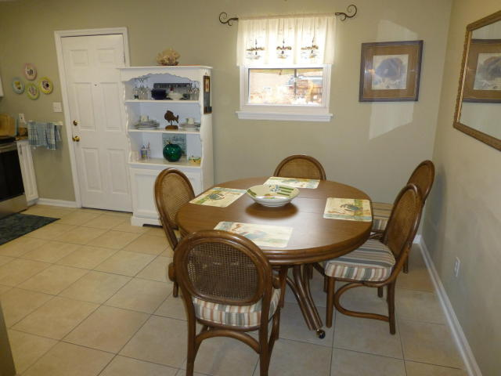
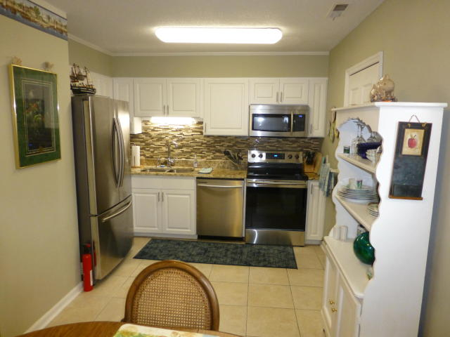
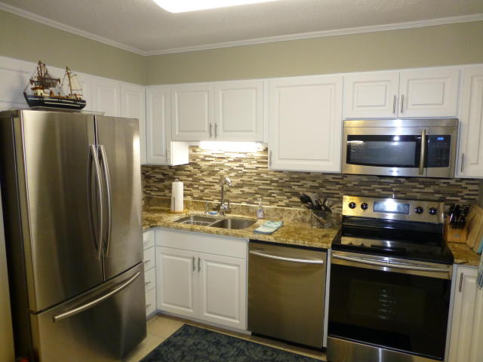
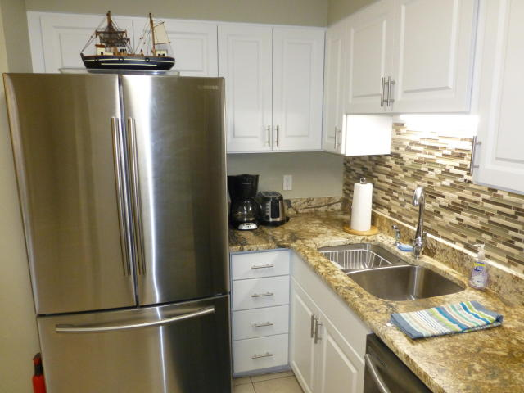
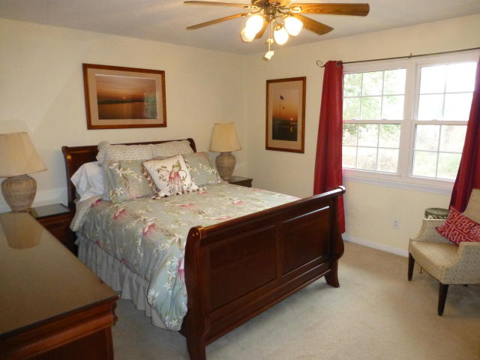
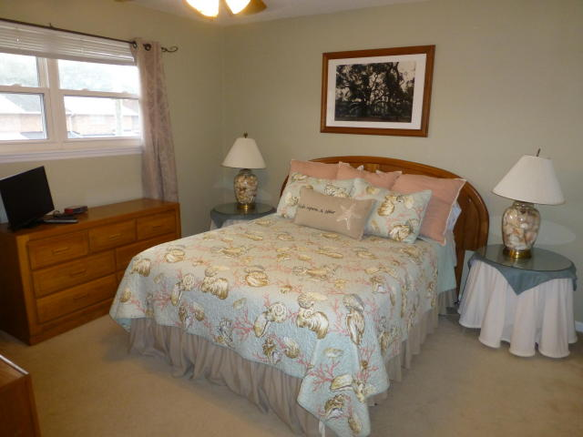
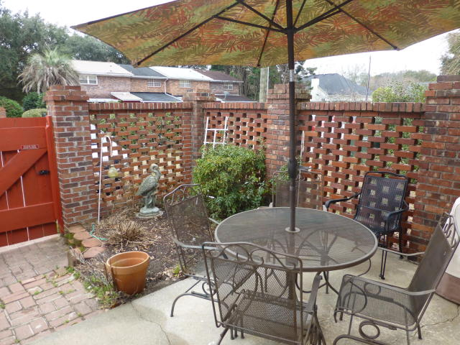
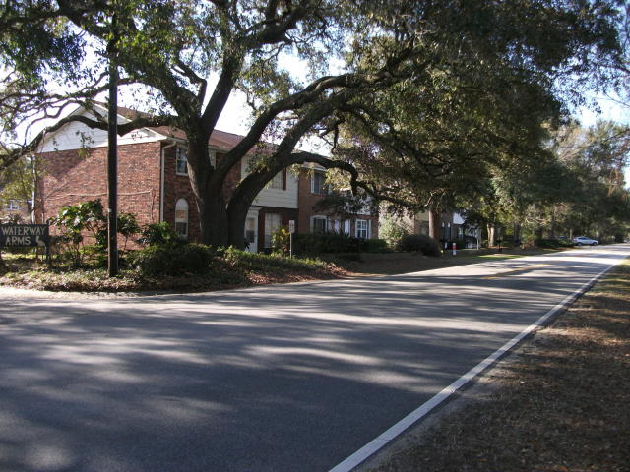
Price Reduction of $15,000 in Old Village
709 Center Street
Waterway Arms ~ Mount Pleasant ~ MLS# 18004010 ~ $315,000
Sought After End unit in Ideal Old Mount Pleasant! Very Short Distance to all Mt P has to offer - Beaches, Restaurants, and Shopping! Totally renovated kitchen with new granite counters, new stainless steel appliances, and new cabinet doors and drawers. Upstairs bath has granite. Great Open Floor Plan, and downstairs has COREtec Plus, luxury, composite flooring. Large Family Room and roomy eat-in Kitchen. Nice sized Master and Guest Bedrooms. New roof in 2016! All appliances convey. If you are an Investor - this property comes fully furnished, and ready to RENT!! Rental history averages over $3200/month! This Property is also PERFECT for a first-time Buyer. Eastern facing courtyard/patio to sit out and enjoy your morning coffee. Neighborhood has Pool, Tennis Court, and Play Park. There are two Off-Street Designated Parking Spaces. Nearby Mount Pleasant Academy is a National Blue Ribbon of Excellence Elementary School. The "Pitt Street Bridge Park" is a short walk from the townhome, and is a wonderful way to enjoy an evening sunset! This is a Perfect Location in the Old Village of Mount Pleasant!!
Make an appointment to see this property today!!!
Randy Espeseth
843-743-1025 | Randy@RandyEHomes.com | Carolina Elite Real Estate

