Slide 1
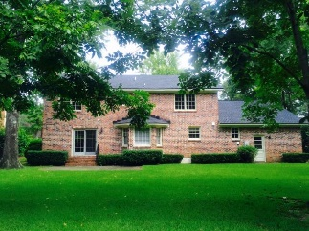
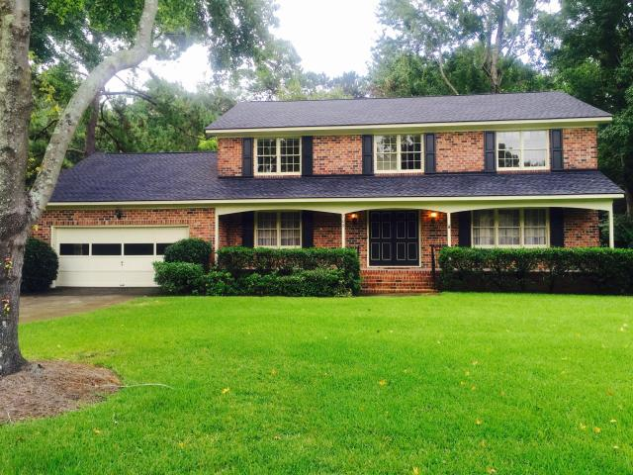
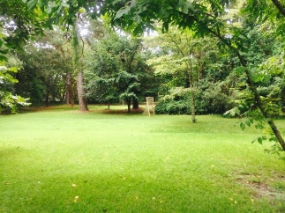
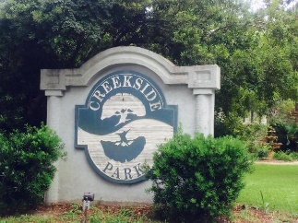
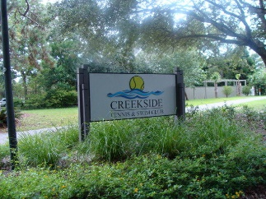
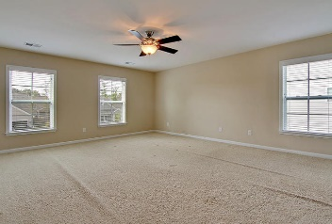
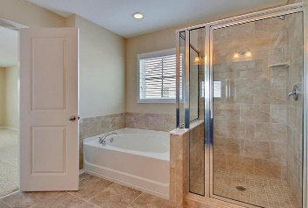
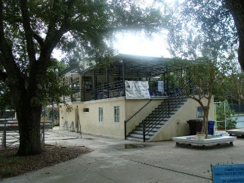
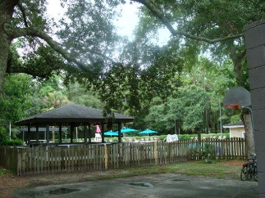
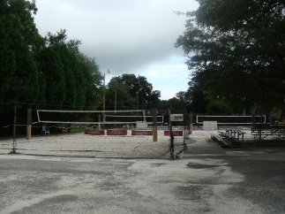
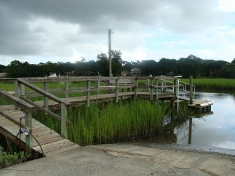

709 Dragoon Drive Creekside Park · Mt Pleasant, SC 29464 · MLS# 17022444 · $675,000
First Time On The Market…
EVER!!
First Time On The Market…EVER!!
1st time ever on the market Custom BRICK, PARK LOT, 4 bedroom home in desirable Creekside Park! This home has an abundance of natural light, solid doors, heavy trim, pocket doors, fireplace, wonderful floor plan with family room open to kitchen, formal living, formal dining, master with private bath, and 3 additional bedrooms.
Creekside Park in Mount Pleasant is a wonderfully landscaped community with a play park, tennis courts and community pool! The neighborhood is close to local shopping and grocery stores and is a short drive to downtown Charleston with 5-star restaurants, world class shopping and iconic history as well as a short drive to the beaches, the airport, Boeing and Daniel Island. Come take a look because you will not find another home that has this location or quality.
Stan Huff
843-670-2835 stan.huff@agentowned.com
Jill Marcacci
843-297-5590 jill@agentowned.com
www.agentownedrealty.com
AgentOwned Realty Co. Preferred Group, Inc. | 824 Johnnie Dodds Blvd | Mt Pleasant, SC 29464

