Slide 1
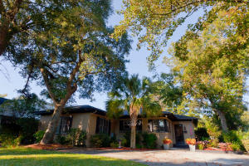
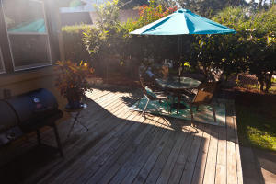
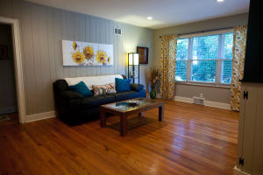
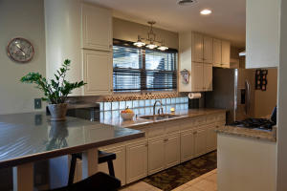
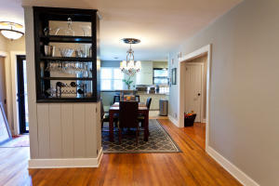
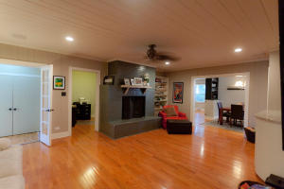
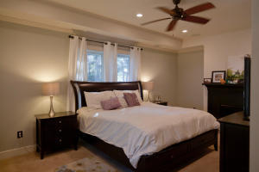
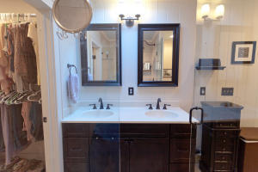
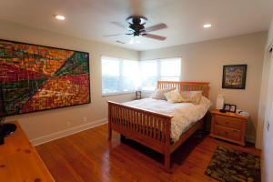
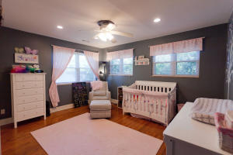
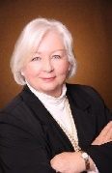

709 Parish Road
Moreland | Charleston, SC 29407 | MLS# 16007647 | $498,000
Living Here Is All About Lifestyle
Minutes from Historic Downtown Charleston. Walk to South Windermere, walk to West Ashley shops and restaurants. One story living with three bedrooms, three baths plus an office. Master bedroom suite is impressive with fireplace, master bath and walk in closet.
The galley kitchen with granite counters, lots of storage, newer recessed lighting, newer energy efficient windows makes for cozy family living. Irrigation system covers the front yard and half of the backyard.
Margaret Ostergard
(843) 364-0440 Mobile | (843) 856-8800 Office
surfside@aol.com
www.OstergardRealEstate.com
Coldwell Banker United, REALTORS | 1127 Queensborough Blvd. 103 | Mt Pleasant, SC 29464

