Slide 1

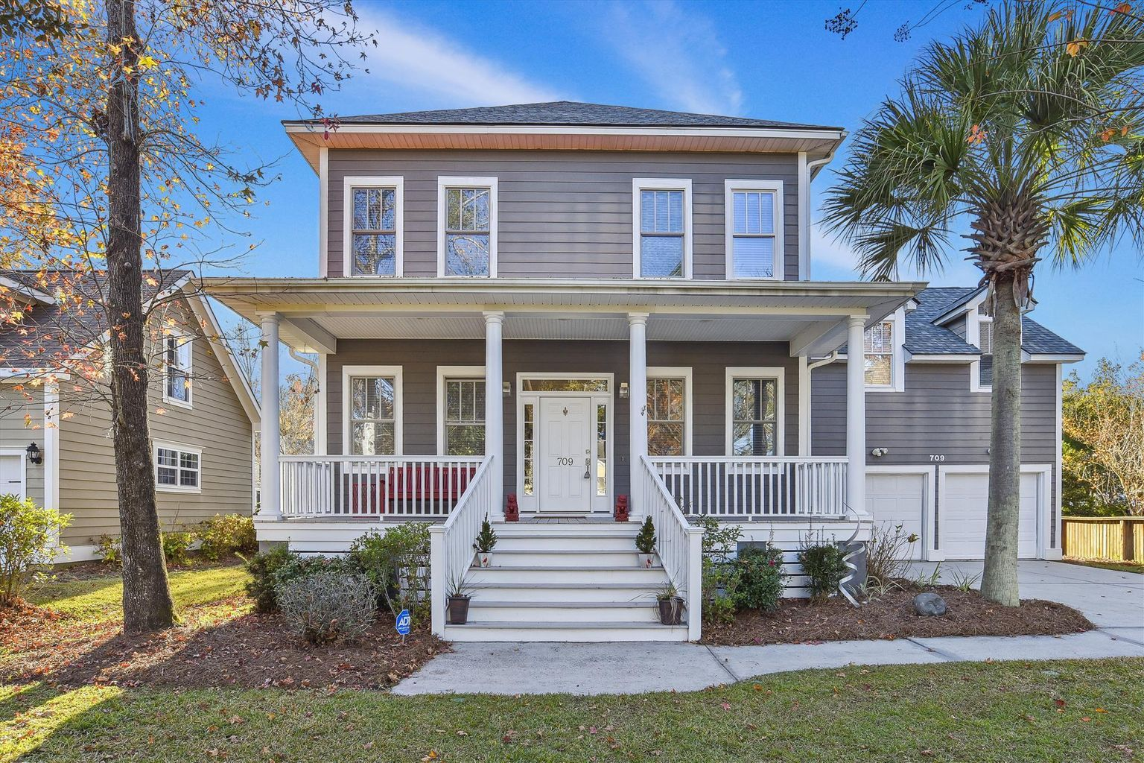
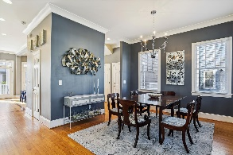
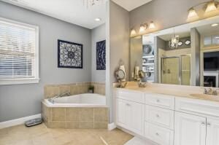
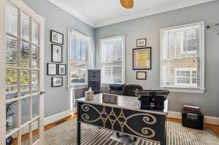
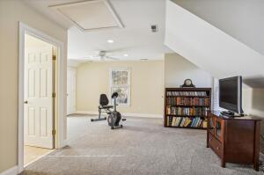
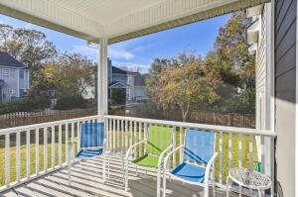
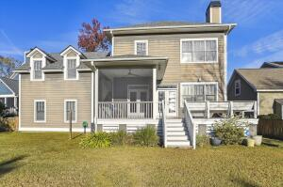
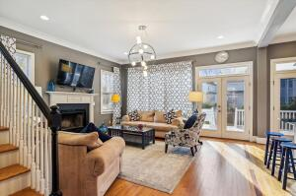
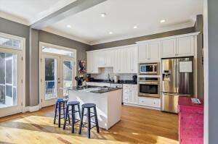
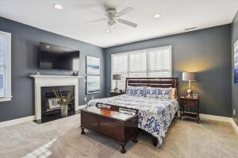
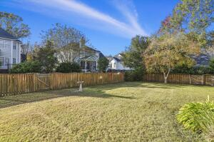


709 Hunt Club Run
Hunt Club • Charleston, SC 29414 • MLS# 22029955 • $537,000
Open House Thursday from 1-3
Move-in Ready. This lovely home is full of light, an open floor plan, a screen porch and deck just waiting for easy living and entertaining family and guests. The full front porch is welcoming and invites you in to see the many attractive features of this home. As you enter, you will see hardwood floors throughout the first floor. On the right is a spacious dining room which leads to the pantry area with many cabinets for convenient storage. The kitchen is open and suited for several cooks or for friends to enjoy snacking at the separate island. The family room adjacent to the kitchen is perfect for relaxing and enjoying the warmth of the wood burning fireplace. Don't miss the extra storage under the stair case. On the left as you walk in the front door is a office or library with a convenient closet. As you go upstairs, please note the brand new carpet throughout. The spacious master bedroom has a lovely bathroom with garden tub and shower. The master closet has a bank of wonderful shelves, drawers and clothes rods. There are two other nice sized bedrooms and a full bathroom as well as a very large multi-purpose room for media, crafts, exercise equipment or additional bedroom with 2 closets and a full bath. As you head back downstairs, please take time to experience the cheery atmosphere of this beautiful home.
Susan Garfinkel
843-696-5838 | susanrealtor44@gmail.com
Elaine Brabham and Associates, LLC • 1890 Sam Rittenberg Boulevard, Suite 217 • Charleston, SC 29407

