Slide 1
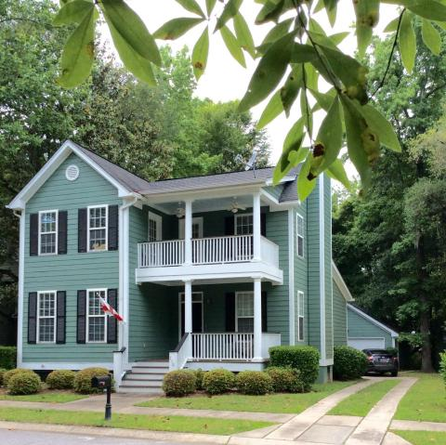
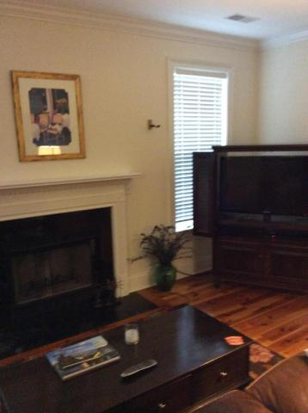
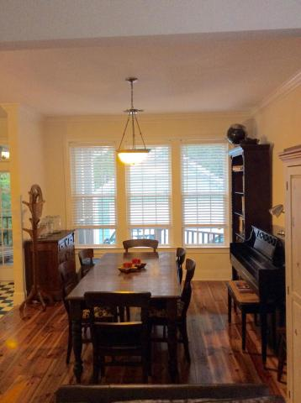
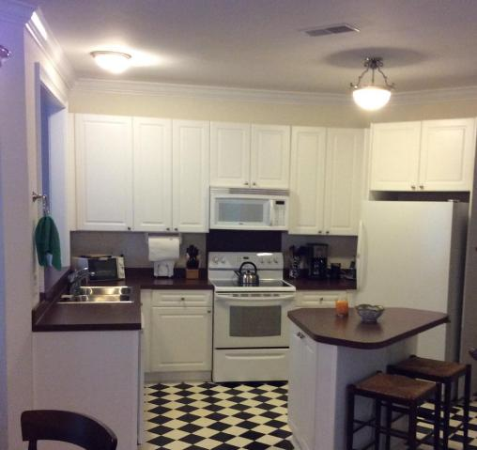
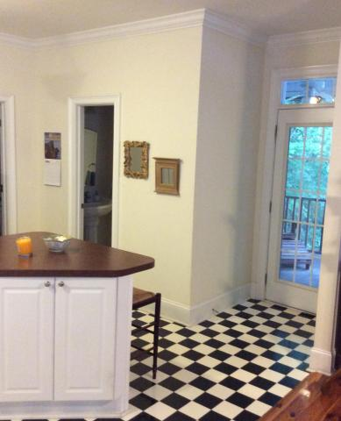
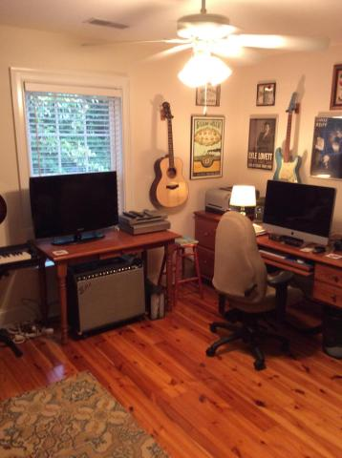
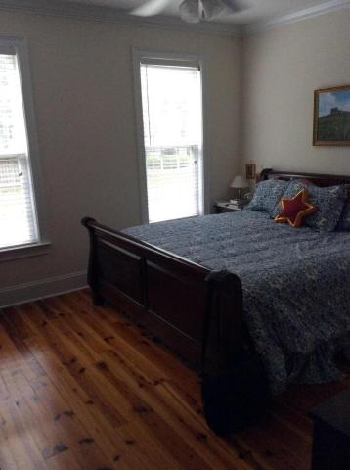
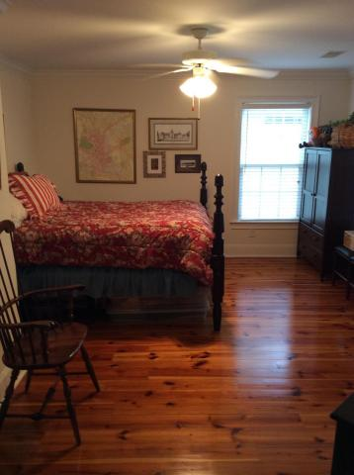
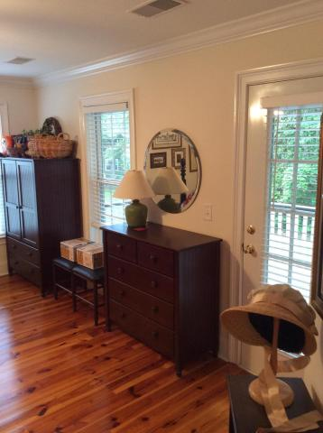
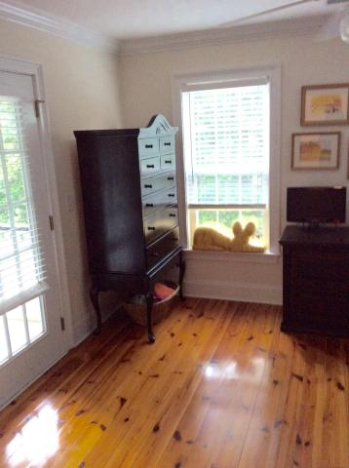
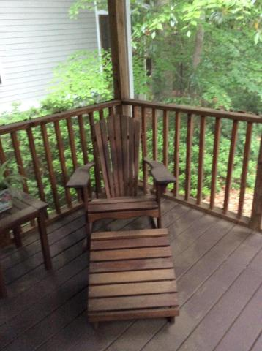
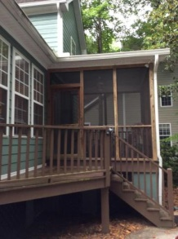


Motivated Seller!
710 Landgrave Avenue
Schieveling Plantation
Charleston, SC 29414
MLS# 15012449
$289,000
$1,000 Buyer's Agent Bonus!
With acceptable offer by June 5th
Adorable 4 BR/2.5 BA home in Schieveling Plantation. Cement plank siding. Double porches off the front and screened porch and deck off the back. Heart of pine wood flooring throughout the entire home except the kitchen and baths. DOWNSTAIRS MASTER BEDROOM and bath!! Open floor plan with Living Room with fireplace, roomy Dining Room and cheerful kitchen. Powder Room right off the kitchen. Large, sunny laundry room also convenient to the kitchen. Upstairs there are 3 more bedrooms and another full bath. All floors upstairs are also heart of pine wood. All bedrooms are a good size but one of them is large enough to make a second master or large guest bedroom. Two of the upstairs bedrooms have doors leading out onto the porch. Outside you have a detached double car garage with plenty of room for the hobbyist. This lovely home is surrounded by mature trees and feels very private and serene. Come see this beauty today! The kitchen, laundry and powder room flooring are being changed out to a neutral color this next week.
Susan Weeks
(843) 813-0495
susanweeksdesign@gmail.com
www.agentownedrealty.com
AgentOwned Charleston Group
902 Savannah Hwy
Charleston, SC 29407-7802

