Slide 1
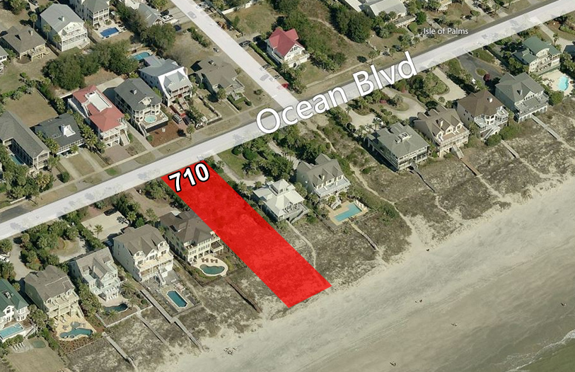
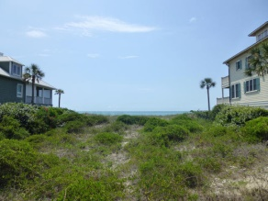
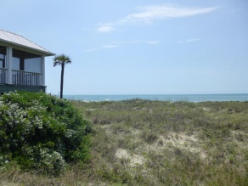
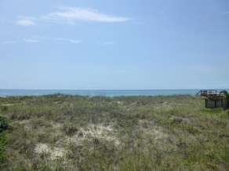
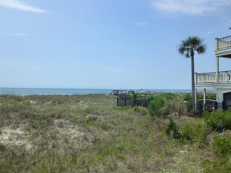
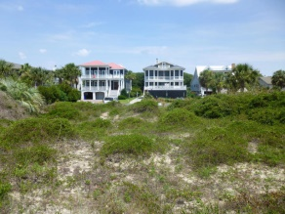


One of the last undeveloped beachfront lots on the Isle of Palms
Reduced!!
710 Ocean Boulevard
Isle of Palms, SC 29451
MLS# 15004863
$2,200,000
Unbelievable and unobstructed views of the Atlantic Ocean and direct beach access.
Property has ten foot set backs on each side and a thirty five foot setback from Ocean Blvd.
Acreage: 0.55 | TMS: 568-11-00-220
Will Phillips
Mobile (843) 259-0859
wphillips@ravenelcommercial.com
View My Listings!
Office: (843) 266-3900
ravenelcommercial.com
Ravenel Commercial Properties | 960 Morrison Drive, Suite 100 | Charleston, SC 29403

