Slide 1
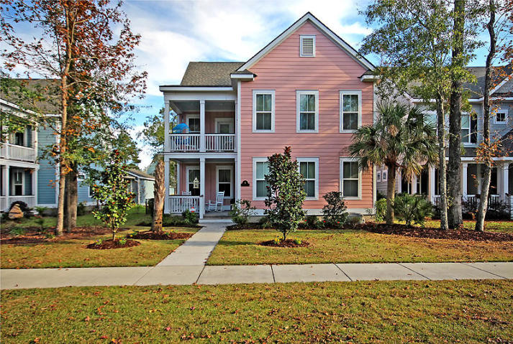
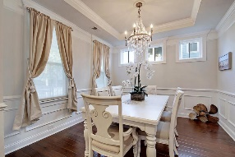
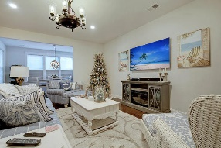
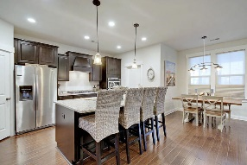
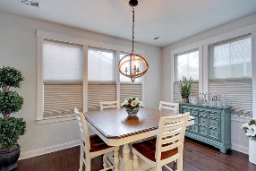
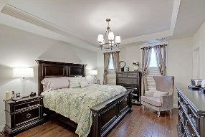
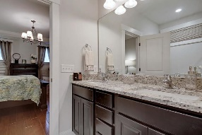
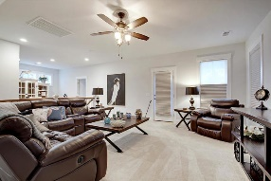
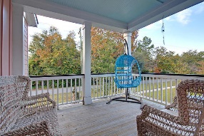
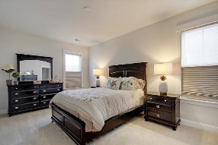
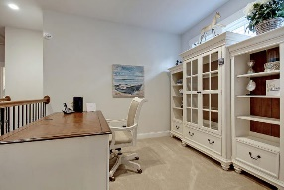
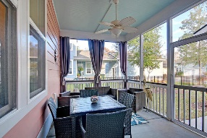
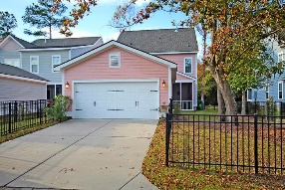


Summerville Southern Charm ~ Dual Masters!
711 N Hickory Street
Daniels Orchard
Summerville, SC 29483
MLS# 19032631
$415,000
4 Bedrooms | 3½ Baths | 2,950 sf
Come live the good life in this like new southern style dream home! Located on a quiet street just one mile to historic downtown Summerville, this home has been barely lived in and is loaded with upgrades. Why wait for new construction when you can move right in to this home?! Need two master bedrooms? This is the home for you! Upon arriving at the home, you'll immediately notice the double front porches, the gas front porch lights and the lovely landscaping. Upon entering, you'll be impressed by the extensive amount of trim and molding throughout, the custom window blinds, upgraded light fixtures and the wood flooring throughout the first floor. On the first floor you'll find the dining room with extensive trim and a tray ceiling. Perfect for entertaining!
The kitchen is a chef's delight and offer stainless steel appliances, granite countertops, large island that sits four comfortably, pantry, gas cooktop, wall oven and built in microwave. This great kitchen overlooks the large living room and eat in kitchen area. Off the living room is the sunroom and access to the back screened in porch which overlooks the fenced in backyard! Finishing off the first floor is one of the master bedrooms. This bedroom offers two walk in closets, a large master bathroom with dual vanities, separate tub and shower. Head upstairs and get ready to be wowed even more! Need a lot of space? This house has it! The upstairs offers a large living area with access to the upstairs porch, as well as a great space for a home office. A second master bedroom upstairs offers a large walk in closet and full bath. Upstairs there are two more very large bedrooms with a full bath in the hall also offering dual vanities. Back outside, you'll find a two-car detached garage with great storage as well as some off street parking. This house has it all and needs to be seen! Don't miss the opportunity to live in one of Summerville's most sought after neighborhoods located so close to tons of shopping and restaurants as well as being serviced by Dorchester District 2 schools!
Larry & Kathy Mazalatis
Larry Cell 843-693-0529
Kathy Cell 843-693-0159
Office 843-871-9133
AGENTOWNED PREMIERE GROUP | 1800 TROLLEY RD | SUMMERVILLE, SC 29485

