Slide 1
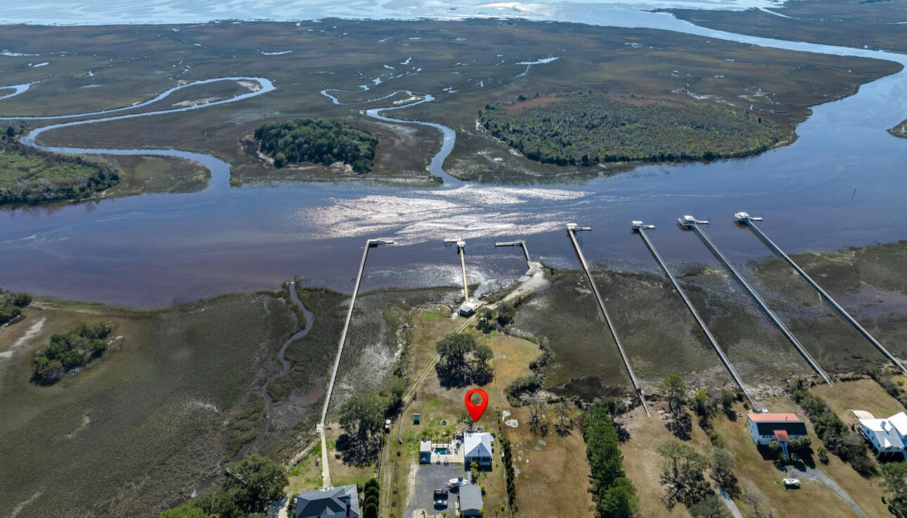
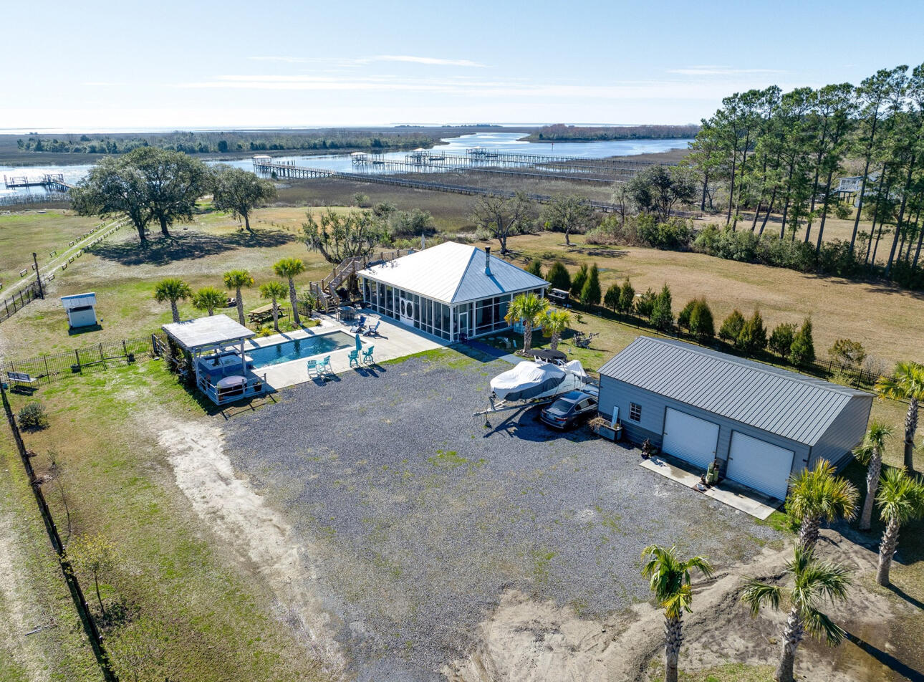
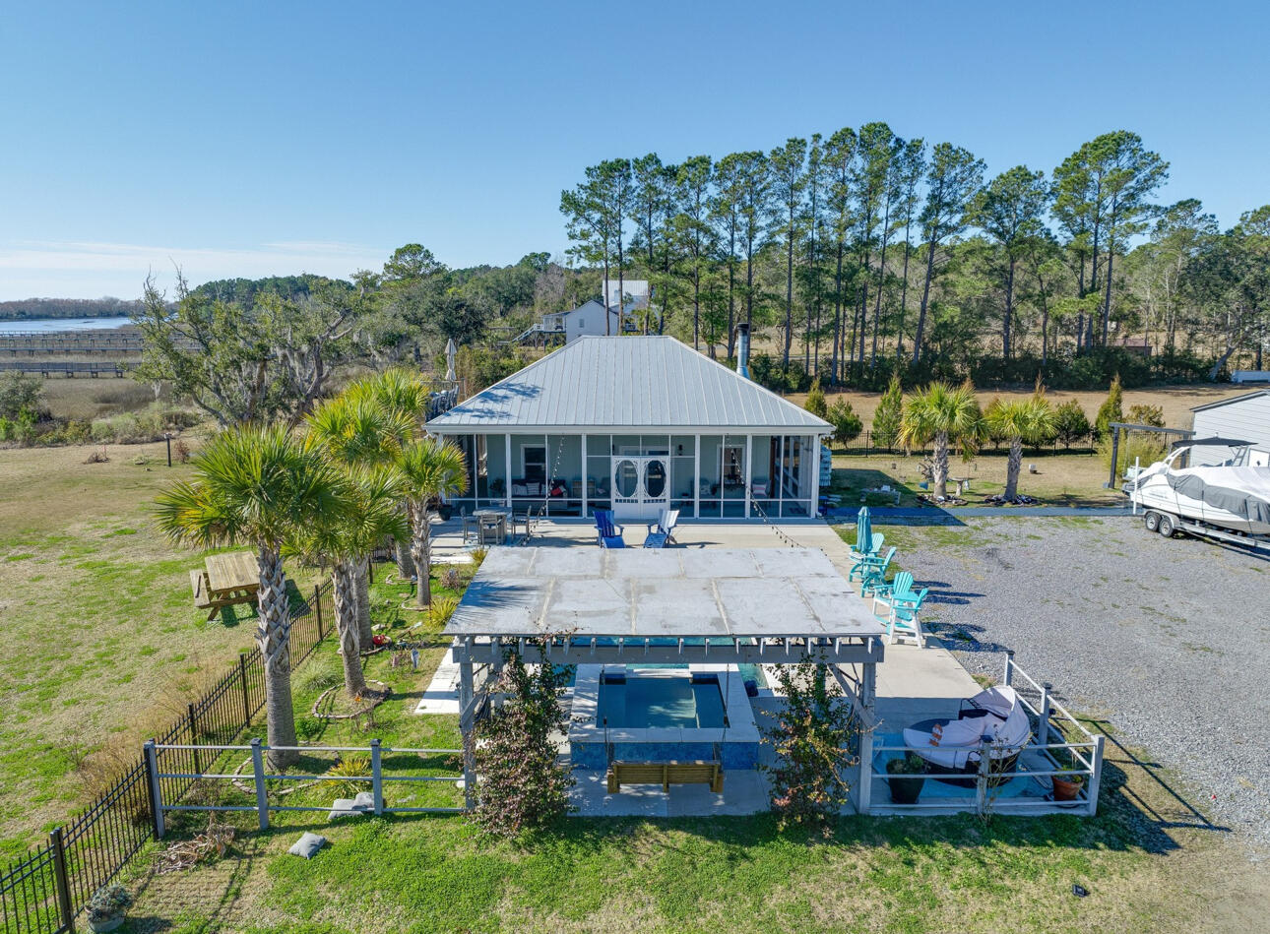
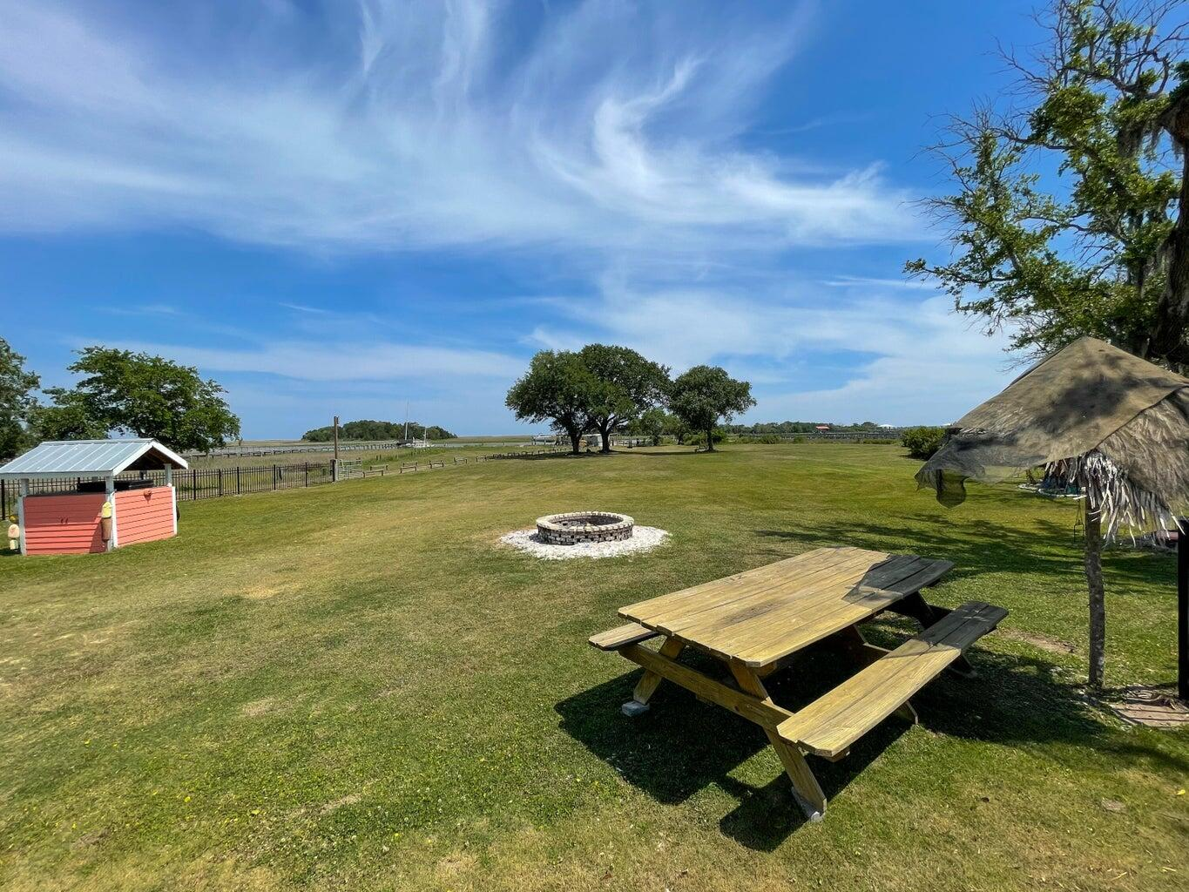
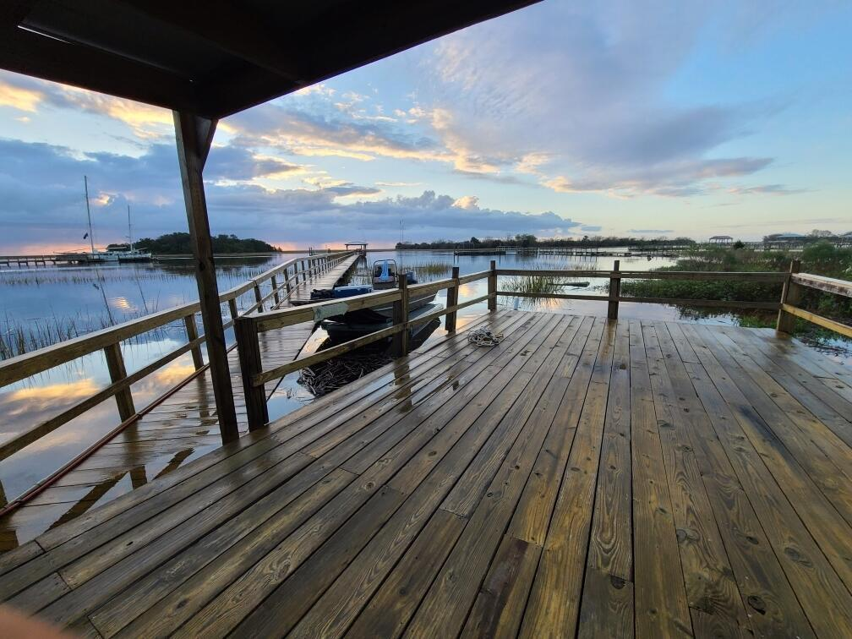
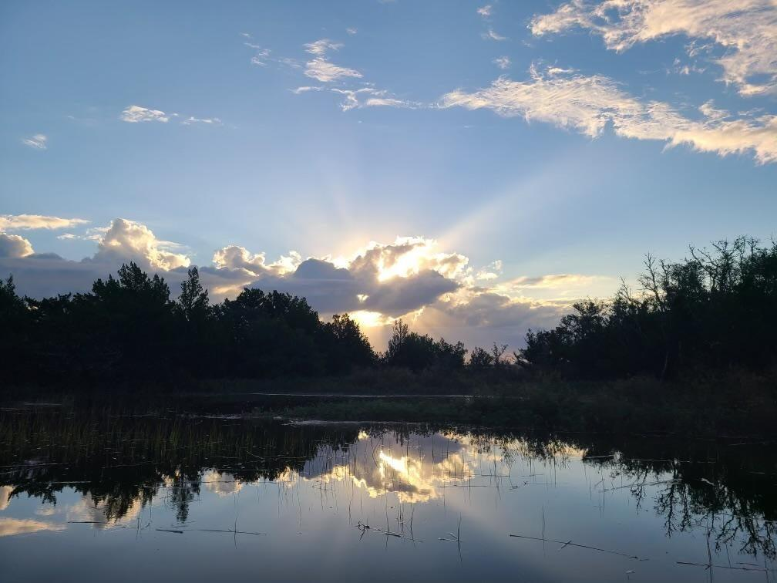
Price Adjusted - Motivated to Sell!
Deep Water Dock With Lift And Acreage
712 B Donnelly Corner Dr
Awendaw, SC 29429
MLS# 24004221
$1,479,000
RARE opportunity to live on the Intracoastal Waterway in the center of Bull's Bay with your own PRIVATE DEEP WATER DOCK with a boat house and lift with NO HOA. Enjoy fishing, shrimping, crabbing, and cruising over to the nearby islands, Georgetown, Shem Creek, or downtown Charleston. Enjoy your days relaxing and taking in the stunning views from your saltwater pool or spa. Imagine waking up to the sound of seagulls and enjoying an evening cocktail watching the dolphins play as the sun sets. Build your dream home and enjoy pool parties, oyster roasts, boating from your back yard, and s'mores and cocktails around the fire pit. The heated pool and firepit allow for the enjoyment of all seasons.
The 788 sf pool house is equipped with a full kitchen, living area, bed, powder room, full bath and closet. The 12'x40' private dock has a 10,000 lb boat lift & two floating docks, and there is an attached 12'x24' covered boathouse with water and power. There is also a private neighborhood landing with a boat ramp for additional options in launching a boat. Graham Creek from the waterway is right by the property's dock which provides access to the ocean. Secluded beaches are just a short boat ride away. The 24'x35' 2 car garage is spray foam insulated with water and power.
Enjoy a video tour of this property
Shanel Pierce
843-779-5523 | shanel.homesales@gmail.com
Charles Salmonsen
843-388-6613 | appraisals@salmonsen.com
Salmonsen Realty | 864 Lowcountry Blvd Ste B | Mt Pleasant, SC 29464

