Slide 1

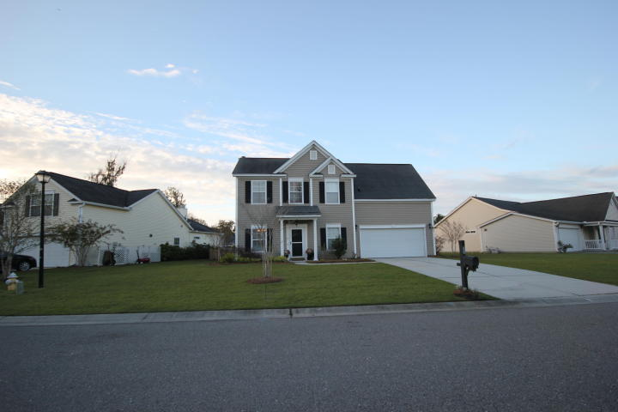
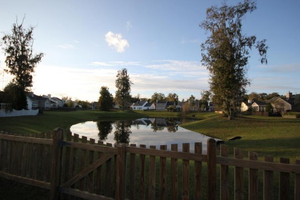
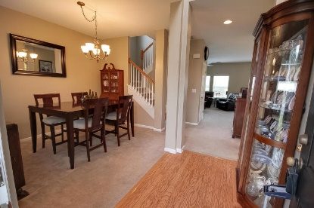
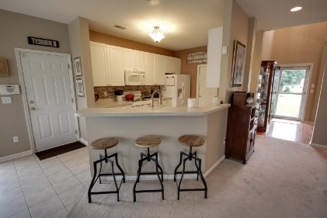
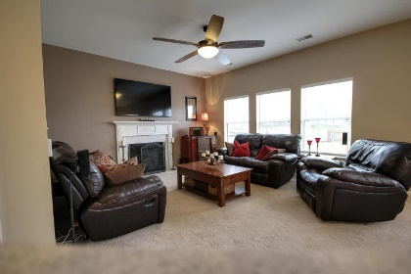

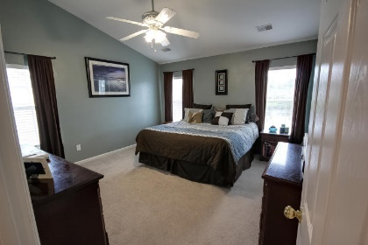
712 Bent Hickory Rd
Grand Oaks Plantation
Charleston, SC 29414
MLS# 15028671
4 Bedrooms
3½ Bathrooms
2,098 Sq Ft
3% Commission + 1% Bonus
Only 4½ miles to
Downtown Charleston!
Just Reduced 10k!
*FOUR bedrooms plus THREE and a half bathrooms
*Premium POND Homesite
*FENCED Yard
*Extended Patio
*Vaulted Ceilings
*Deluxe Master Bathroom
*Architectural Shingles
*GAS Fireplace
*GAS Range
*Custom Tile Backsplash in Kitchen
*Two-Car Garage with Automatic Opener and Remotes
*Home is situated across from a cul-de-sac for added privacy
*Termite Bond (transferable)
*Vinyl Siding Warranty (transferable)
*Subsections in this master planned community have their own pools!!
*3% commission and 1% bonus for ratified contract by 12/31/15 with BIC approval.
*Financing based on credit, income, assets etc. See lender for details.
Meg Hopkins Kandik
Cell - 843-814-5137
meg@holycityre.com

