Slide 1
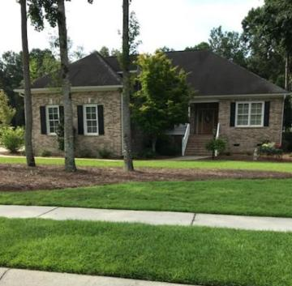
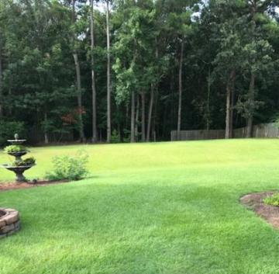
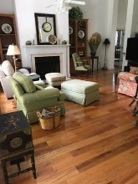
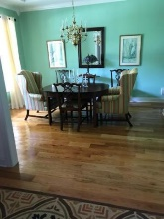
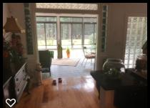
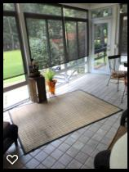
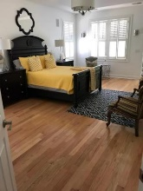
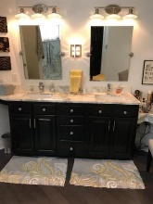
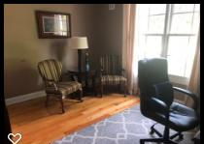
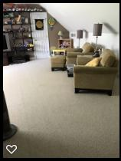
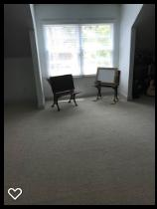


712 Hamlet Circle Crowfield Plantation ~ Goose Creek, SC 29445 MLS# 18020017 ~ $459,000
Just Reduced!
What a great Executive Home, originally Custom Built. Well maintained, lots of upgrades done in last year...All new Master Bath, extra large walk-in shower. Kitchen with Gas Range and convection oven, Granite Countertops, Wine Cooler and much more. This home is move in ready nothing to do at all. Wide 5 in Oak floors and new hardwood floors in Master...Frog has full bath and closet so can be used as a playroom for the kids or Bedroom. Plush landscaping with huge deck and privacy at rear, Sunroom with lots of windows and A/C ducts adjoins kitchen and breakfast area so there's lots of open space. High Ceilings and Gas Fireplace in main living room. This is on a large lot and backs up to all woods and wonderful wildlife, house backs up to Natural Preservation Area. Lawn Irrigation in Front and Rear of house. Outdoor Storage Shed in back for lawn equipment storage. Garage has 9 ft doors and is approx. 21/2 rather than 2 car, extra room. A/C is central and there's a large walk-in closet in the Master.
John H. Beckroge
ABR, EPRO, REALTOR
jbeckroge@gmail.com
(843) 367-3196
Brand Name Real Estate | 4 Carriage Lane Suite 106 | Charleston, SC 29407

