Slide 1

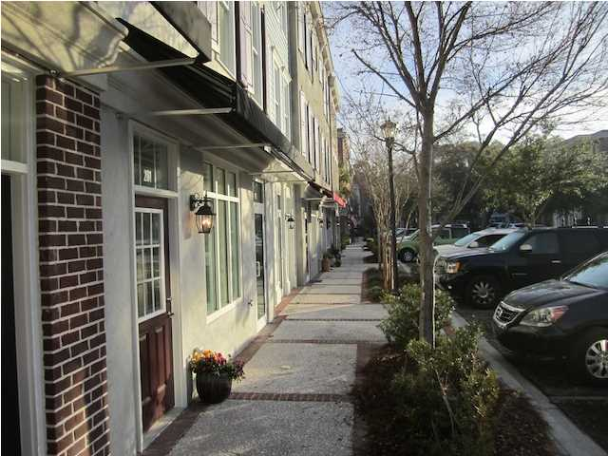
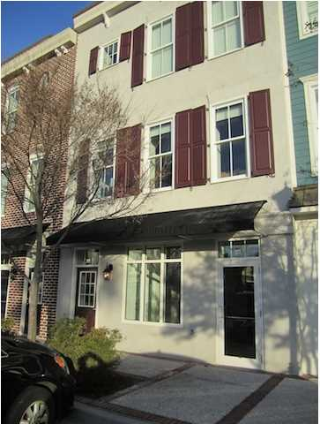
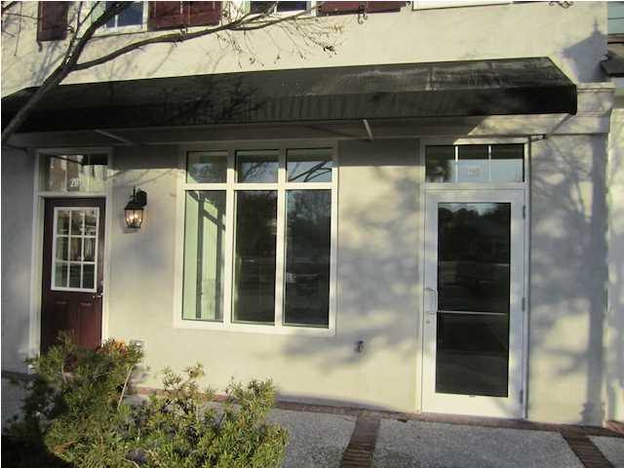
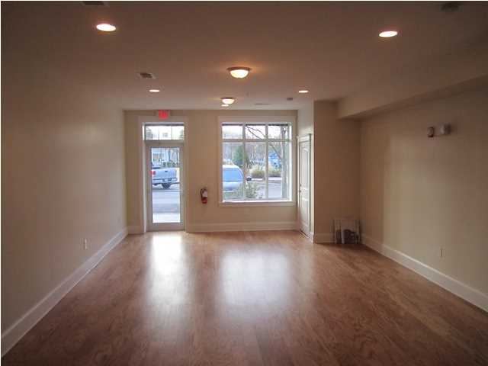
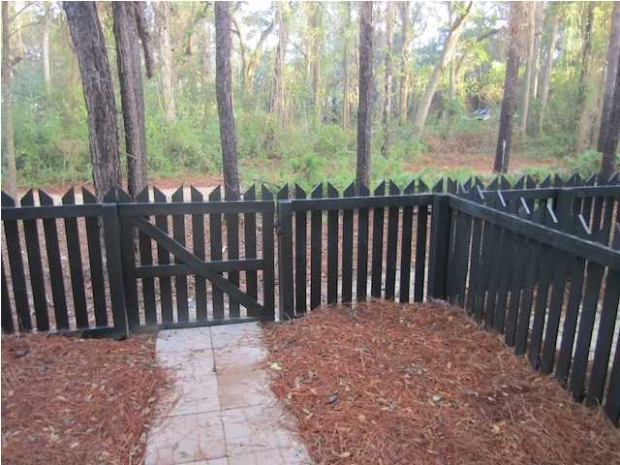
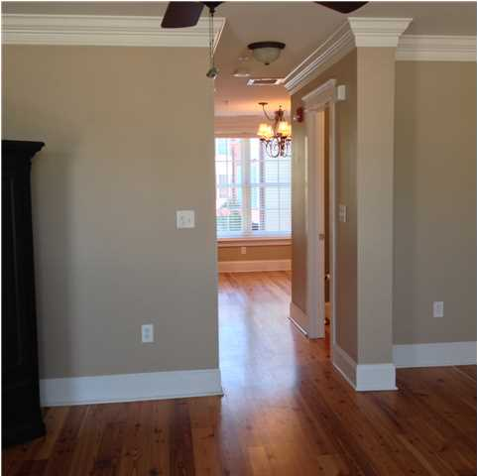
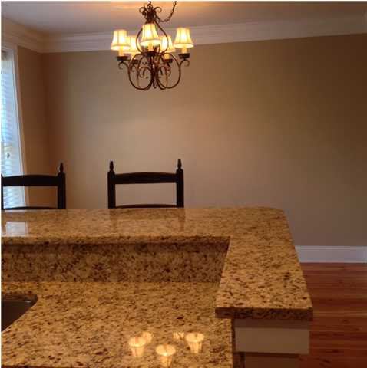
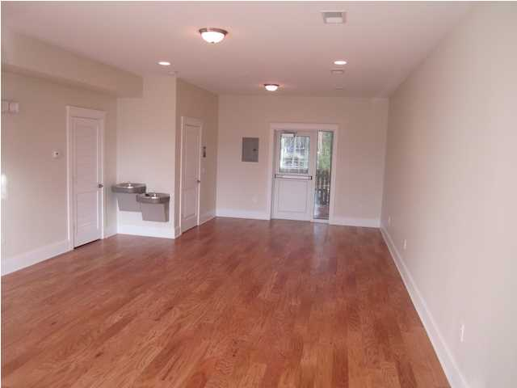
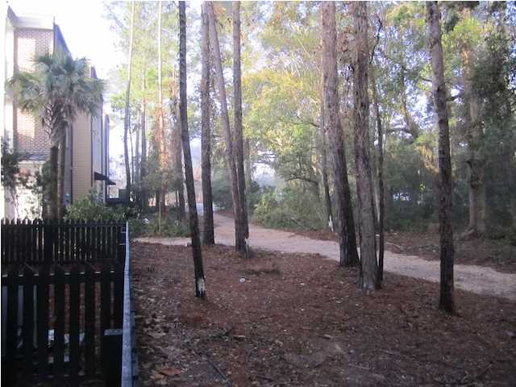
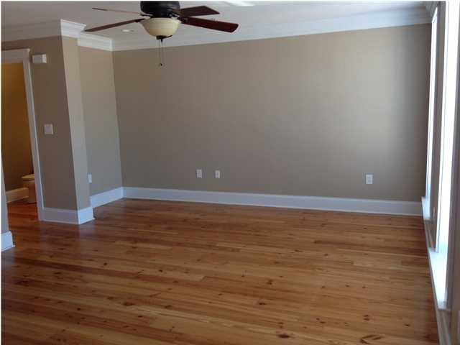

GROUND FLOOR OFFICE SPACE
This suite is move in ready with street level parking and a patio in the rear. Rate includes all operating expenses but excludes utilities and consumables. Private bathroom and wide open floor plan. Wood flooring and large janitor's closet that included a mop sink. Two water fountains in the unit and residential space is above (not included). Perfect space for an office user or retailer. All parking is shared and many wonderful tenants will be your neighbors. A grocery store, liquor store, Chinese restaurant and Triple AAA Four Diamond Award Winning Langdon's Restaurant and Wine Bar are yards away. The famous O'Quinn's school is across the street so drop the kids or grandkids off and go to work. I'On is right across the street along with O'Brion's Pub among others. Jog or bike on Mathis Ferry or to the Waterfront Park. You can be Downtown Charleston in minutes. Call today for an appointment to see this property. If square footage is important - MEASURE!!
Address: 712 S SHELMORE BLVD
Area: CHS-Mt.Pleasant South of IOP Connector
Building Square Feet: 725
Category: details
City: MOUNT PLEASANT
County: Charleston
Listing ID: 1401600
Listing Price: $1,450
Max Contiguous SqFt: 725
Minimum Div. SqFt: 725
Office Class: A

