Slide 1
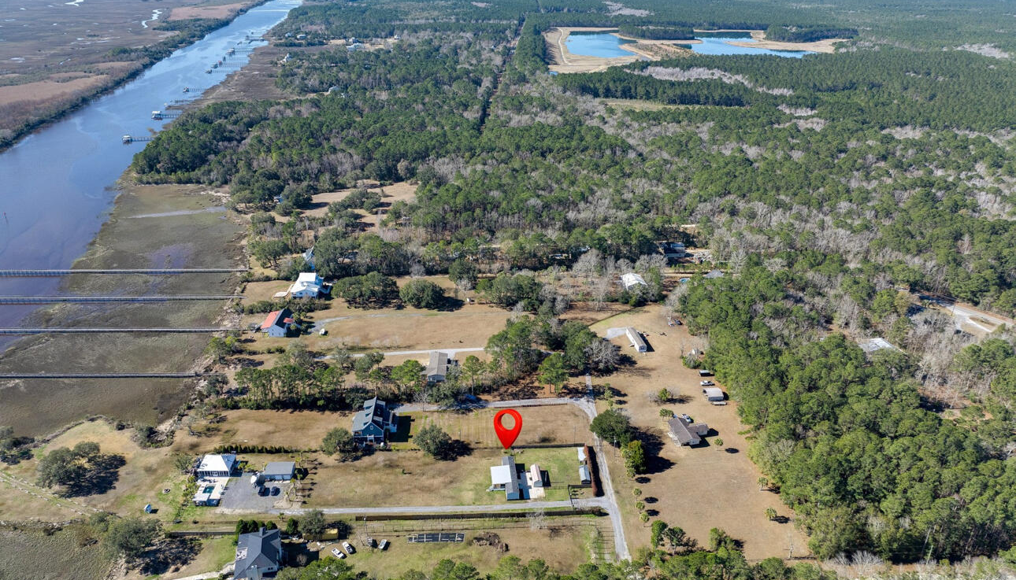
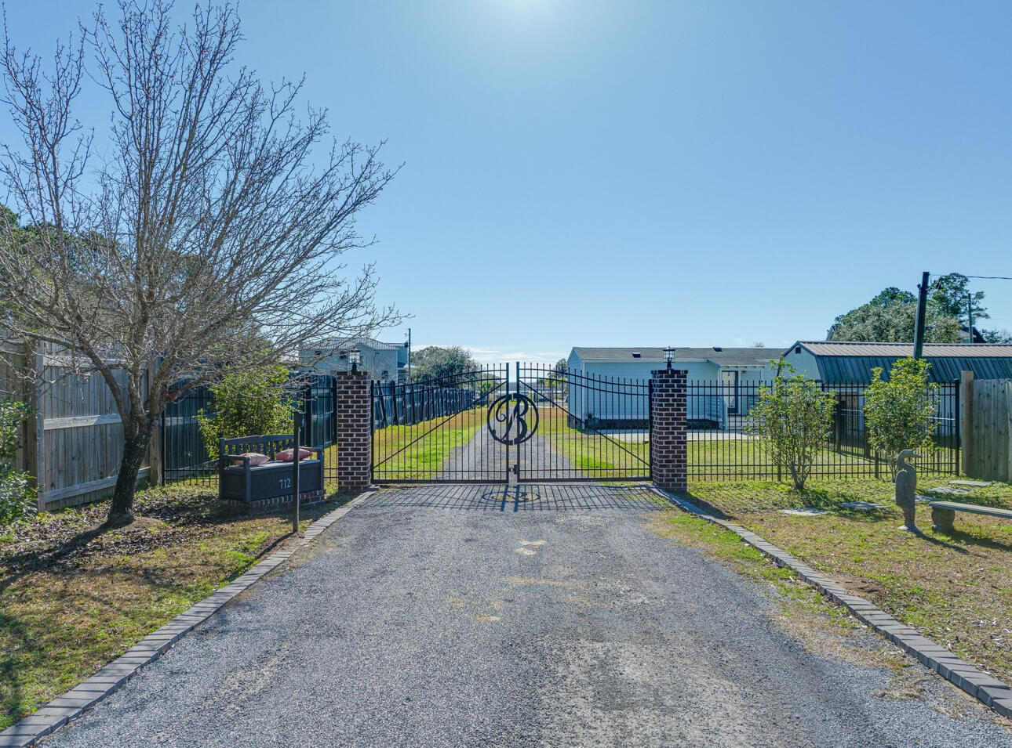
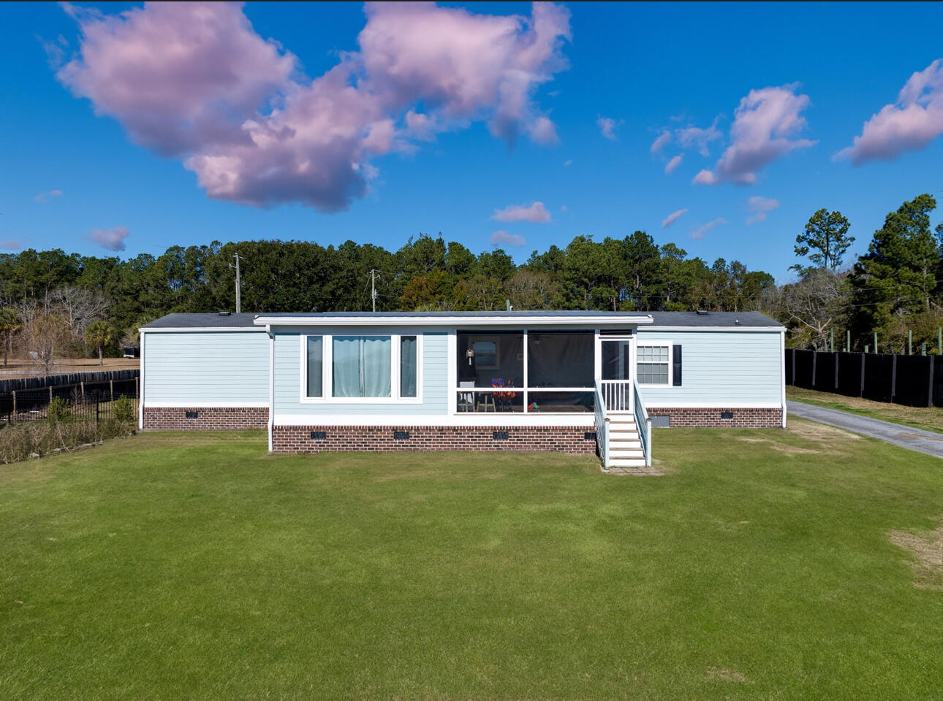
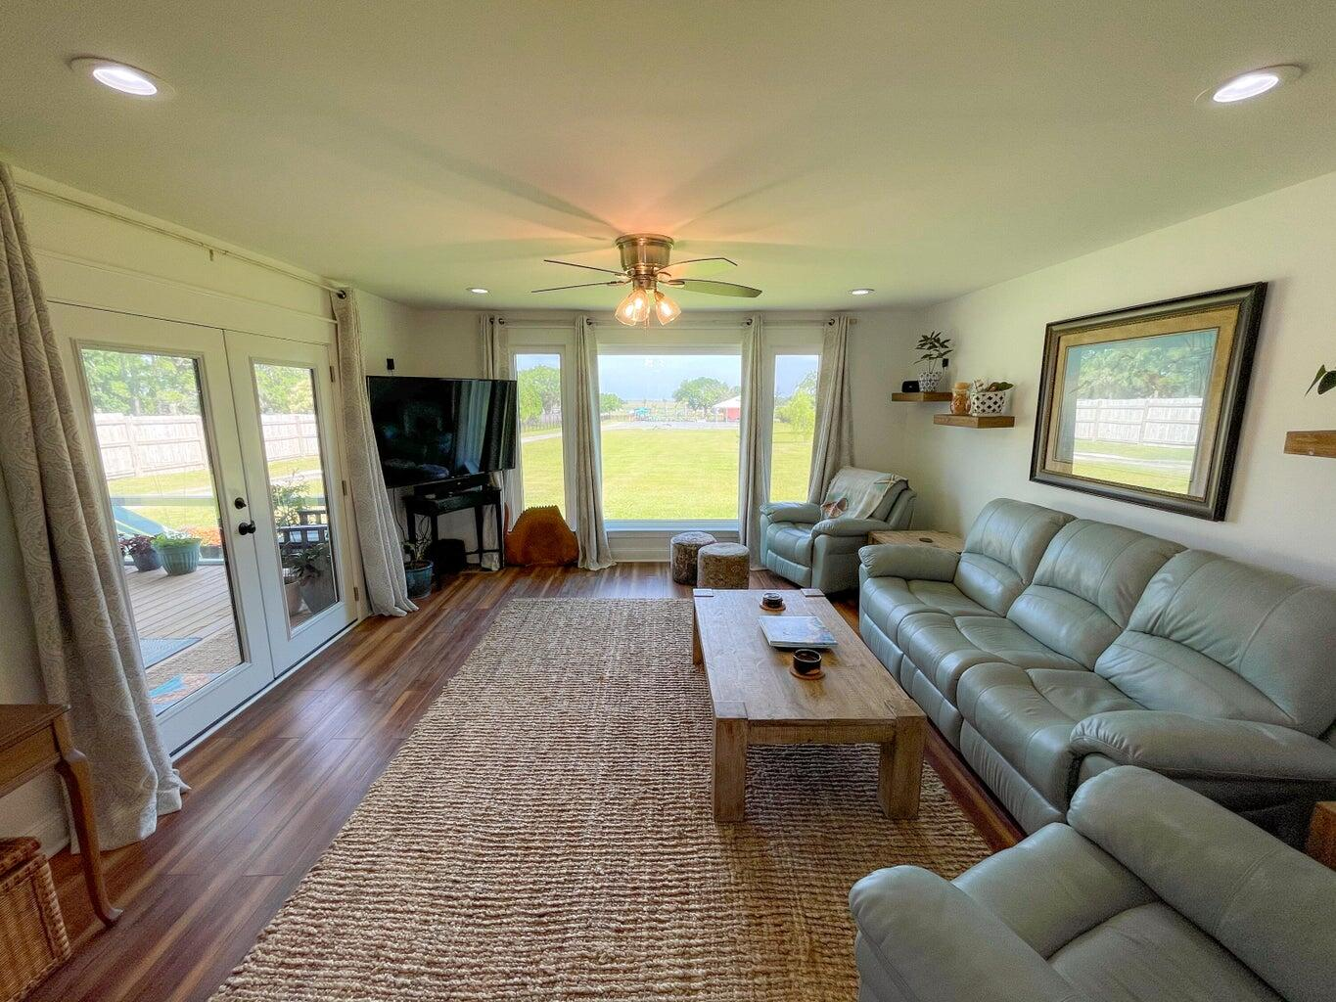
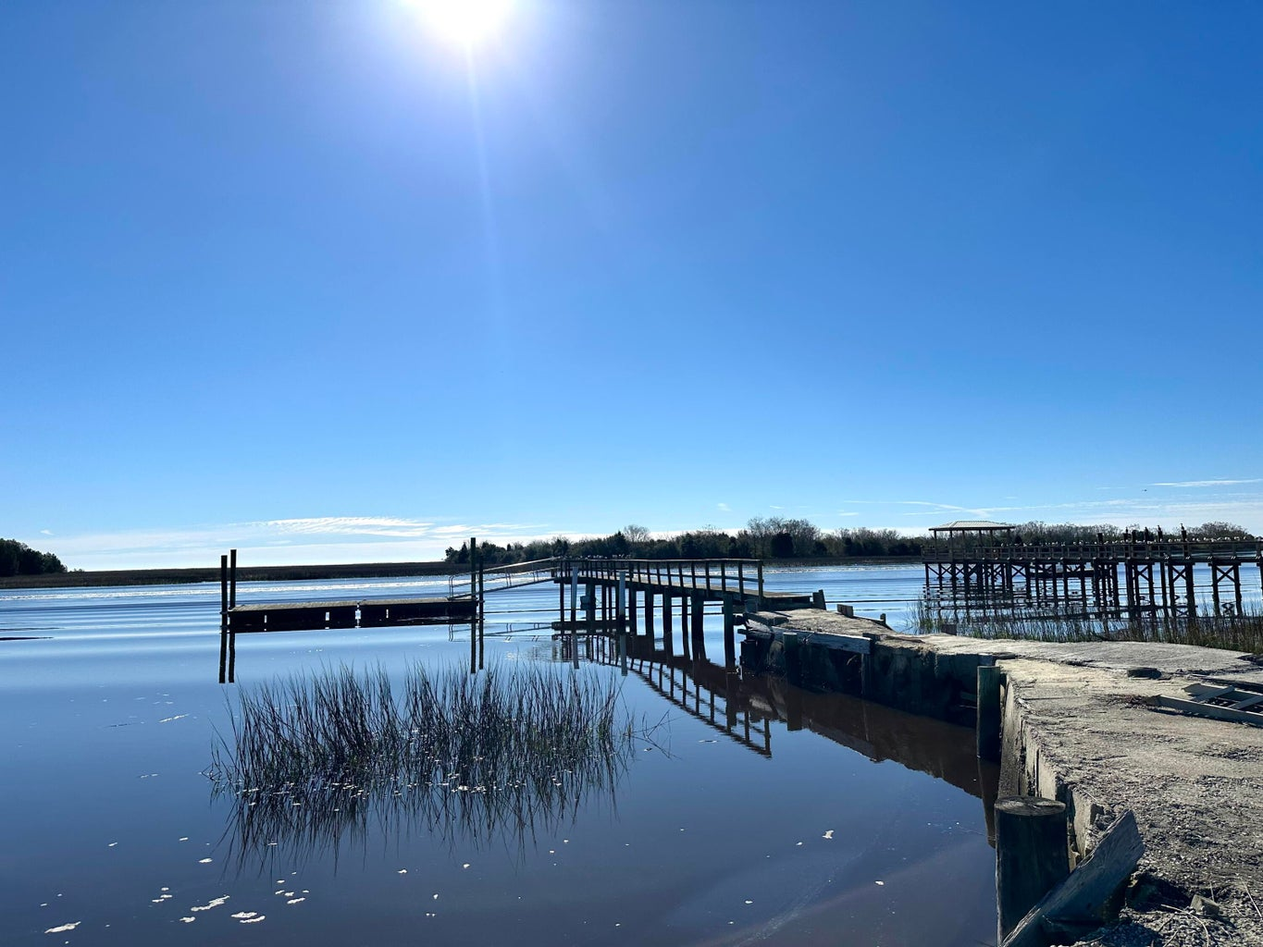
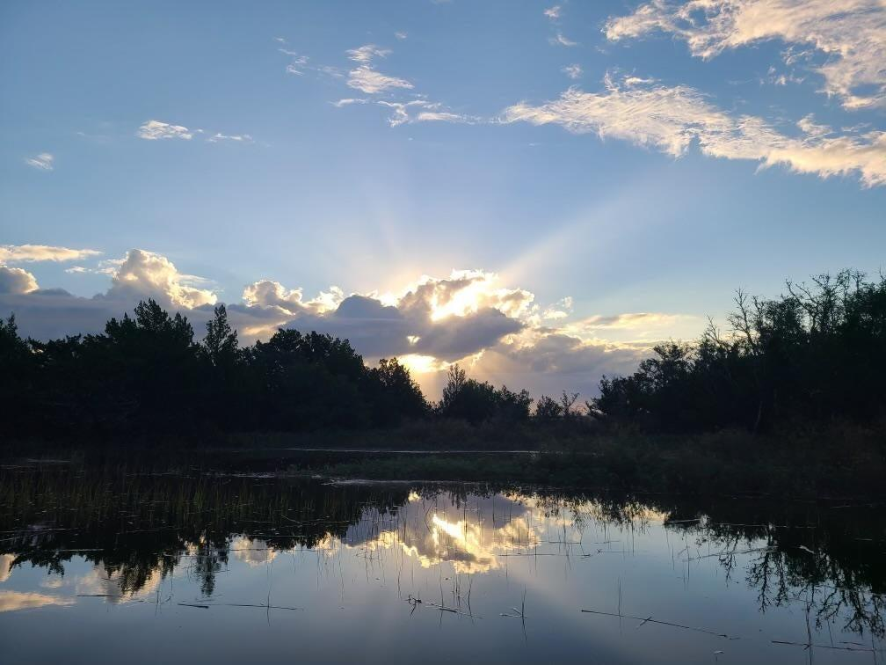
New to Market
.7 Acres with Deep Water Access
712 Donnelly Corner Dr
Awendaw, SC 29429
MLS# 24004246
$579,000
This spacious lot with NO HOA also has DEEP WATER ACCESS to Bull's Bay at the shared boat landing connected to the adjoining property.
Enjoy the serenity of nature in the quickly growing community of Awendaw that is a short drive to all the shopping, entertaining, schools and beaches in Mount Pleasant. Or hop on your boat, that you can store on your property, and cruise to the surrounding beaches, islands, Georgetown, Shem Creek, or Downtown Charleston.
The opportunities to own land and have deep water access in this proximity to Mt. Pleasant, the beaches, and Downtown are becoming more rare and expensive. Grab this opportunity while it lasts!
Enjoy a video tour of this property
Shanel Pierce
843-779-5523 | shanel.homesales@gmail.com
Salmonsen Realty | 864 Lowcountry Blvd Ste B | Mt Pleasant, SC 29464

