Slide 1
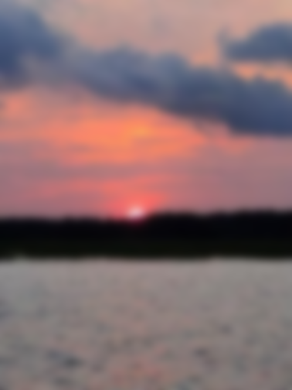
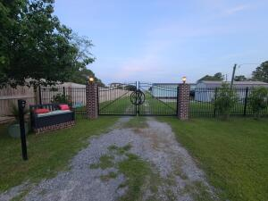
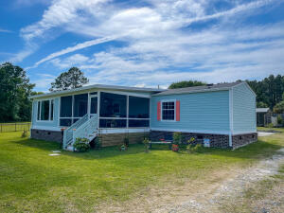
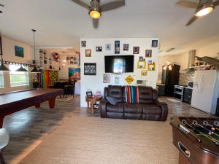
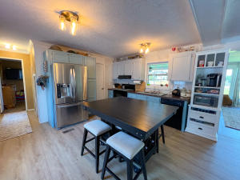
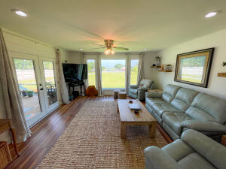
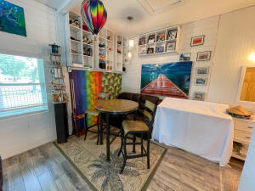
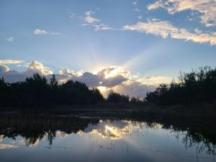
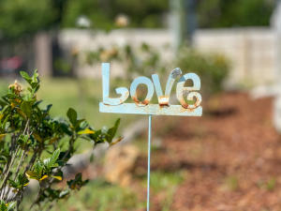
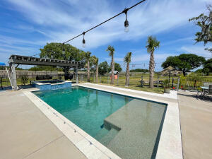

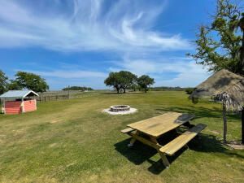
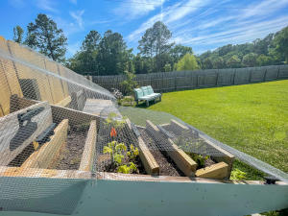
Last Chance ~ Price Reduced
Serious Inquiries Only!
712 Donnelly Corner Drive
Awendaw, SC 29429 | MLS# 21015778 | $1,899,900
First Time Ever Listed On The Market! Welcome to paradise with this stunning privately gated 3.5 acre property with expansive views over the ICW & out to Bulls Bay. Property includes a 3 bedroom 2 bath bricked in manufactured home, beautiful pool house/guest suite, salt water pool & spa, storage, private dock with 10,000 lb boat lift & big floating dock, with power & water, covered deck before the dock, chicken coop, & private community boat landing, This property is the most gorgeous, unique property I have seen. You will never want to leave home with the spectacular sunrise views. This property has been approved for another home site near the pool &/or another building site near the water.
Charles Salmonsen
M (843) 224-0300 | O (843) 388-6613 | charles@salmonsen.com
Salmonsen Realty | 864 Lowcountry Blvd Ste B | Mt Pleasant, SC 29464

