Slide 1
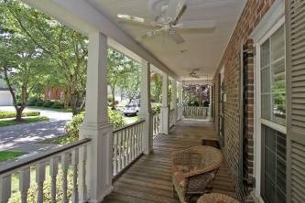
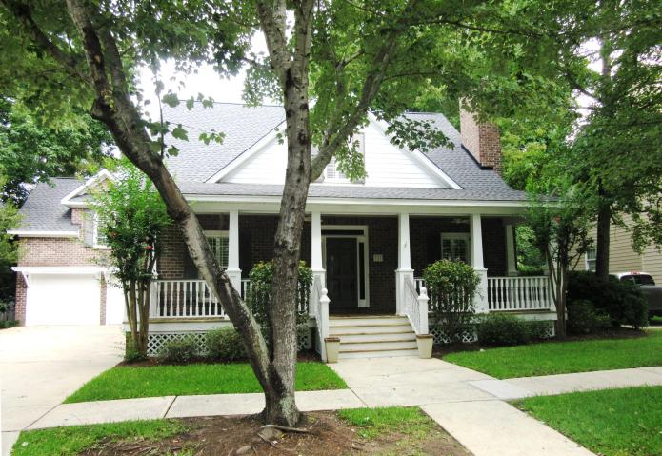
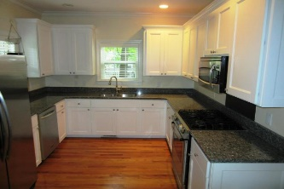
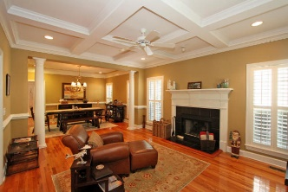
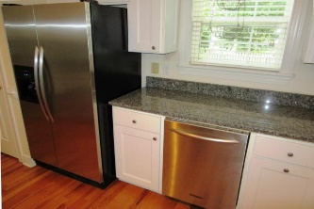
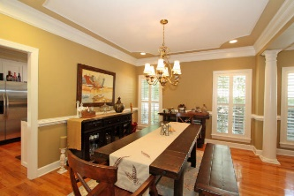
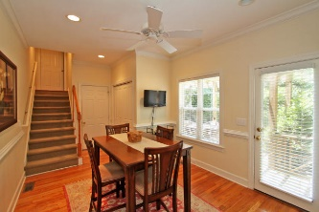
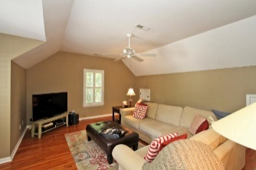
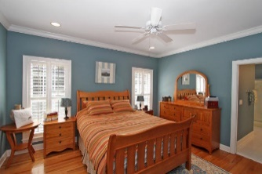
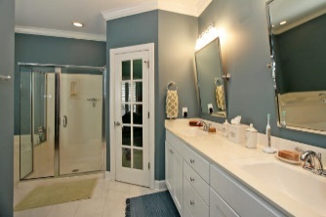
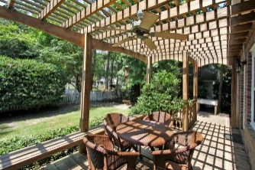
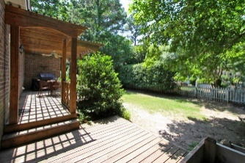


713 Preservation Place Hamlet Square | Mount Pleasant | MLS# 15018444 | $569,000
Great location! Great schools! Great value!
JUST REDUCED!
Custom built brick two story home with downstairs master, gleaming hardwood floors, amazing custom moldings, trims, coffered ceilings, plantation shutters, recessed lighting, coffered and tray ceilings. Brand New granite counter tops and stainless under mount sink. All top of line stainless appliances with gas cooktop range. Brand New architectural shingled roof. Freshly pressure washed exterior and freshly painted shutters and wood trim. Large Bonus room over the garage with ample storage could be 5th bedroom . Fenced in back yard with wood arbor over deck. Great location with easy access to I-526 and HWY 17 , schools, shopping, beaches, East Cooper Hospital and much more. Easy to show. Vacant and on Sentrilock (front porch swing).
Tommy & Lynne Lovett Tommy - (843) 442-1276
Lynne - (843) 697-0491
tlovett@carolinaone.com lynne.lovett@carolinaone.com
www.tommylovettrealestate.com
Carolina One Real Estate
628 Long Point Rd.
Mt Pleasant, SC 29464-3032

