Slide 1
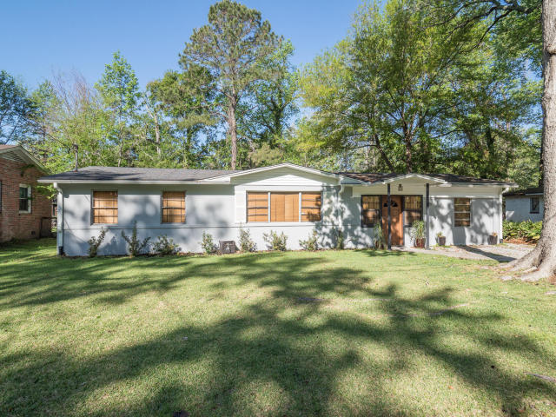
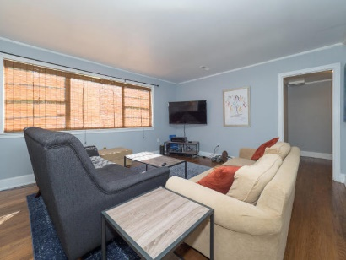
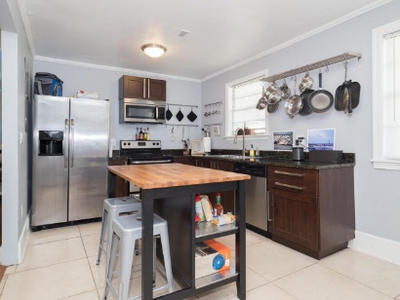
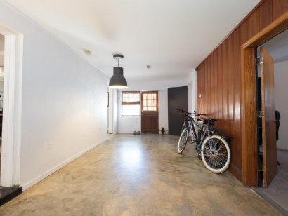
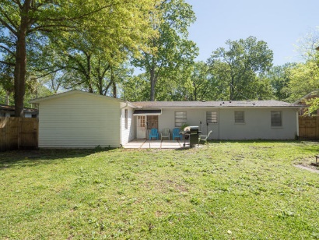

715 Tahoe Street Forest Acres ~ Charleston ~ MLS# 17010931 ~ $269,900
Renovated Ranch in West Ashley
3BR 2BA 1508 SF
Open Living/Kitchen
Large Lot
Existing Backyard Structure
Open House Saturday & Sunday 1-4
Donna Landry
Mobile - (225) 921-2111
donna.landry@cbcarolinas.com
Betsy Sarsfield
Mobile - (843) 608-1048
betsysarsfield23@gmail.com
Coldwell Banker Residential Brokerage | 35 Broad St | Charleston, SC 29401 | www.thebestincharleston.com

