Slide 1
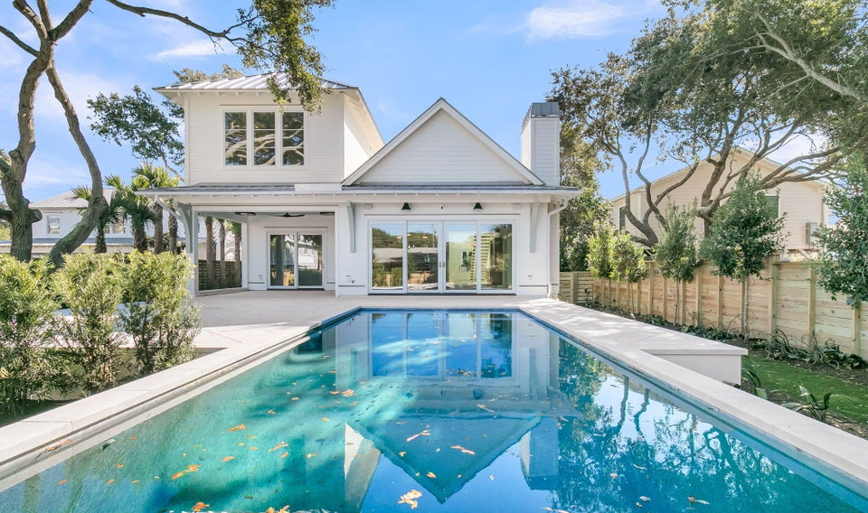
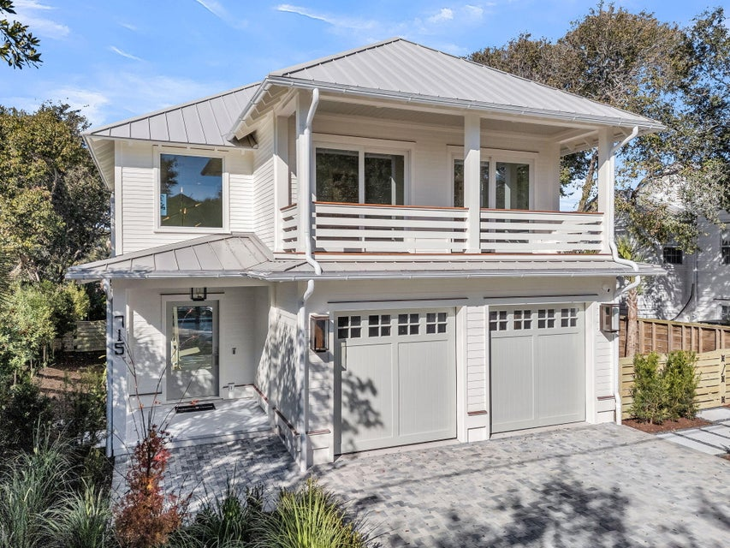
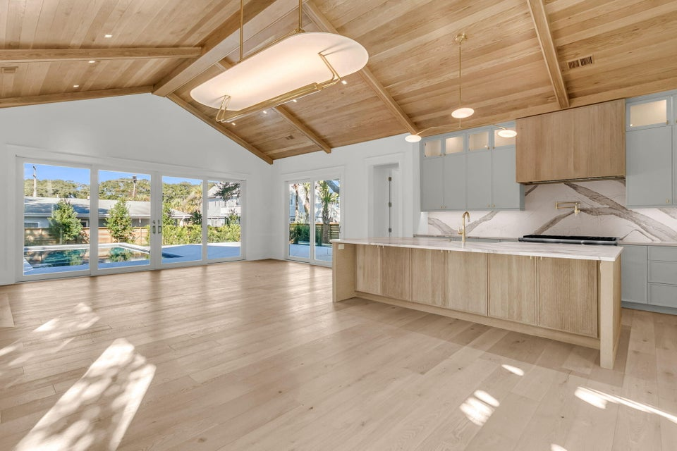
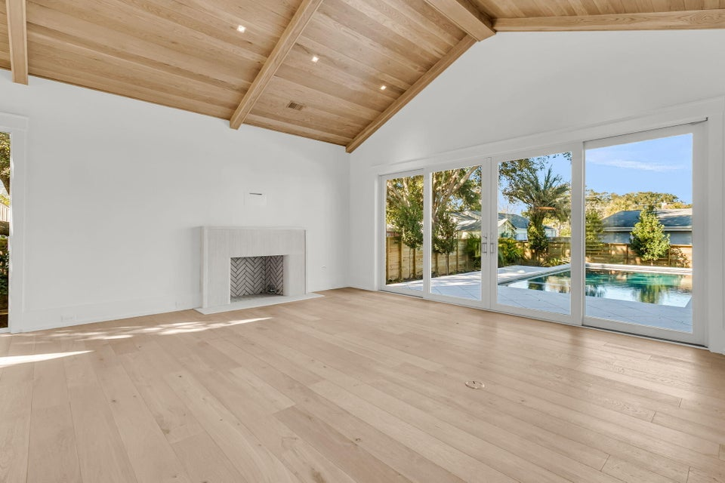
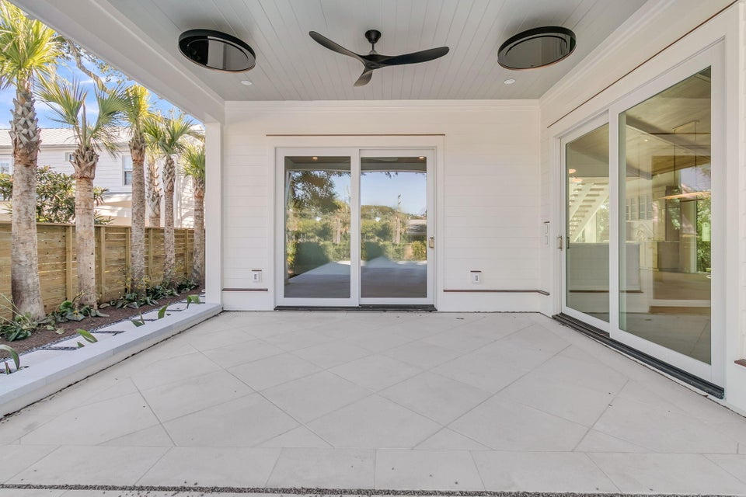
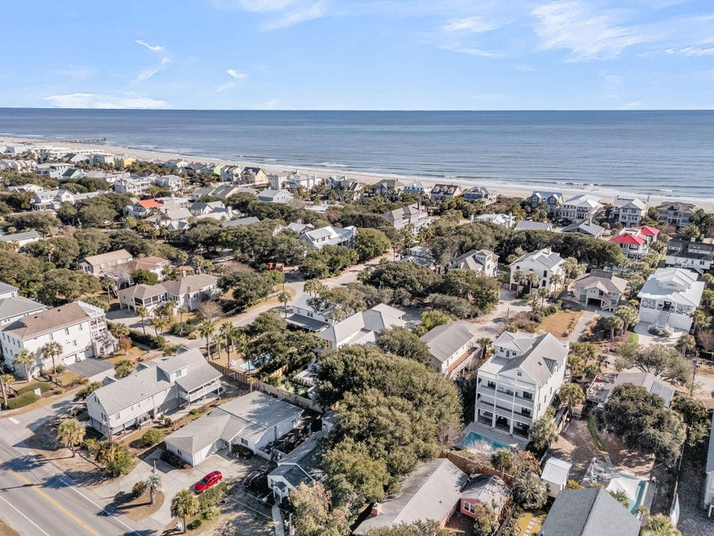
New Construction on the Isle of Palms
715 Carolina Boulevard
MLS# 25032346 | $4,395,000
Coastal Luxury Perfected on Isle of Palms! Experience refined coastal living at 715 Carolina Boulevard, a newly completed, thoughtfully designed residence where modern elegance meets timeless Lowcountry charm. Ideally positioned in the heart of Isle of Palms, this exceptional home offers over 3,400 square feet of elevated living space with five bedroom suites, five and a half baths, and a seamless blend of indoor and outdoor living designed for both grand entertaining and everyday comfort. The light-filled interior showcases soaring ceilings, custom finishes, and an open-concept layout that effortlessly connects the living, dining, and gourmet kitchen spaces. At the heart of the home, the chef-inspired kitchen features a statement island, premium appliances, and beautifully appointed cabinetry, creating a warm yet sophisticated gathering space. Each bedroom is a private retreat with its own en-suite bath, offering comfort and privacy for owners and guests alike.
Outdoor living is elevated to a resort-style experience with expansive porches and balconies, a private pool and spa, and gentle ocean breezes that set the tone for relaxed island living. Whether hosting evening gatherings or enjoying quiet mornings near the coast, this home delivers an unparalleled lifestyle just steps from the beach. Complete with a spacious garage, exceptional craftsmanship, and a prime location near Isle of Palms dining, shopping, and recreation, 715 Carolina Boulevard represents coastal luxury at its finest a rare opportunity to own a move-in-ready island retreat.
ENJOY A VIRTUAL TOUR
Jamie Hollingsworth
843-442-6492 | iopsold@aol.com
Salmonsen Realty | 864 Lowcountry Blvd Ste B | Mt Pleasant, SC 29464

