Slide 1
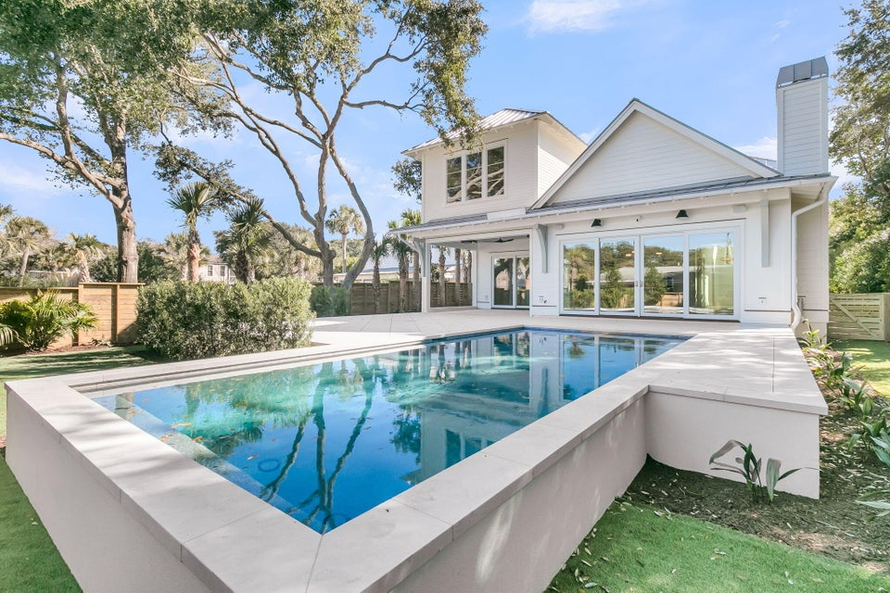
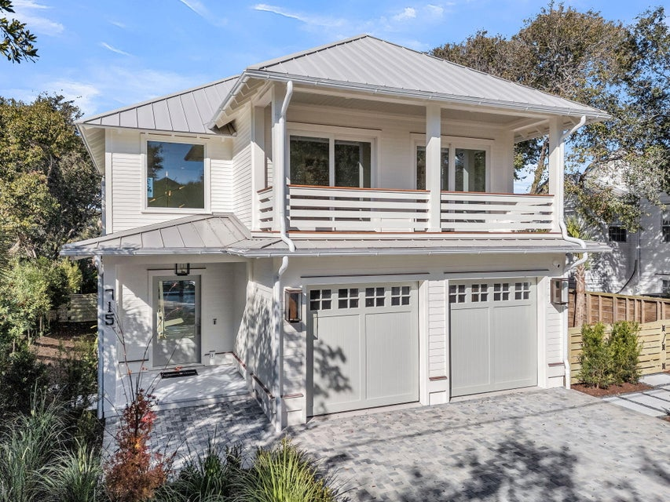
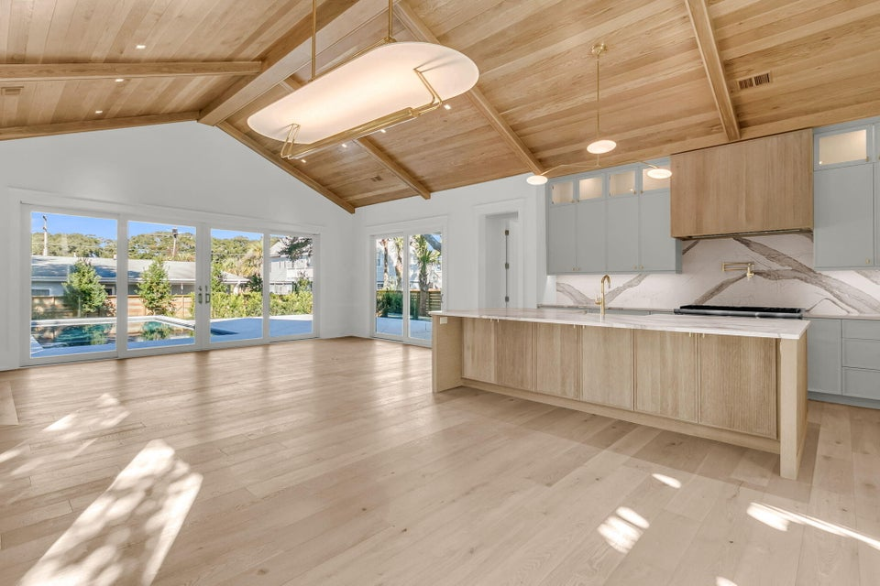
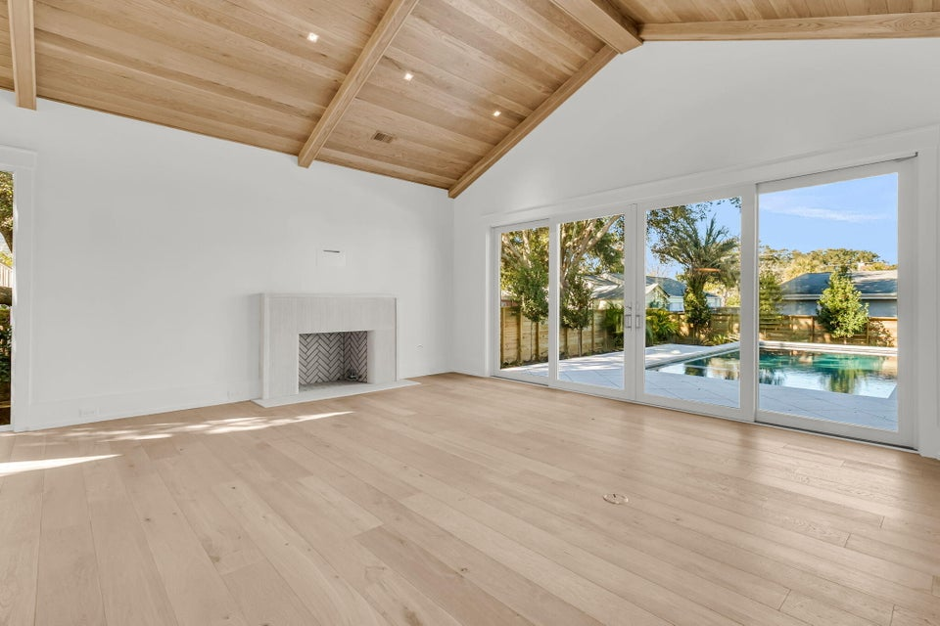
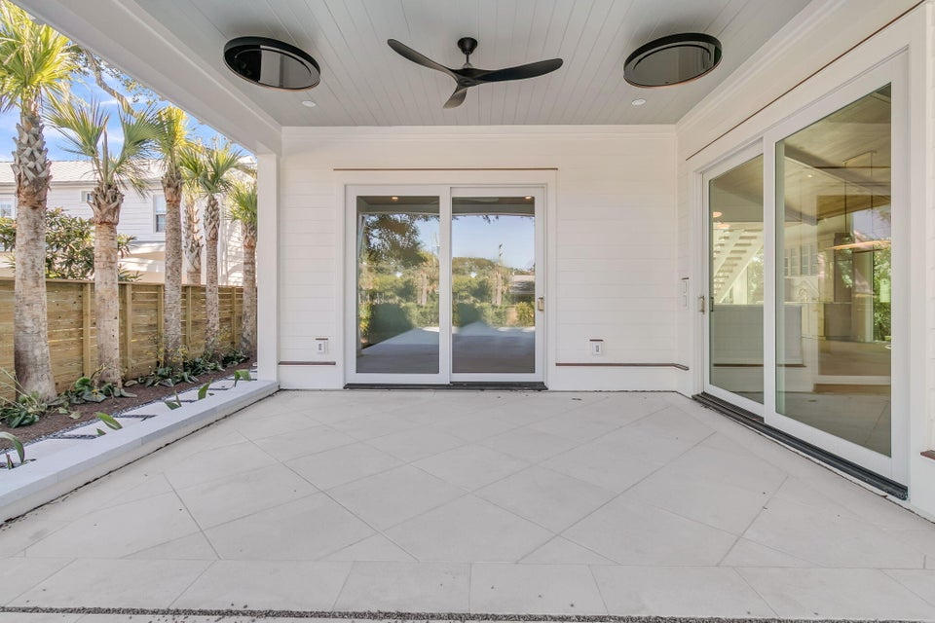
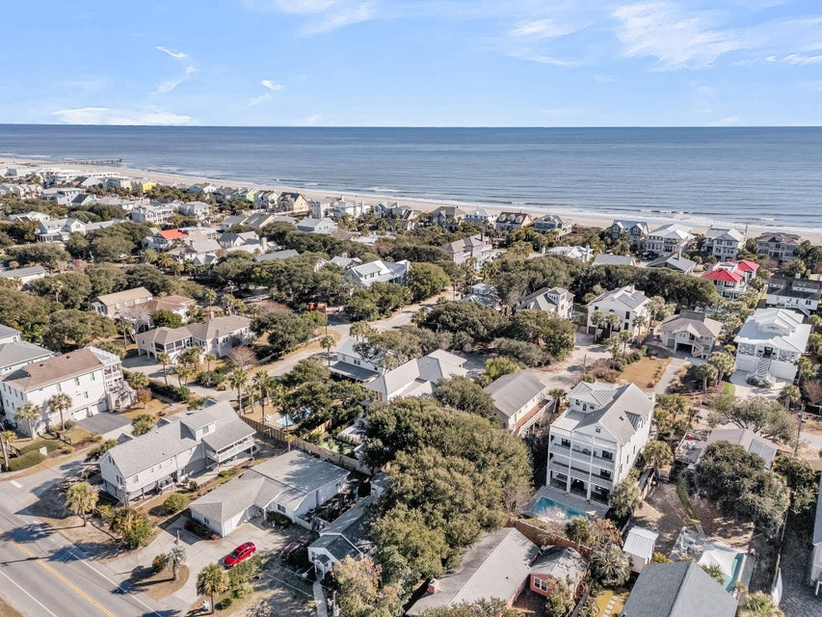
Brand New Coastal Cottage On Isle Of Palms
715 Carolina Boulevard
Isle of Palms, SC 29451
MLS# 25032346 | $4,395,000
Brand New Construction by Saltwater Homes.
Outdoor living is elevated to a resort-style experience with expansive porches and balconies, a private pool and spa, and gentle ocean breezes that set the tone for relaxed island living. Whether hosting evening gatherings or enjoying quiet mornings near the coast, this home delivers an unparalleled lifestyle just steps from the beach. Complete with a spacious garage, exceptional craftsmanship, and a prime location near Isle of Palms dining, shopping, and recreation, 715 Carolina Boulevard represents coastal luxury at its finest a rare opportunity to own a move-in-ready island retreat.
ENJOY A VIRTUAL TOUR
Jamie Hollingsworth
843-442-6492 | iopsold@aol.com
Salmonsen Realty | 864 Lowcountry Blvd Ste B | Mt Pleasant, SC 29464

