Slide 1
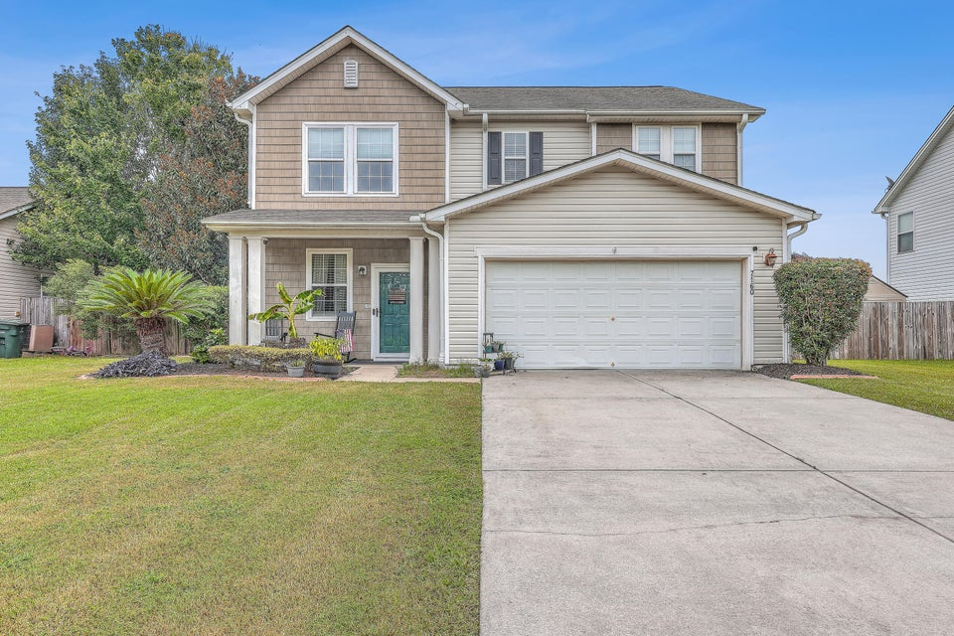
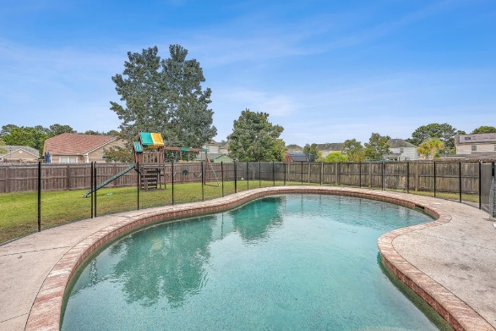
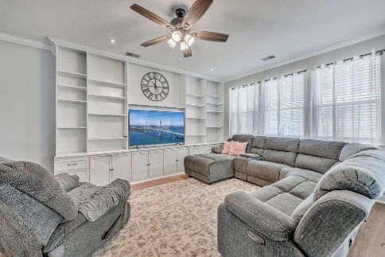
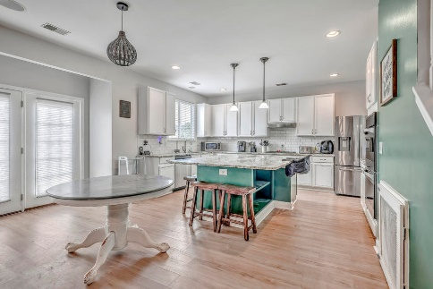
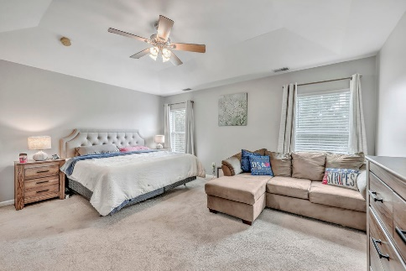
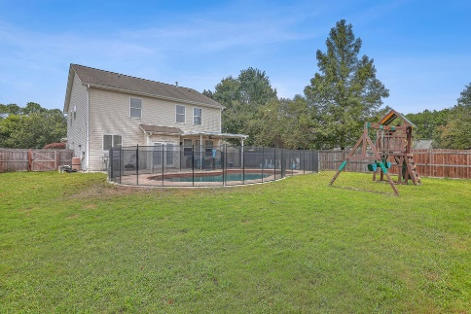

Beautifully Updated Home in Tanner Plantation
7160 Sweetgrass Blvd
Tanner Plantation
Hanahan, SC 29410
MLS# 24024004 | $529,000
Welcome to 7160 Sweetgrass Boulevard! This beautifully updated home is located in the highly desirable Tanner Plantation neighborhood. Perfect for entertaining, the open floor plan provides an abundance of space and flexibility to suit your family's needs. The kitchen features an oversized granite island, stainless steel appliances and double ovens, while the large family room offers a full wall of custom built-in shelving. Numerous windows along the rear allow for an abundance of natural light to flow through the home, and provide for a seamless transition into your backyard oasis, complete with covered patio and salt water pool. The large front room is perfect for a formal dining area or additional living space. The upstairs features three spacious bedrooms, two full bathrooms, a large loft space that can easily be converted to a fourth bedroom, and designated laundry room. This home is within walking distance to Bowen's Corner elementary, local restaurants, and the newly built marina in Bowen Village. It is very convenient to the military base, and is within a 30 minute drive to Downtown Charleston and local beaches. Schedule your showing today!
Kara Hicks
803-804-8090 | kara@thechsrealtor.com
www.karahicksrealtor.com
The Boulevard Company, LLC
806 Johnnie Dodds Blvd Ste 100
Mt Pleasant, SC 29464

