Slide 1
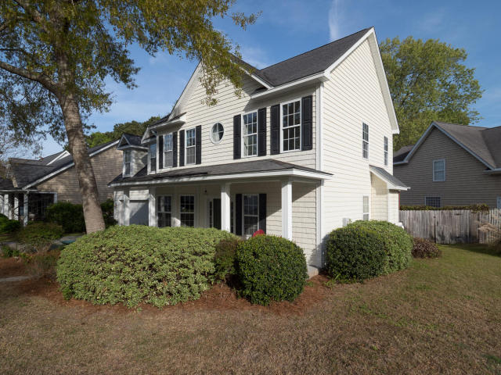
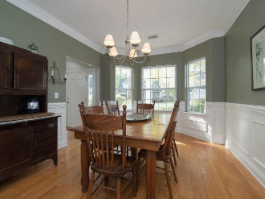
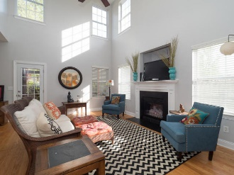
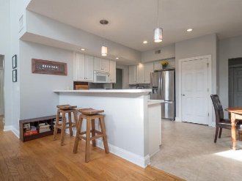
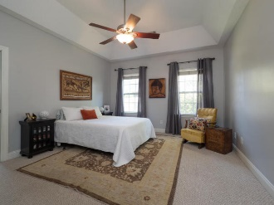
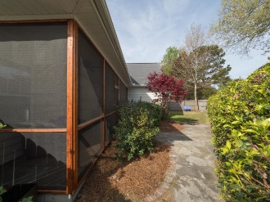

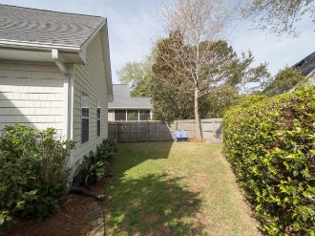

716 Lawton Harbor Drive
Price Reduced!
716 Lawton Harbor Drive
MLS# 18008720
$409,000
Lowest Price Per SF In Lawton Harbor
2577 sf
4 Bedrooms
2.5 Baths
Master Down
Screened Porch
Newly Painted
Built 2002
Walk To Stiles Point Elementary
Minutes From Historic Downtown Charleston, Beaches And Parks
Open House
Sat 11-2 & Sun 12-3
Donna Landry (225) 921-2111
donna.landry@cbcarolinas.com

