Slide 1
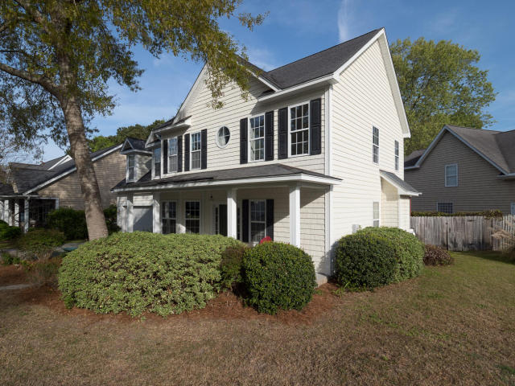
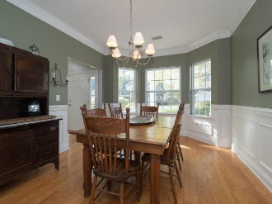
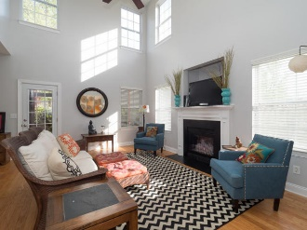
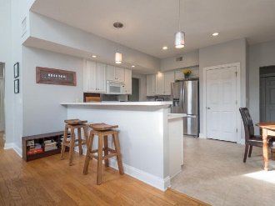
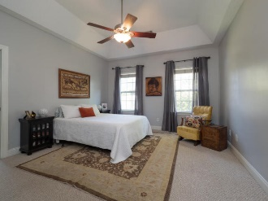
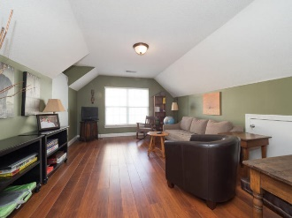

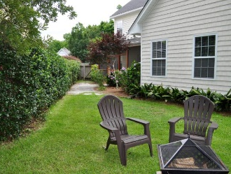

716 Lawton Harbor Drive
716 Lawton Harbor Drive
MLS# 18015483
$399,999
Lowest Price Per SF In Lawton Harbor
2577 sf
4 Bedrooms
2.5 Baths
Master Down
Screened Porch
Newly Painted
Built 2002
Walk To Stiles Point Elementary
Minutes From Historic Downtown Charleston, Beaches And Parks
Open House This Weekend
11a-2p both days
Donna Landry
(225) 921-2111
donna.landry@cbcarolinas.com

