Slide 1
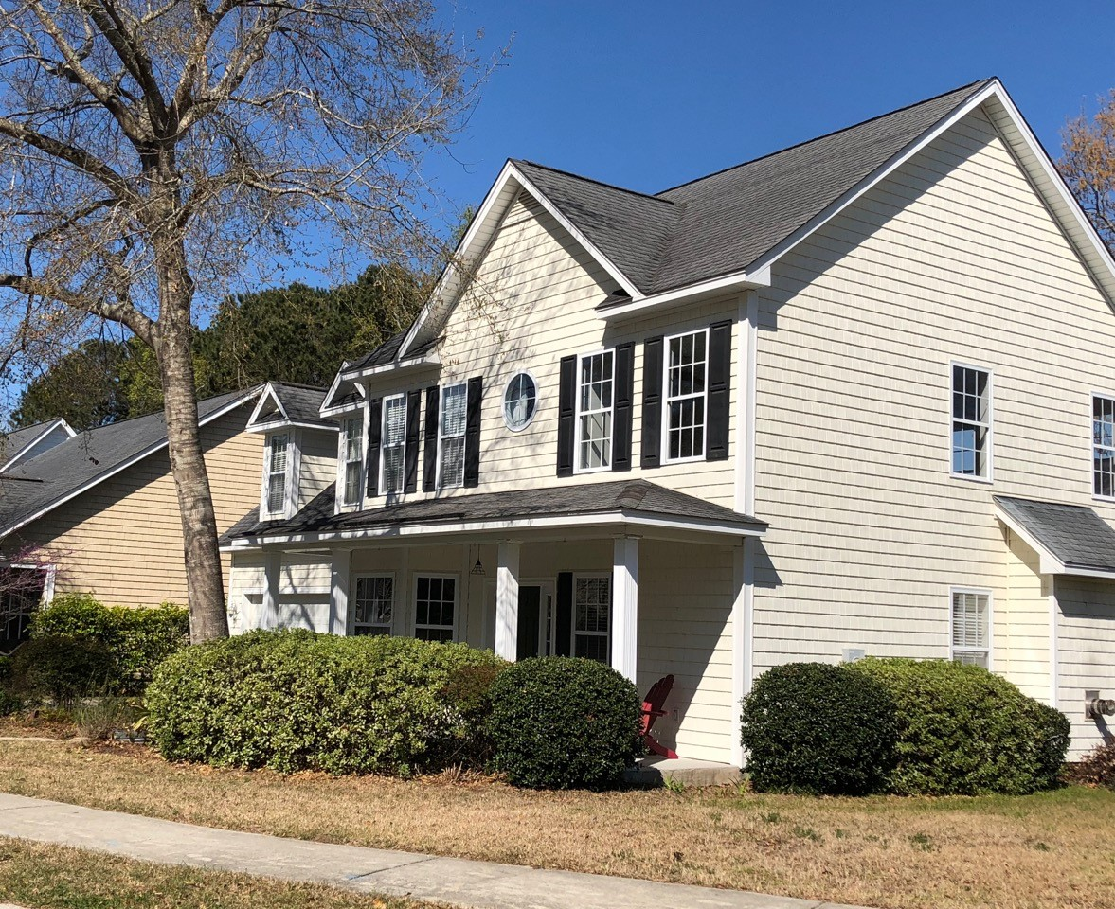


716 Lawton Harbor Drive
Coming Soon
Bring your James Island buyers to one of the largest homes in the desirable subdivision of Lawton Harbor.
$70,000+
Price Reduction
2577 SF
3 BR + bonus room
2.5 baths
Master Down
Screened Porch
Newly painted
Built 2002
Walk to Stiles Point Elementary
Call me to schedule a showing before this beauty is listed.
Donna Landry (225) 921-2111
donna.landry@cbcarolinas.com

