Slide 1
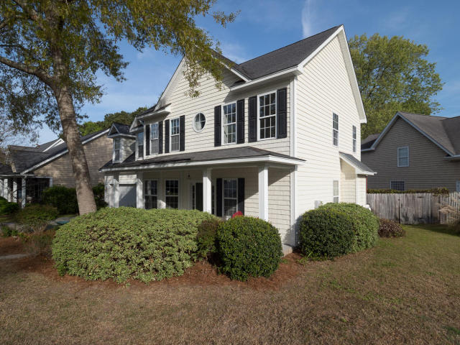
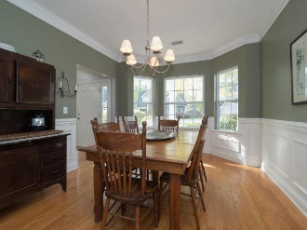
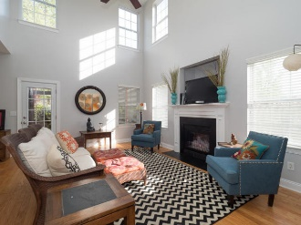
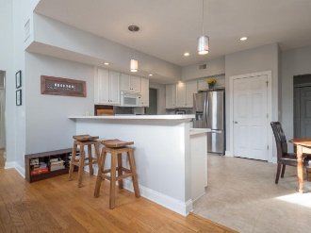
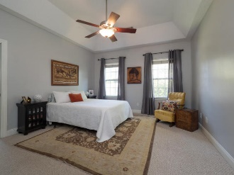
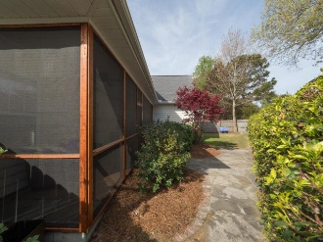

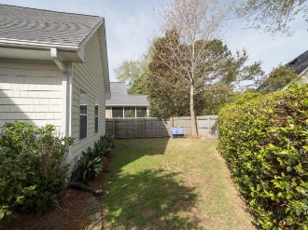

716 Lawton Harbor Drive
BIG Price Reduction
716 Lawton Harbor Drive
MLS# 18008720
$415,000
$70,000+
Price Reduction
Lowest Price Per SF In Lawton Harbor
2577 sf
3 Br + Bonus Room
2.5 Baths
Master Down
Screened Porch
Newly Painted
Built 2002
Walk To Stiles Point Elementary
Minutes From Historic Downtown Charleston, Beaches And Parks
Donna Landry (225) 921-2111
donna.landry@cbcarolinas.com

