Slide 1

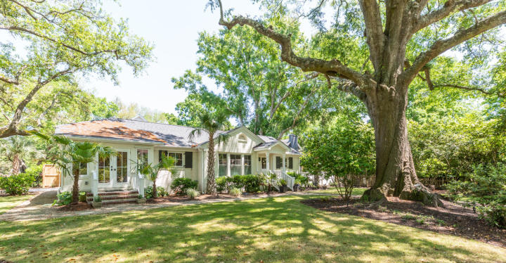
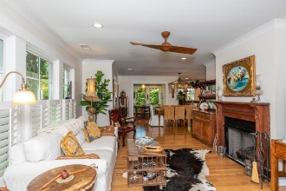
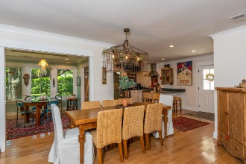
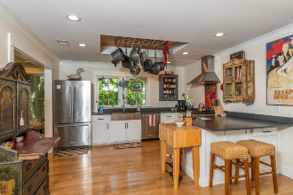
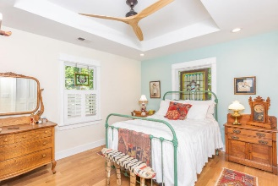
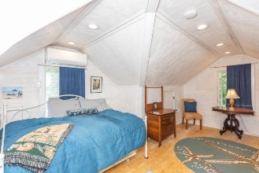
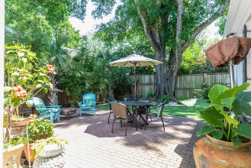
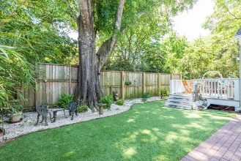

Old Village ~ Completely Renovated ~ New Price!
716 Royall Avenue
Old Village
Mount Pleasant
MLS# 20010571
$1,095,000
Charming, classic and completely Renovated One-story Cottage in the heart of Mount Pleasant's Old Village. This exquisite property was completely refurbished and rebuilt in 2017. Seller has spared no expense in the renovations which includes the newly added Sunroom and beautifully detailed chef's Kitchen with top of the line appliance package. Two Bedrooms, two new Bathrooms, plus new Flooring, Windows, Doors, Plumbing, Electrical and a New Roof. Seller also added a new 1.5 car detached garage with FROG (and half bath) that can be used as Office or 3rd Bedroom. The professionally maintained front yard has majestic oak trees and the private and enclosed Backyard Patio is perfect for relaxing and enjoying outdoor living in the Lowcountry. There is also pet friendly artificial turf!
This home is walking distance to the Pitt Street Bridge and easy access to the beaches and historic downtown Charleston... There are two items sentimental to the Seller and attached to the property that do not convey. They are the 'jellyfish' light fixture in the sunroom and antique wooden swing hanging from oak tree in the side yard.
Bill Roettger
843-224-0553
bill@theroettgerteam.com
TheRoettgerTeam.com
Lisa O’Keefe
ABR, GRN, SFR
843-442-7968 C
lisa@theroettgerteam.com
Carolina One Real Estate
195 W Coleman Blvd
Mt Pleasant, SC 29464

