Slide 1
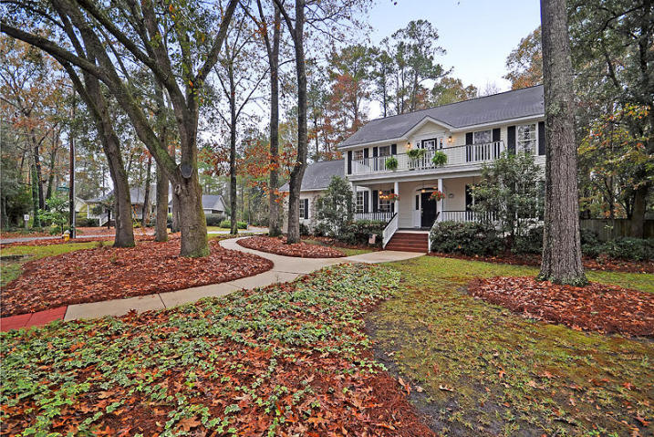
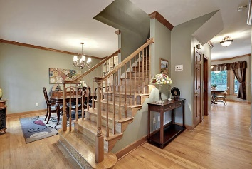
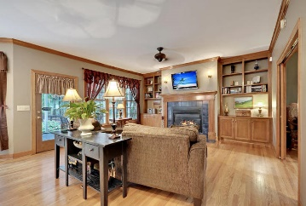
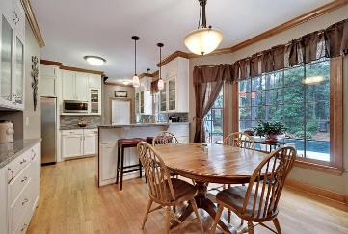
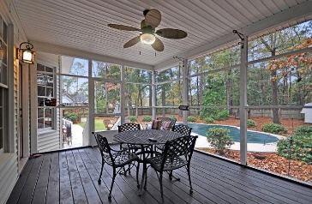
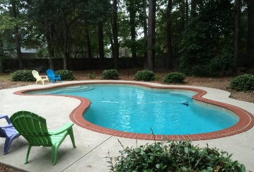


PRICE REDUCED!
716 Simmons Avenue
Shepards Park
Summerville, SC 29483
MLS# 15030637
$439,900
YOU DO NOT WANT TO MISS THIS MAGNIFICENT HOME!
This Amazing fully detached 2 story home is situated on a quiet tree-lined street and is surrounded by a large ½ acre, private, landscaped, fenced yard. This Remarkable home has 4 large bedrooms upstairs including the Spacious master bedroom suite that offers ample storage including built-in maple cabinets, large walk-in closets, and a modern ceramic tile master bathroom with double vanities, a relaxing garden tub and an awesome stand-alone shower. The 4th bedroom is currently being used as a flex room/game room, access to the upper front porch deck is available from the upstairs loft area and if extra living space is needed an unfinished room located on the 3rd floor would add approximately, an additional 300 sqft of living space. The main floor with beautiful selected wood flooring throughout offers several large rooms including the charming formal dining room, the authentic formal living room (currently being used as an office), from the living room enter the classic family room through the genuine pocket doors and enjoy the warmth of the gas fireplace on chilly evenings, the modern kitchen is delightful and offers expensive granite countertops with a distinctive back splash, crafted wood cabinets. Quality built-in stainless appliances including a Thermadore cook-top & oven, the Stylish breakfast area is perfectly placed adjacent to the kitchen and is filled with natural sun light that enters through the incredible bay window, there is a French door walk-out to the popular screened-in porch and to the massive landscaped back yard and the magnificent Gunite, Saltwater Pool. The Owner has had a pre-listing home inspection and a pre-listing appraisal completed and will provide upon request. FYI, this Incredible Home is priced below the current appraisal! However the Owner will consider reasonable offers. I'm not sure if a nicer home is currently on the market that offers more value than this exclusive home? Seller will have a NEW ROOF installed with acceptable offer at closing. Age, sqft, regime fee, HOA fee, schools, acreage and taxes are approx. Buyer to verify.
Bill Everett, Jr
Broker
843-693-8539
Bill@TheEverettGroup.net
RE/MAX Pro Realty, 9209 University Blvd, Charleston, SC 29406

