Slide 1
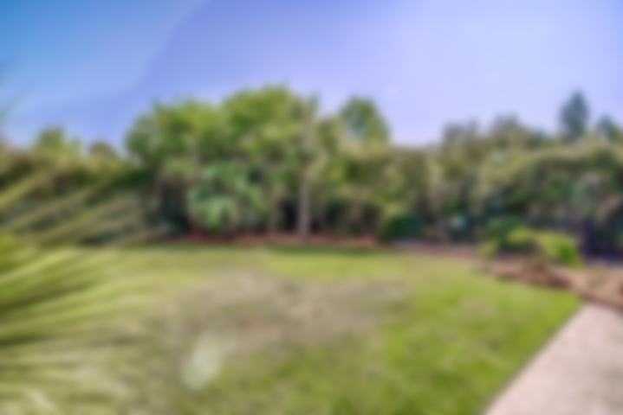
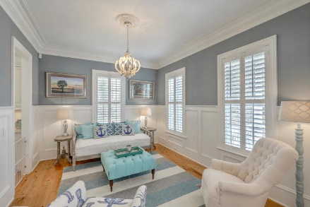
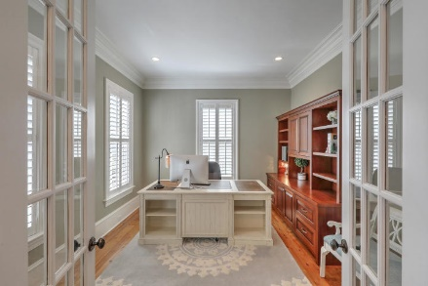
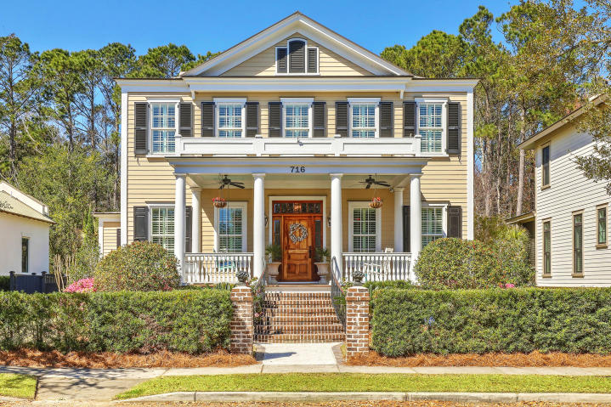
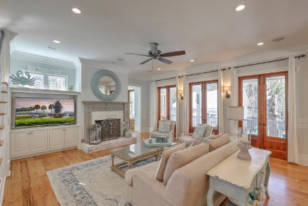
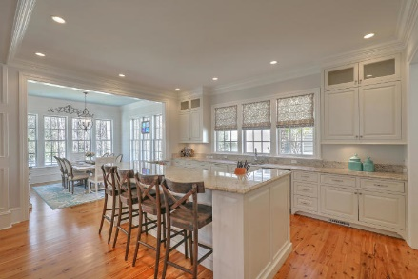
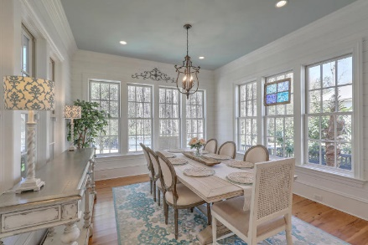
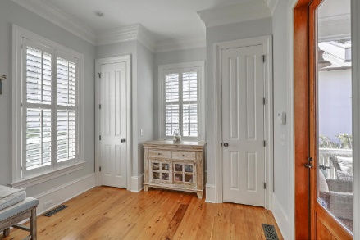
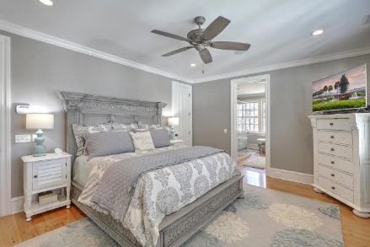
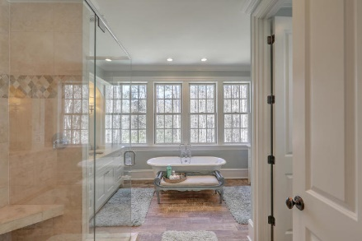
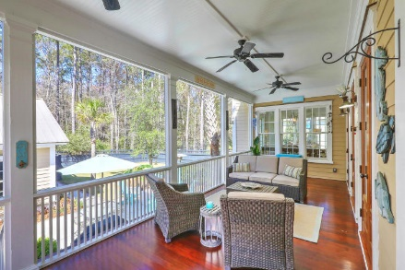
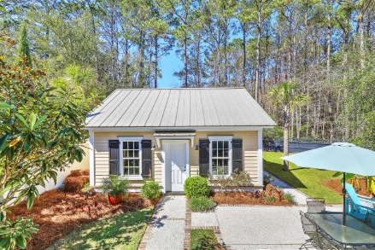
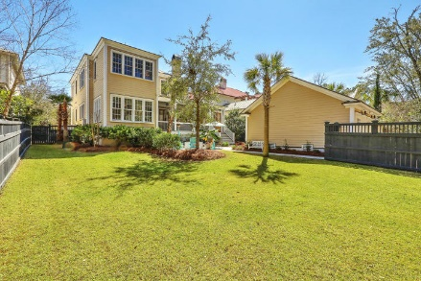
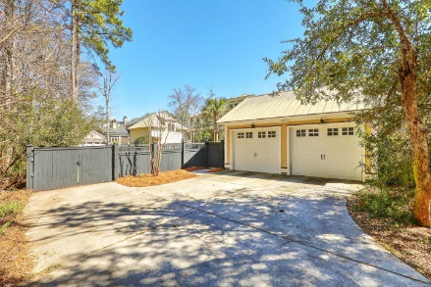


716 Stucco Lane Belle Hall Mount Pleasant, SC 29464 MLS# 19023309 $1,080,000
Stunning Home in Hibben
Deep in the heart of Belle Hall, inside the prestigious Hibben neighborhood, this southern plantation style home is nestled into a beautifully landscaped lot abutted by private, protected wetlands.
Located in one of Mount Pleasant's most sought-after and conveniently situated neighborhoods. Belle Hall Plantation offers residents a clubhouse for hosting events and parties, sports courts including four tennis and a basketball court, two swimming pools, children's play park and miles of walking and jogging trails. Just minutes to the beaches and I-526, residents can enjoy easy access to Daniel Island as well as all of the world-class shopping and dining of historic downtown Charleston.
Asking $1,200,000
MLS# 17023051
3,692 SqFt
4 Bed/3½ Baths
Short Drive to Historic Downtown Charleston & Beaches
Don Dawson 843-514-0452 ddawson@carolinaone.com Carolina One Real Estate • 2713 Highway 17 North • Mount Pleasant, SC 29466
www.TeamDawsonSC.com

