Slide 1
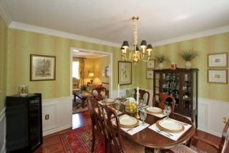
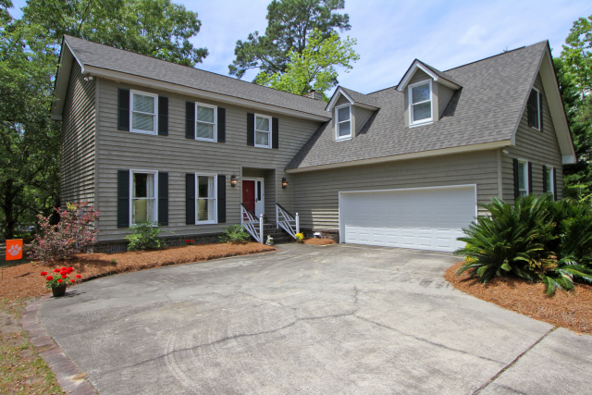

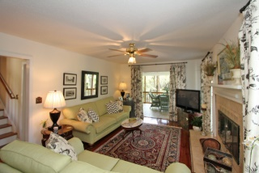
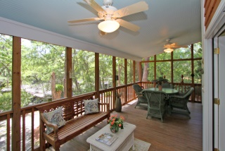
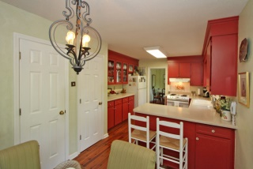
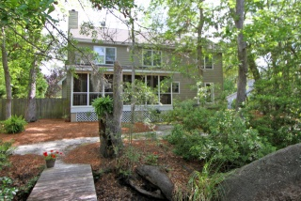
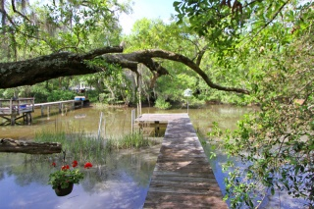
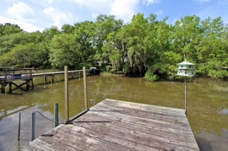
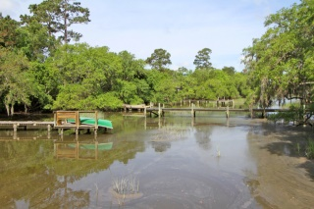


717 Oak Marsh Drive
Wakendaw Lakes - Mount Pleasant - MLS# 15011670 - $559,000
Tidal Creek ~ Price Reduced!
This lovely tidal creek home is located in Wakendaw Lakes in Mt Pleasant. The neighborhood is centrally located in Mt Pleasant. This traditional home is situated on a private lot about 1/3 of an acre with mature landscaping and trees. The rear of the property has a dock that is located on the back of Hobcaw Creek just minutes to the Wando River. The creek is tidal and at high tide you can easily get in and out. The owners always kept a 14ft boat at the dock. Hardwood floors are throughout the main floor. The home has a nice floor plan with a formal dining, living and large family room and kitchen. The kitchen and family room have French doors that open to the large screened porch that overlooks the creek and dock. This setting is so serene! You can enjoy your mornings, afternoons and evenings in this space! The home has a traditional floor plan, but can be opened up for those looking to take advantage of the homes waterfront and location but desire a more modern flow. The room over the garage is almost a suite to itself with laundry and full bath, perfect for older children, guest, bonus, or even a great playroom. The second floor offers the additional three additional bedrooms, spacious and ample storage/closet space.. The dock has water access the owners always kept a 14 ft. boat at the dock and would just take boat rides. It is about 2 minutes to Hobcaw creek and a short scenic boat ride to Cooper River. The high tide varies, but is between five and six feet of water depending on weather conditions, and moon tides. Also there is about a three hour access both before and after the two high tides a day. Wakendaw Lakes is close to Town Center Shopping, minutes to the beaches of Isle of Palms and Sullivan's Island, 10 Minutes to Historic Downtown Charleston.
Charla McDonald
Office - (843) 884-1622
Cell - (843) 343-1456
Fax - (843) 746-4845
cmcdonald@carolinaone.com
charlamcdonaldproperties.com
Carolina One Real Estate
628 Long Point Rd
Mt Pleasant, SC 29464

