Slide 1
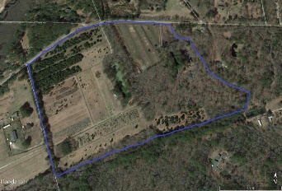
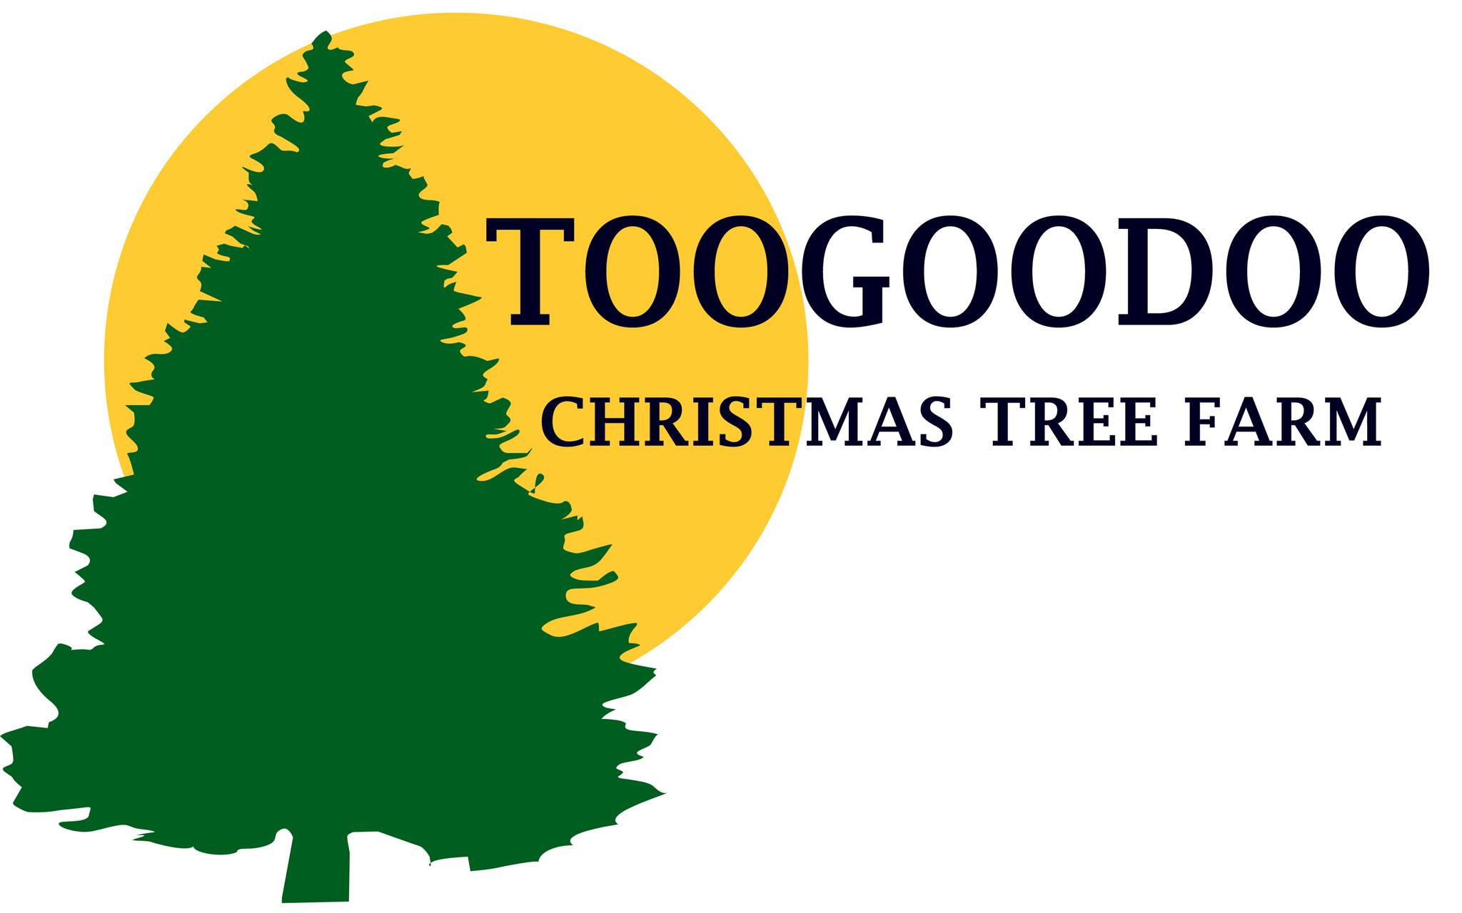
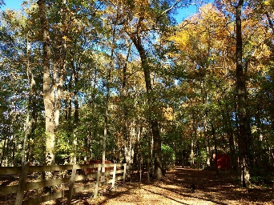
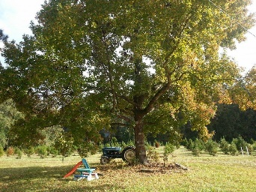
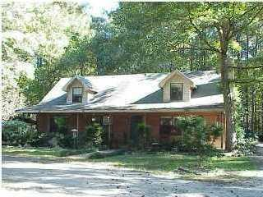
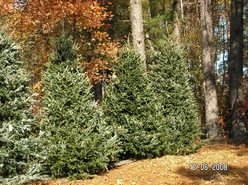
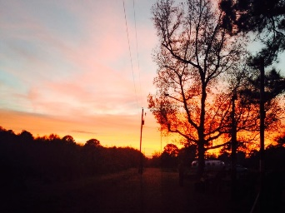
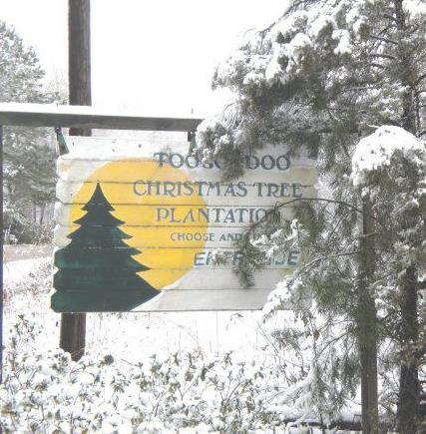
Own a Lowcountry tradition
3 Bedroom
2½ Bath
1,649 Sq Ft
7181 Toogoodoo Road
Yonges Island, SC 29449
MLS# 15024405
$815,000
The Toogoodoo Christmas Tree Farm has been a local family tradition for decades. The farm consist of approx 36 acres of fields, fenced pastures, and a pond. Approximately 20 of the acres are planted with trees. The current owners operate the tree farm as a part time business, but there is tremendous potential for year around nursery sales and expanding the Christmas business. An owner could also create a country retreat with dove and deer hunting. The property comes complete with all the equipment and tractors. The adjoining 9.76 acres features a 3 bedroom, 2.1 bath house, barn/workshop, pond, and fenced pastures. Please don't miss this Lowcountry Gem.
All tractors and equipment are included.
The farm opens the day after Thanksgiving.
Sale consists of two parcels:
TMS # 164-00-00-352 which is the house and 9.76 acres
TMS # 164-00-00-291 which is the Christmas Tree farm consisting of 36.34 acres.
Come to the Toogoodoo Barn Bash Dec 5th from 1:30 to 4 to experience the farm for yourself.
Melanie Thornhill, Realtor®
(843) 270-8997
melaniethornhill1@gmail.com
Frank Thornhill Realtor®
(843) 224-7997
frank@thornhillpropertiesllc.com
Places LLC
400 Hibben St., Suite 200
Mt Pleasant, SC 29464
www.scplaces.com

