Slide 1
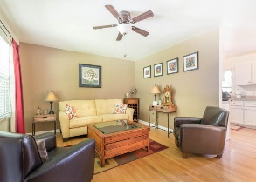
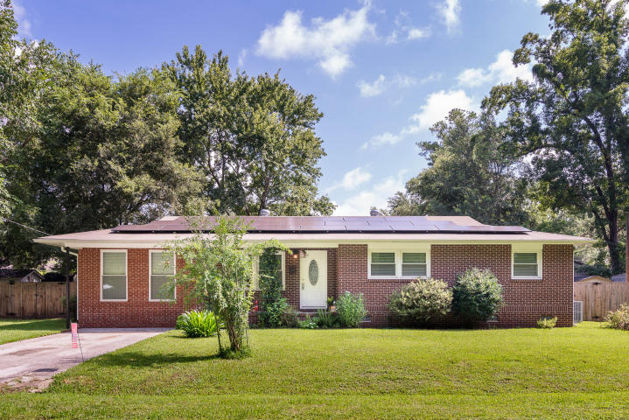
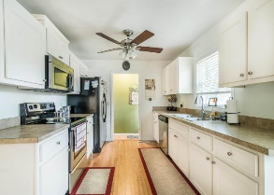
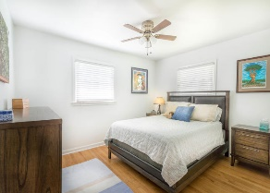
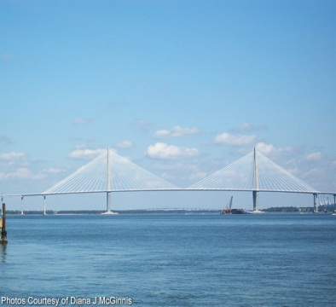
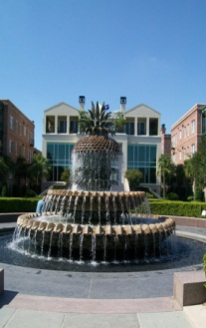
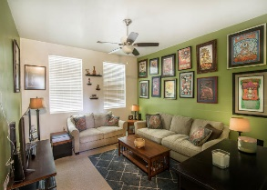
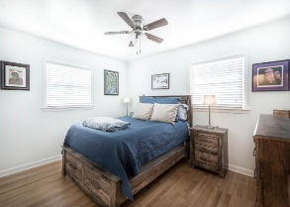
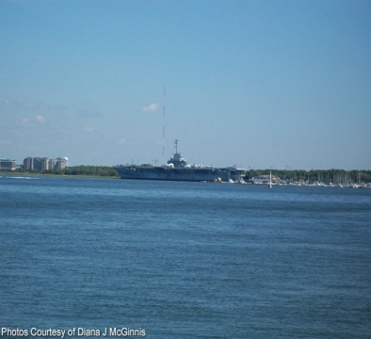
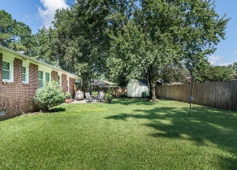


OPEN HOUSE
Sunday August 26th
1:00 - 4:00
$450,000
$450,000
718 S Westchester Drive
Essex Village · Charleston, SC 29414 · MLS# 18021333 · $269,900
Rodney Hancock
(843) 437-1347
rodneyhancock08@gmail.com
mortgageprofessionalsonline.com
Brand NEW AC, BRAND NEW WATER HEATER! Solar panels on roof. Buyers come get these free upgrades that cost the seller 30k not to mention the discounted electric bill. As for the home, it is a brick ranch in West Ashley and a must see! Pride in ownership definitely shows. There are hardwood floors throughout the main living area in addition to tile in bathrooms. The kitchen has plenty of cabinets and counter top space with stainless steel appliances. There is a brand new glass shower door installed in master bathroom. Also, the garage has been turned into incredible living space that is carpeted and is perfect for an additional living room, play room, or even a 4th bedroom. This house also has a large fenced backyard with a storage shed and patio. French drains along left side of home.
Come check out your new home today!
AgentOwned Charleston Group
902 Savannah Hwy
Charleston, SC 29407
Real Estate ● Mortgage
Insurance ● Business Brokerage

