Slide 1
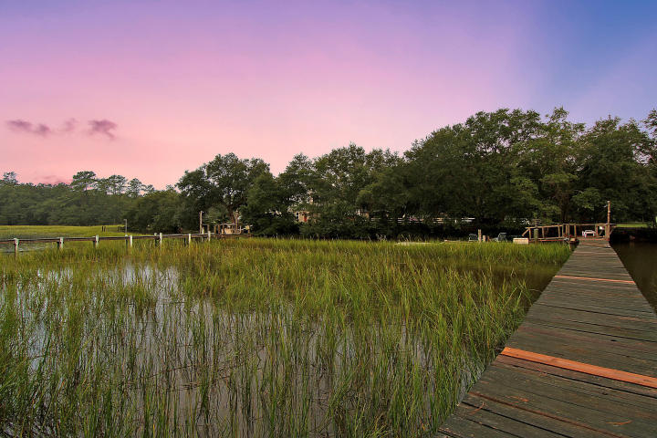
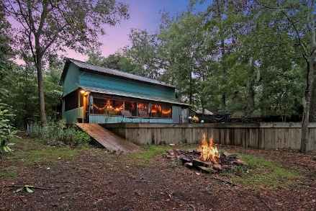
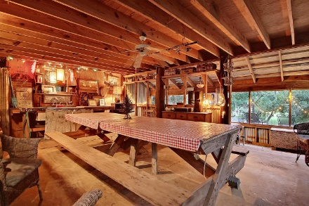
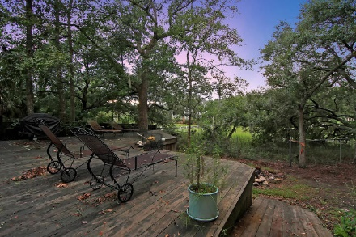
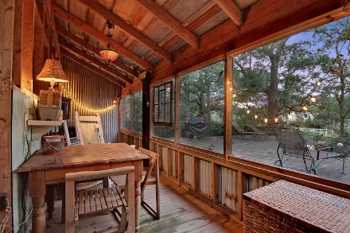
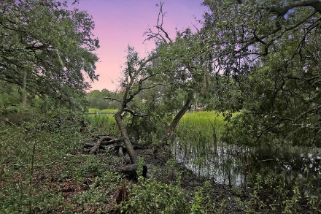
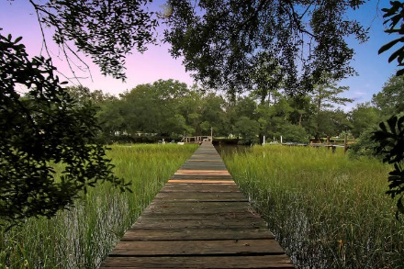
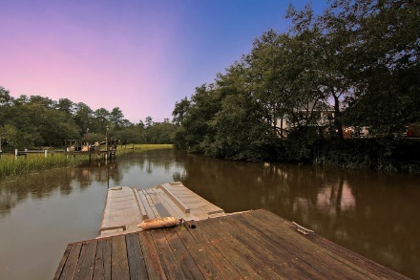
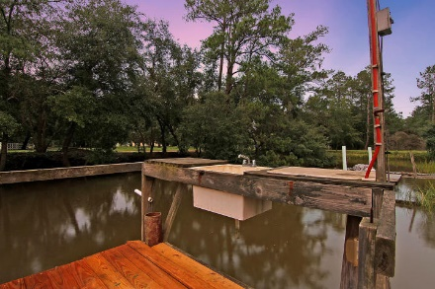
The Ultimate Fishing Getaway
Reduced $200k!
7198 Ethel Post Office Road Toogoodoo Acres ~ Meggett ~ MLS# 16025607 ~ $249,000
Private 1.5 acre fenced lot with dozens of naturally growing palm trees on a salt water Toogoodoo River tidal creek with access to deep water including Intracoastal Waterway, White Point Beach, Bohicket Marina & Restaurants, Wadmalaw River, beautiful unspoiled marshlands, horse farms, dolphins & bird sanctuaries that all connect to the Atlantic Ocean between Seabrook Island, Kiawah & Edisto Beach.
Two story charming Fish Shack with electric, plumbing and septic, large heated shower, screened rocking chair porch overlooking large deck and water view, handicap ramp access, indoor picnic table that seats 20, dual insulated utility sinks for fish processing, toilet, microwave, mini fridge and upstairs Game Room with barrel bar, pool table, ping pong table & foosball table.
Upgraded dock with pier head, fresh water sink, shower, floodlight, 15' floating dock and attached floating Jet-T for up to 16ft. boat/jet ski/kayak gives access to the Toogoodoo River tidal creek .
Two covered dry boat storage slips.
Deep water boat landing ten minutes away (off Parishville Rd.)
Harmony Hall Plantation - A Charleston County Park, consisting of 420 acres including two miles of waterfront acreage that is perfect for fishing and crabbing is located directly opposite the driveway entrance to this property.
Just 5 minutes to charming downtown Meggett (historical railroad town established in 1905) with newly renovated town hall, party shelter and playground. 25 minutes from downtown Charleston and 35 minutes to Edisto Beach State Park.
Nate Gainey nate@mattoneillteam.com 843-513-2038

