Slide 1
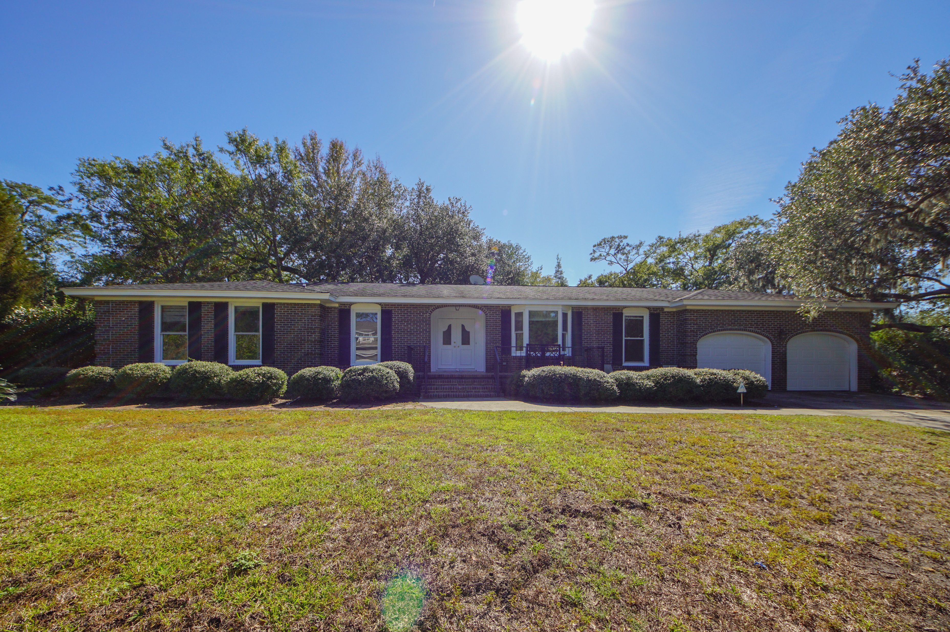
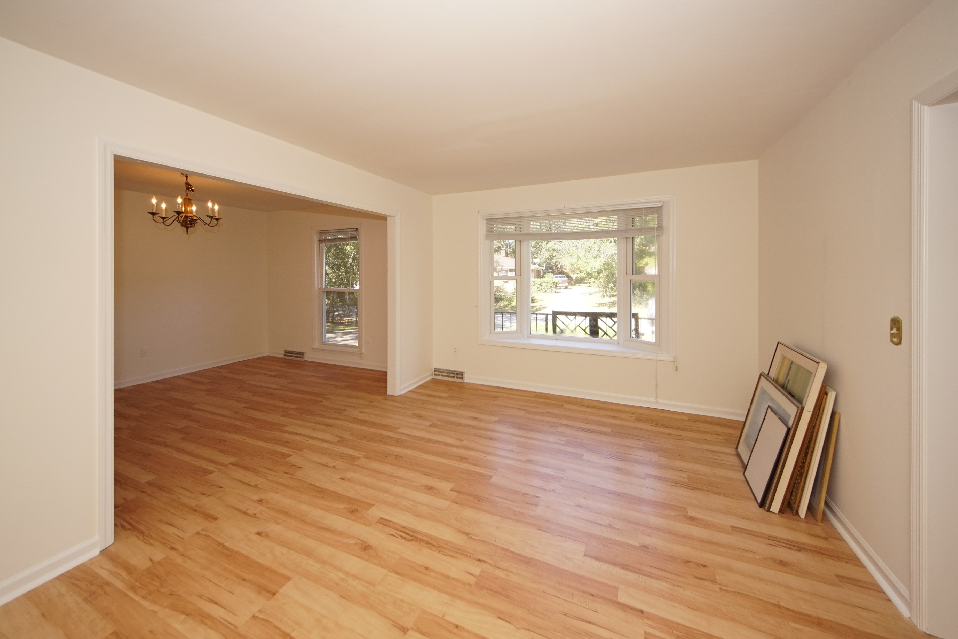
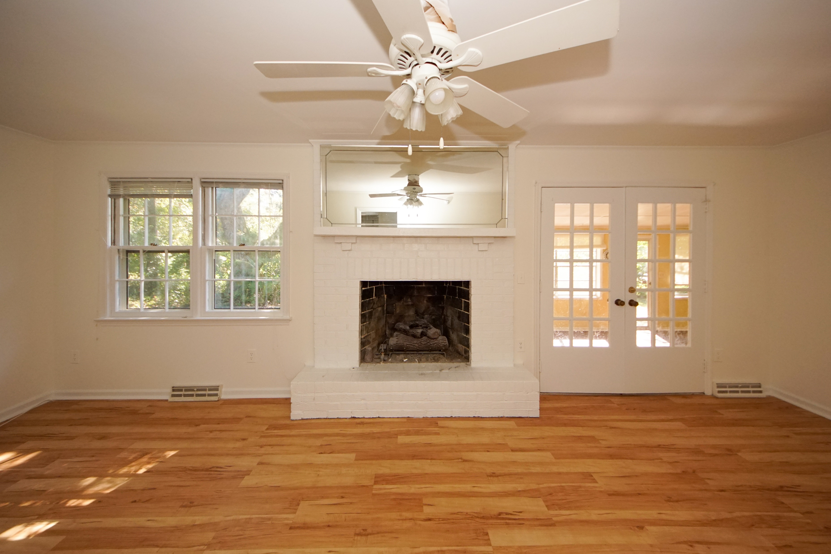
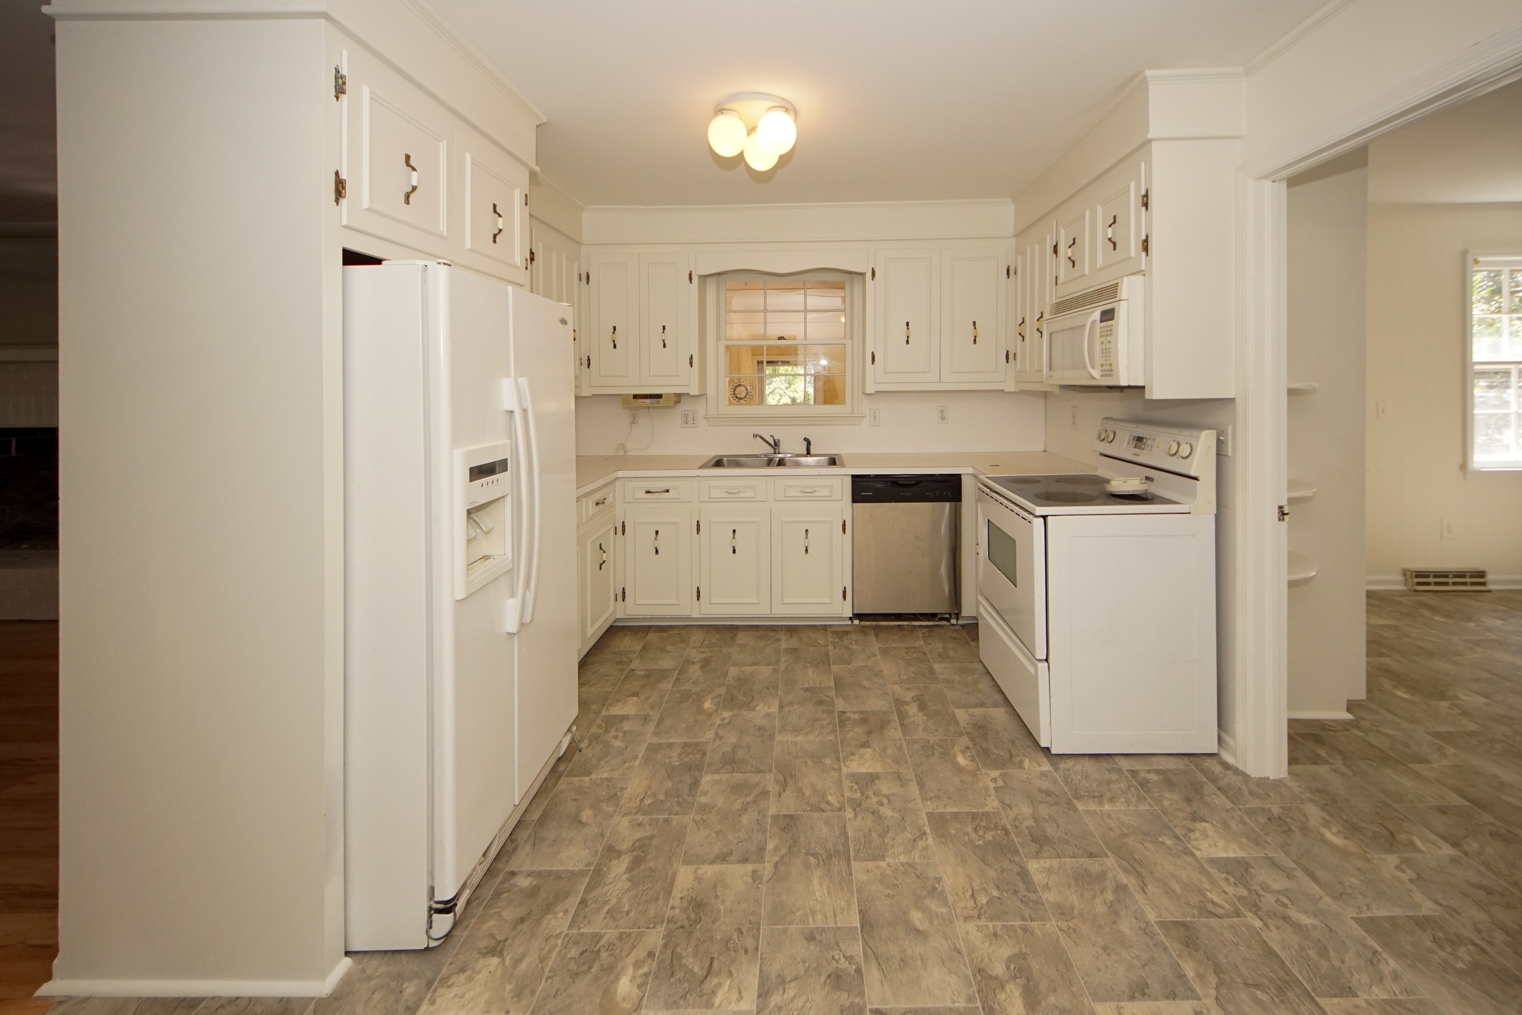
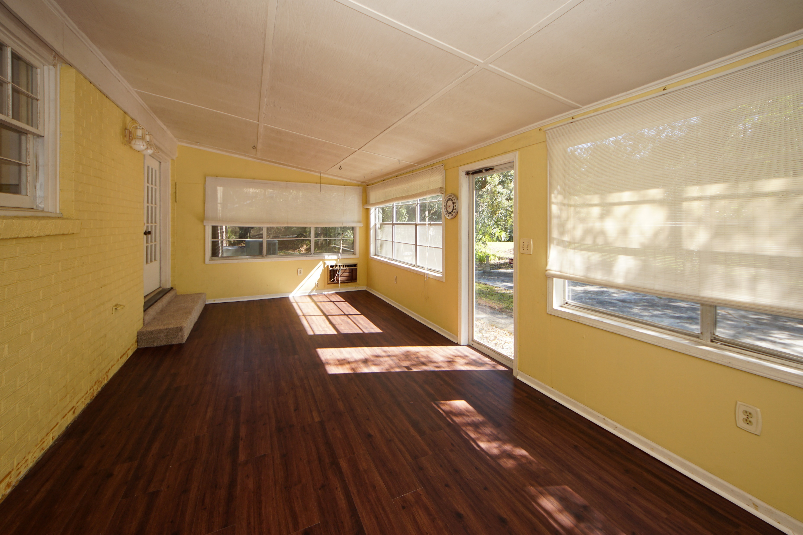
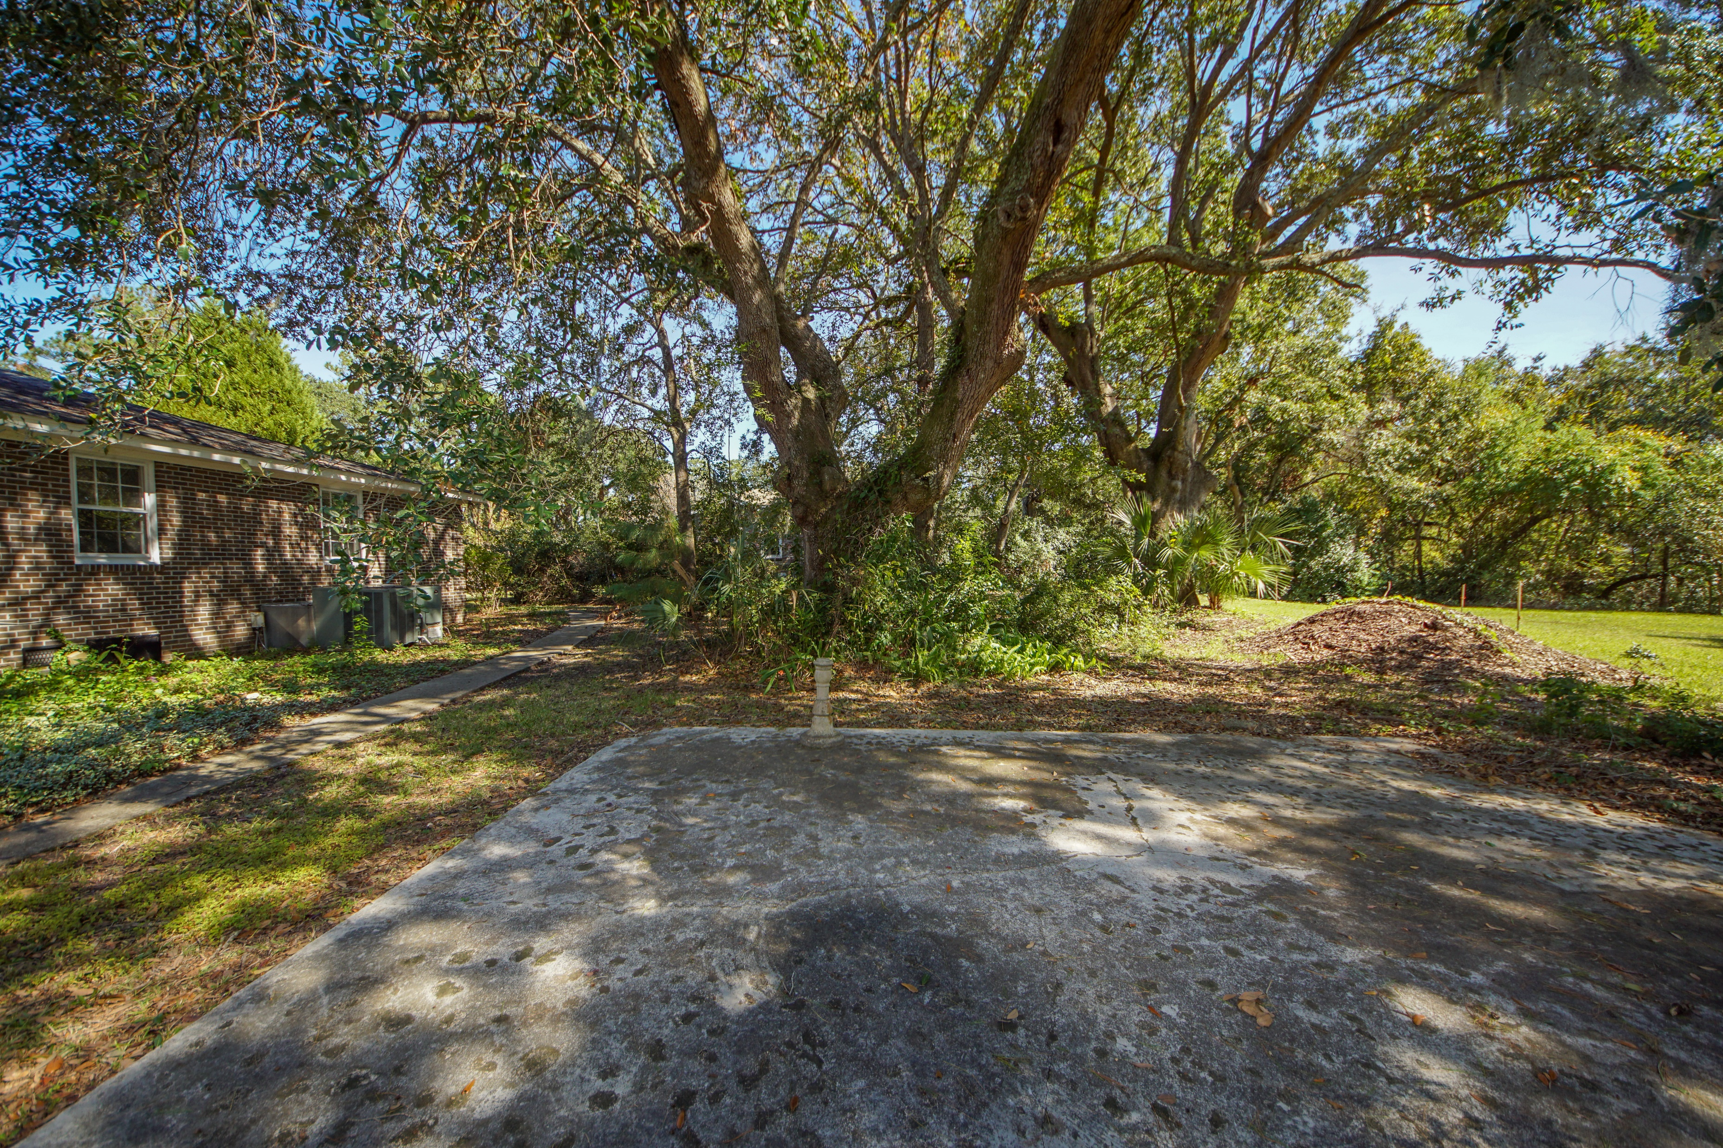
New Listing in Wespanee Plantation
Easy to show!
71 Fort Royal Avenue
Charleston, SC 29407 | MLS# 19029628 | $359,900
Great location convenient to schools, shopping, Downtown, & North Charleston. House is situated on the corner of Old Towne Rd & Fort Royal Ave.
4 Bedroom 2 full bath home with an enclosed porch on the rear. House has been recently painted inside & out, new carpet, new vinyl, windows caulked & painted, & landscaping has been cleaned up & trimmed.
Items in garage & attic will be removed prior to closing.
Charles Salmonsen
M (843) 224-0300 | O (843) 388-6613 | charles@salmonsen.com
Salmonsen Realty | 864 Lowcountry Blvd Ste B | Mt Pleasant, SC 29464

