Slide 1
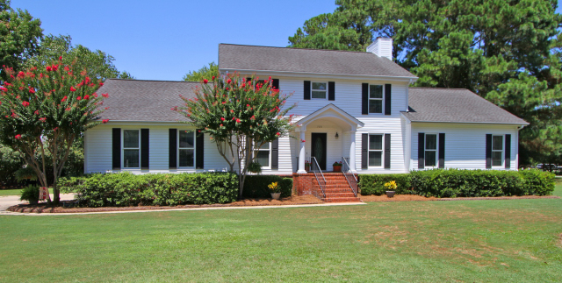
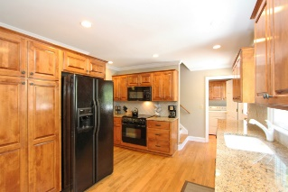
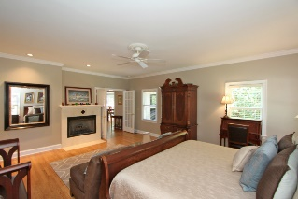
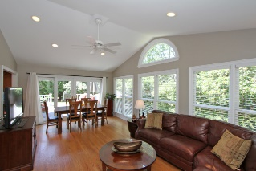
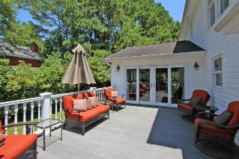
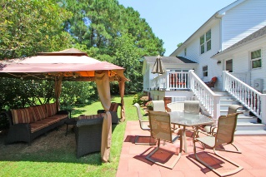


720 Oak Marsh Drive
Wakendaw Lakes - Mount Pleasant - MLS# 15020029 - $589,900
Open House – Sunday, Oct 11th 2-4p
Welcome home to 720 Oak Marsh Drive! If you are looking for excellent location, established neighborhood, desirable schools, and a well maintained and updated home this is the ONE for you! As you enter the home, to the left is a formal dining room, leading into the kitchen with granite countertops, and to the right is the large family room with hardwood floors and a fireplace. In 2002, the property was renovated and added an entire additional wing that included a master suite on the first level, and opened up the original floor plan to enjoy a larger informal dining area and a lovely sunroom that is all part of the open living space of the first floor, a new deck and a new roof at that time. The master bedroom is oversized with fireplace to enjoy. Master bathroom has a large travertine tile shower and bathtub. The master closet is very large with built in shelves and organizers. The upstairs has another master bedroom or small suite with a full bath with tile shower. There are two other nice sized bedrooms, another full bathroom and a FROG that can be used as the 5th bedroom or a large media room on the second floor. Currently, the owners use one of the upstairs bedrooms as an office. The home has two stairways to access the upstairs. Additional features include a laundry room, large pantry, two car garage with shelving, and a lovely deck, landscaped yard and outdoor space to enjoy and entertain your family and friends. The owners have taken great care and pride in the home and the landscaping and it shows! The home has new HVAC units installed this year, has a current termite bond and is transferable at closing to the new owners.
Charla McDonald
Office - (843) 884-1622
Cell - (843) 343-1456
Fax - (843) 746-4845
cmcdonald@carolinaone.com
charlamcdonaldproperties.com
Carolina One Real Estate
628 Long Point Rd
Mt Pleasant, SC 29464

