Slide 1
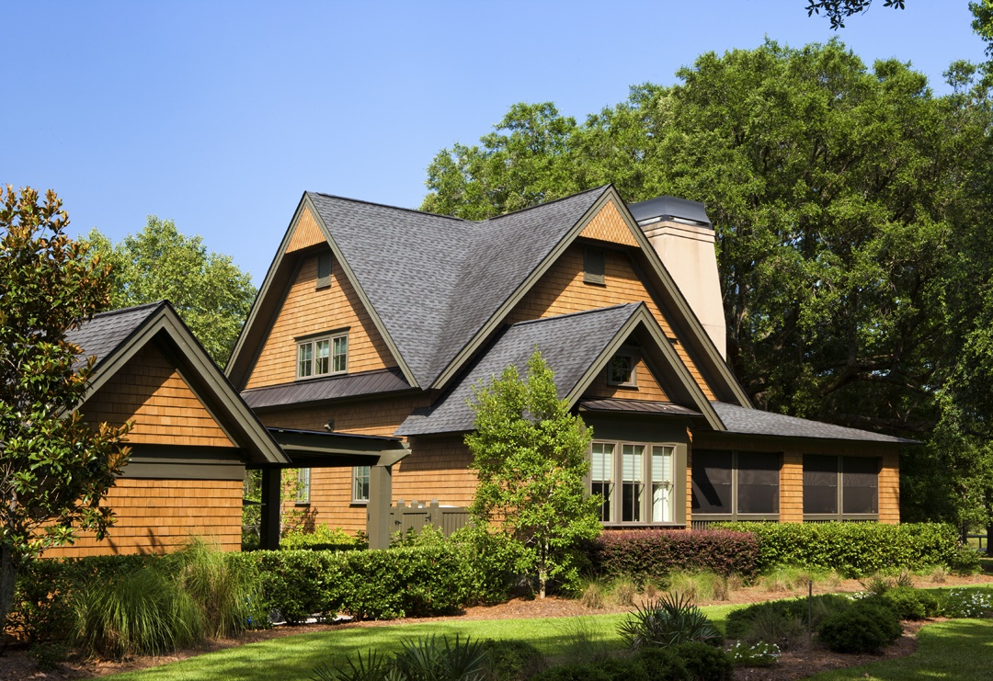
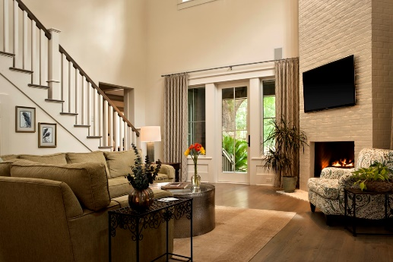
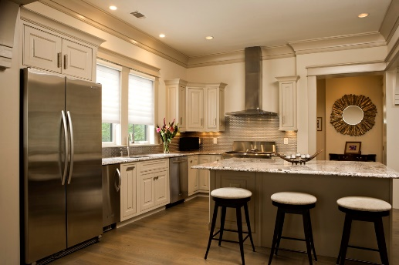
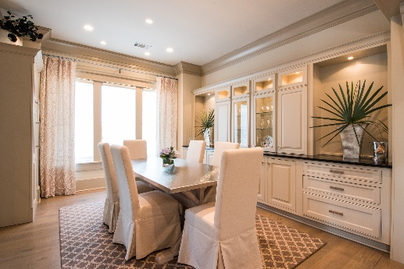
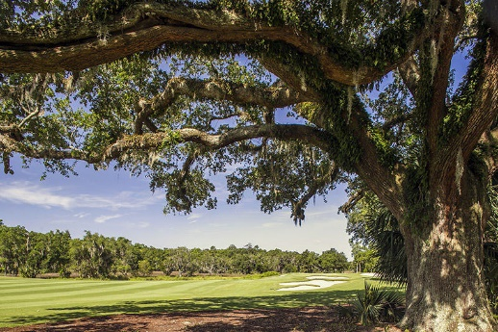


720 Island Park Drive #101 Daniel Island Park Daniel Island, SC 29492 MLS# 16007382 $1,175,000
Sophisticated Park Cottage with Motivated Seller
New Price!
Very easy to show. Call today to schedule an appointment.
Three Bedrooms, Three-Full and One-Half Bath
First floor Master with En Suite Bath
Two-story Great Room
Nestled among live oaks on 5th hole of Beresford Creek Golf Course
Professionally decorated with Screened-in Wrap-around Porch
Connie Dittrich Realtor, ABR, CNE, SFR
cdittrich@carolinaone.com
(843) 475-7993
Carolina One Real Estate
628 Long Point Road
Mt Pleasant,SC 29464

