Slide 1
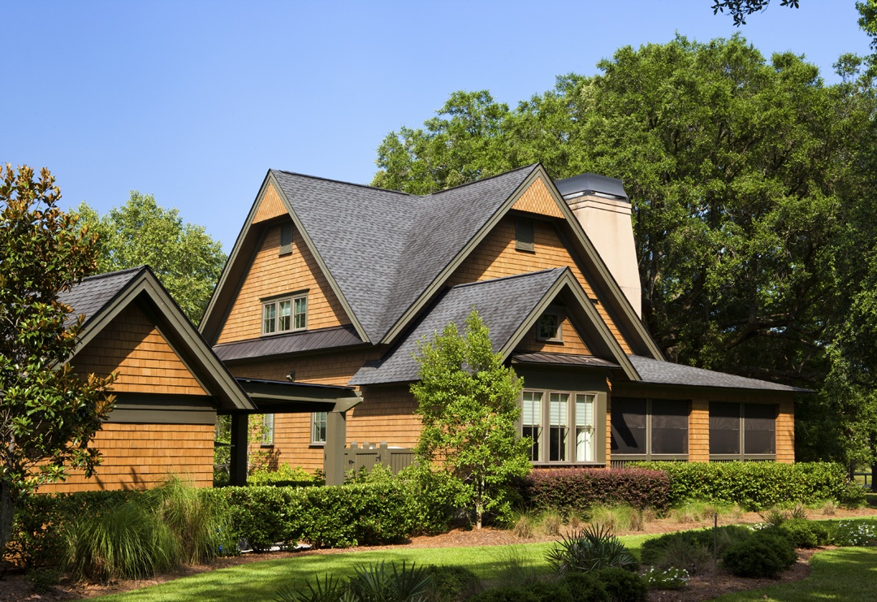

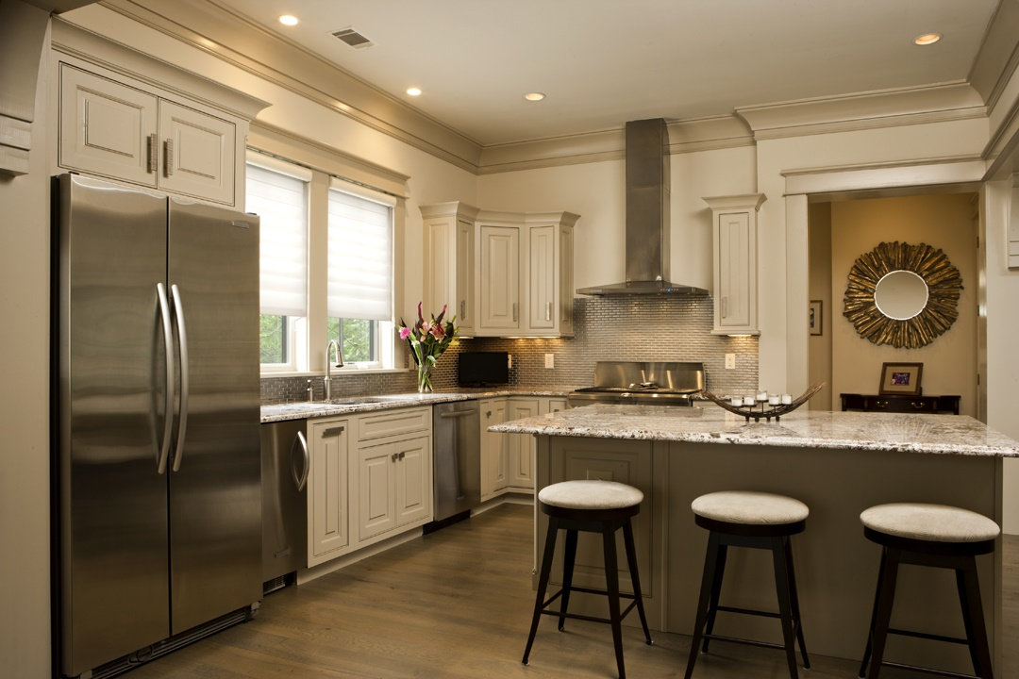
Are your clients Down sizing, Investing, Buying A First Home? Maybe it’s time to Consider 720 Island Park Drive #101 Daniel Island asking: $1,175,000 MLs: 16007382
Connie Dittrich, Realtor, ABR, CNE, SFR
Carolina One Real Estate 843-475-7993 cdittrich@carolinaone.com

