Slide 1
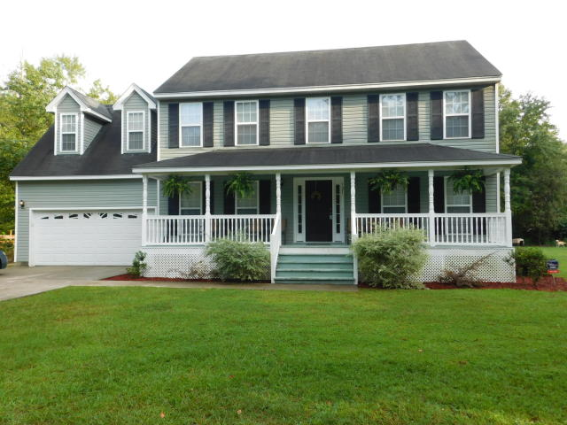
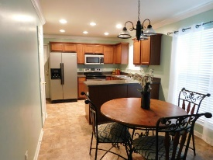
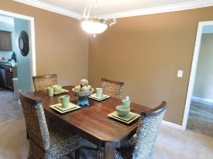
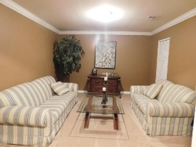
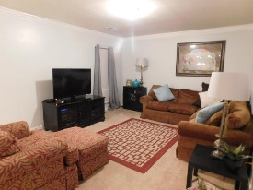
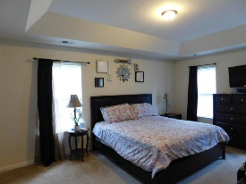
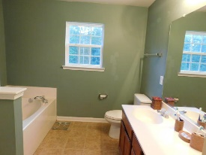
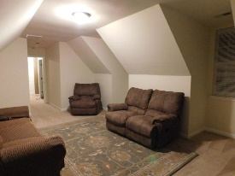
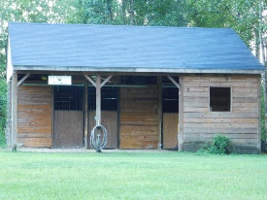
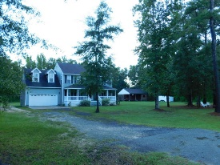

1 Acre of Privacy ~ A Must See!!!
Offering $1,000 Agent Bonus
721 Moultrie Lane
Huger, SC 29450 · MLS# 16023322 · $280,000
Well Maintained Home with a True Country Porch on a Glorious Acre of private land without HOA covenants or restrictions. This Beautiful 2 story home showcases a spacious living space with formal living and dining rooms, large family room, and eat-in kitchen with Stainless Steel appliances. Upstairs there are 3 bedrooms and a large FROG. Home has Master Suite with a trey ceiling featuring a sitting area, upgraded bath with separate garden tub. The yard is beautifully landscaped with a 3 Stall Matted Barn equipped with water and electric. If fishing is your passion-grab your pole and enjoy being 3 minutes from free freshwater docking and 7 minutes from saltwater docking. This property is located minutes away from Mount Pleasant, Beaches, Nucor, BP and more!
Henry Richardson
(843) 696-3155 | hrichardson@ergroupofsc.com
The Elite Realty Group of SC, LLC · 8310-A Rivers Ave · North Charleston, SC 29406

