Slide 1
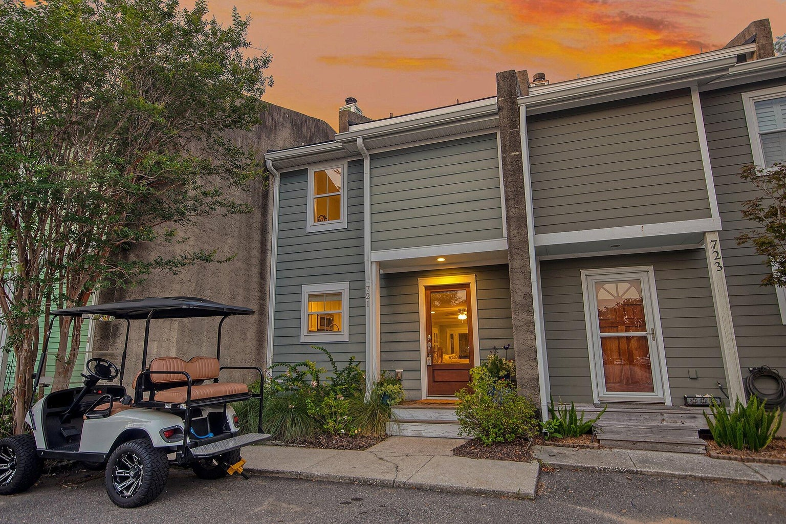



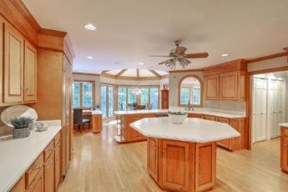
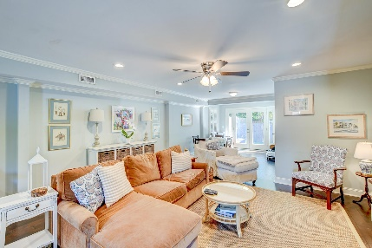



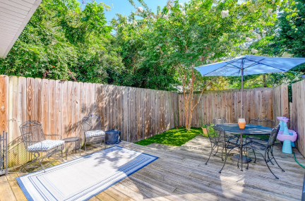

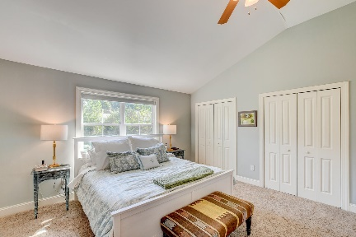
Parkshore Marshfront
Open House
Sunday, September 24th, 1-3pm
721 Davenport Drive
Cove Inlet Villas | Mount Pleasant | MLS# 23015918 | $725,000
Three story townhouse in an incredible Mt Pleasant location with NO HOA! This charming residence in Cove Inlet Villas boasts numerous updates and features that are sure to impress even the most discerning buyer. As you step inside, you'll immediately notice the granite countertops in the kitchen, adding a touch of elegance and sophistication. The kitchen also offers stainless steel appliances, white cabinetry, and an island with seating. The beautiful wood floors throughout the main living areas create a warm and inviting atmosphere. The open floor plan effortlessly connects the living, dining, and kitchen areas, creating a seamless flow that is perfect for entertaining guests or simply enjoying quality time with loved ones. With window treatments (plantation shutters and blackout shades) added in 2017, you can effortlessly control the amount of natural light that fills the space, providing both privacy and ambiance. Out back, you'll discover a roomy deck and a fenced in area. For pet lovers, you'll be delighted to discover that the owners have installed pet turf in 2022, ensuring a low-maintenance and enjoyable space for your furry friends to play and relax. Head to the second level to find two bedrooms, one with vinyl flooring added in 2022, and a full bathroom with a new upgraded bathtub/shower (2022). On the third level, you'll find the relaxing owner's suite with vaulted ceilings, multiple closets, a laundry area, and a full bathroom with a dual sink vanity and a large step-in shower.
Other notable features of this home include an AC unit installed in 2016 and new gutters in 2022.
Conveniently located in Mt Pleasant, this home is close to it all! This property is just 1 mile from Alhambra Hall, 1.2 miles from the Pitt Street Bridge, 1.6 miles from the shops on Pitt Street, 1.9 miles from Shem Creek, 2.6 miles from Sullivan's Island, and 5.7 miles from downtown Charleston. With its impeccable updates and attention to detail, this home is truly a gem that must be seen to be appreciated. Don't miss the opportunity to make it yours today!
Colin Spann ColinSpann@mattoneillteam.com 864-934-7724

