Slide 1
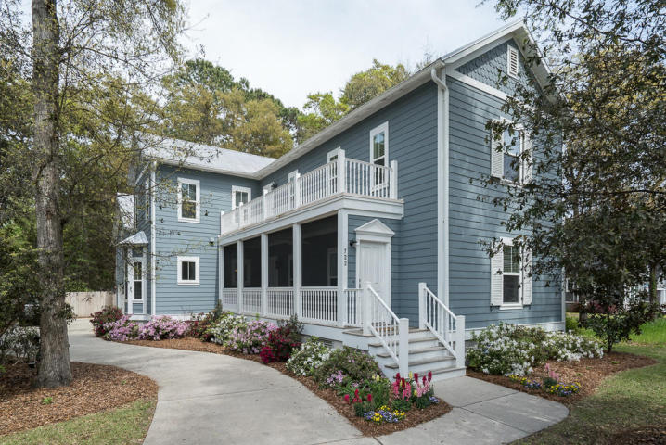
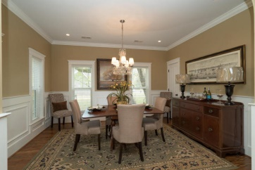
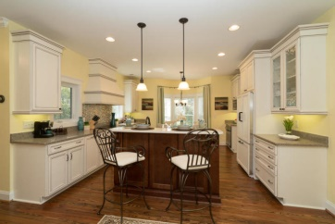
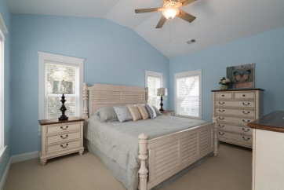
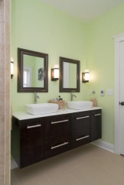
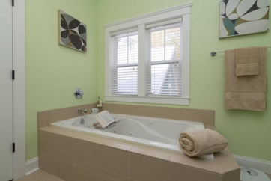
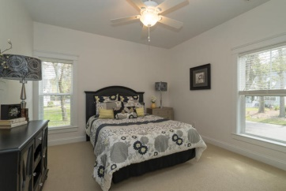
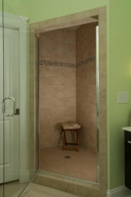
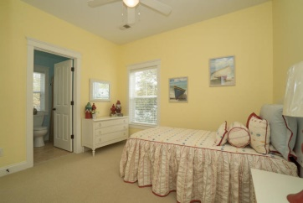
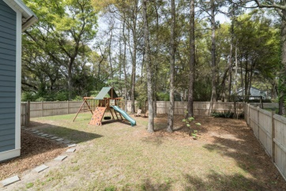

Perfect James Island Location
Carolina Oaks at Lighthouse Point
722 Canopy Cove
Charleston, SC 29412
MLS# 15003535
$499,000
5 Bed | 3½ Bath
This meticulously kept custom Charleston-Single style home, located on a quiet tree-lined cul-de-sac, melds traditional southern charm with modern day upgrades. Floorplan & bedroom locations lend themselves to a variety of different uses. The 5th bedroom serves as a perfect nursery or small home office & the large Bonus Room, with its own full, private bath could serve as a 6th bedroom. Home includes reclaimed heart pine wood floors & crown moulding throughout the main living areas, designer kitchen cabinets with soft-close drawers, quartz countertops & stainless steel appliances, including a Jenn Air French Door refrigerator with custom cabinet doors & warming drawer in the range. Master bath includes heated tile floor, large jetted soaking tub and tiled walk-in shower
Manorhouse Builders of SC
215 East Bay St., St. #504
Charleston, SC 29401
O: (843) 377-1312 x 213
F: (843) 722-0332
Kimberly J. Byrd
Sales and Marketing Manager
Kimberly@EastBayCompany.com
M: (843) 214-0609

