Slide 1
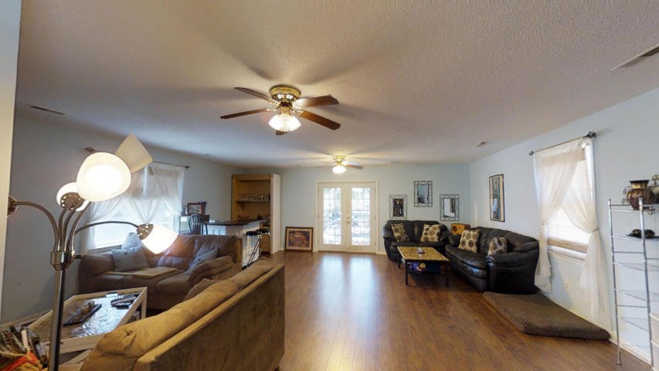
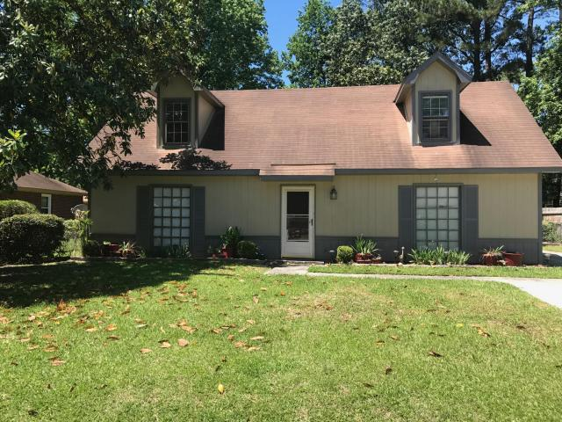
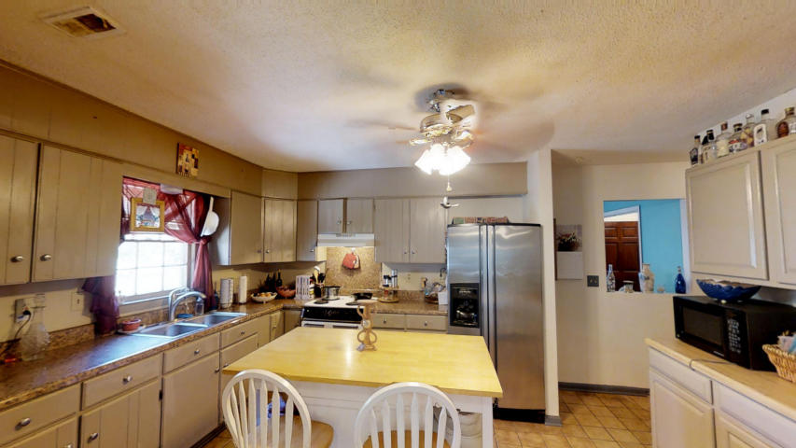
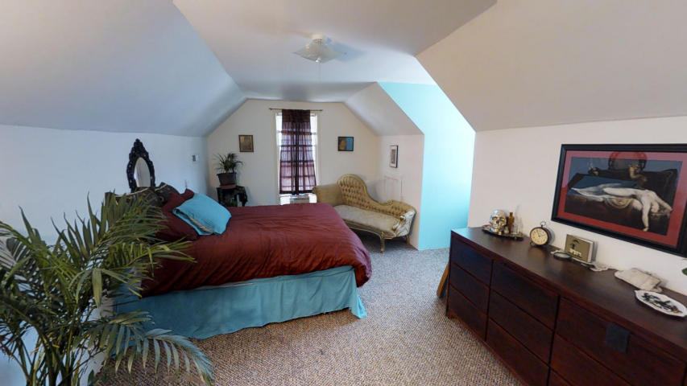
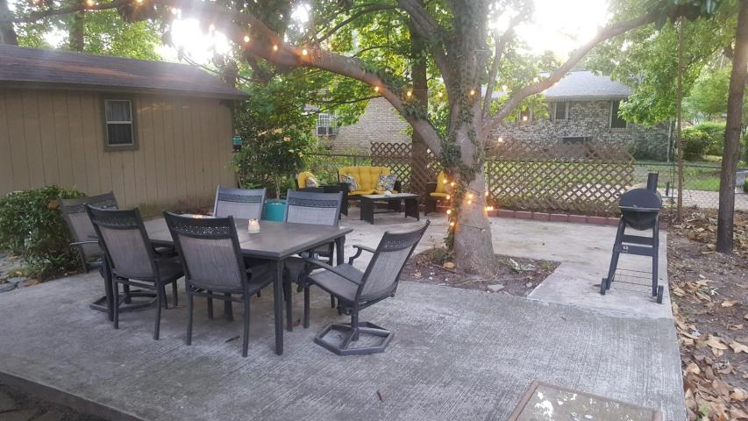

Incredible Value with 4 Bedrooms
723 Corral Drive
Ponderosa ~ Charleston, SC 29414 ~ MLS# 17013173 ~ $210,000
This home is the best value in town! A four bedroom two bath house with nearly 2300 sf of living space for $210,000! This is less than $93 per sf and the floorplan is the screams VERSATILITY! With two bedrooms and a full bath on the main level plus two more bedrooms and a full bath upstairs, this is awesome for families, a professional with a roommate, or an Investment Property! Run the numbers and you will see there will be a GREAT monthly profit if this home was rented. The huge family room addition off of the kitchen boasts brand new wood floors, and the fenced in yard is PERFECT for entertaining. A short ride to Downtown Charleston, the beaches at Folly and Kiawah Island, public boat launch and popular Greenway for biking and walking, this home is in a Fantastic LOCATION! No restrictive covenants here, so bring your boat, jet skis, or camper. Time to cash in on this INCREDIBLE VALUE!
3D Walk thru tour on mls or go to
https://my.matterport.com/show/?m=Rvf5eJaUhvL&mls=1
Ellen O'Neil
Broker/Owner
Ellen O'Neil Realty
ABR, e-PRO, CNE
Charleston Realtor of Distinction
(843)300-8530
http://EllenONeilRealty.com

