Slide 1
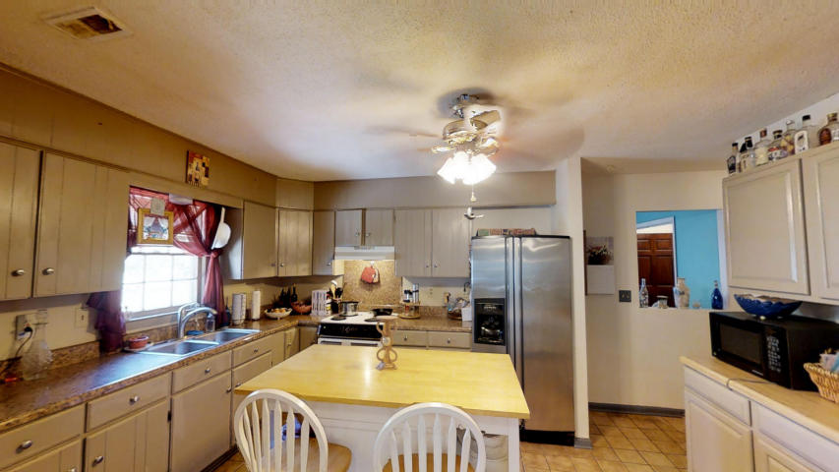
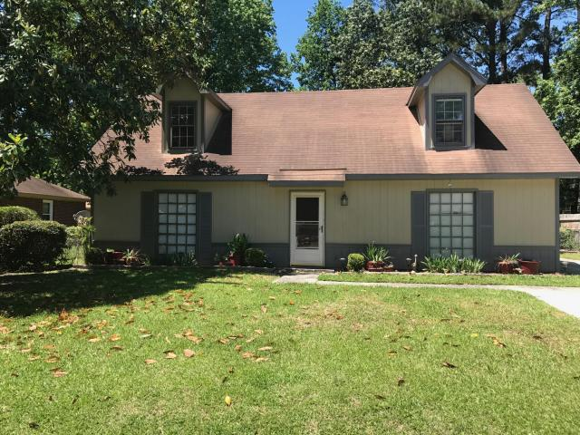
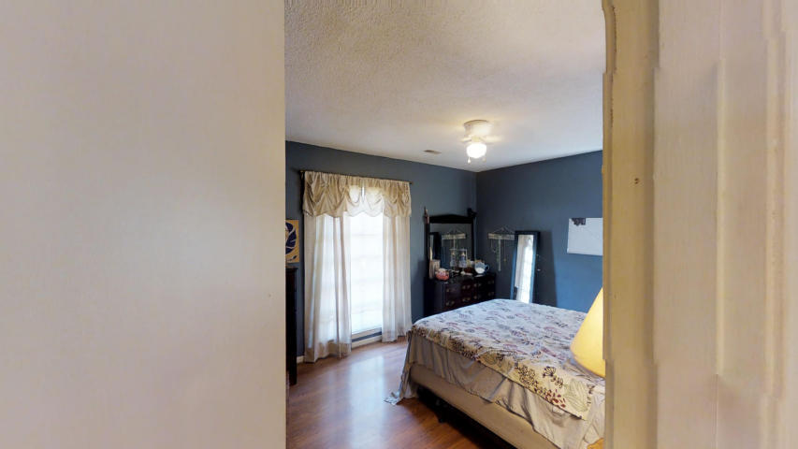
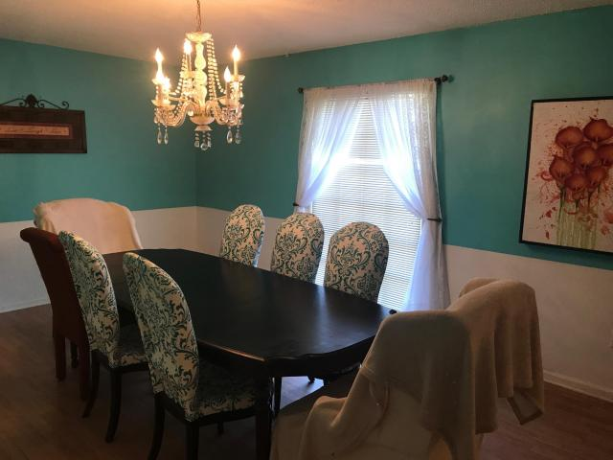
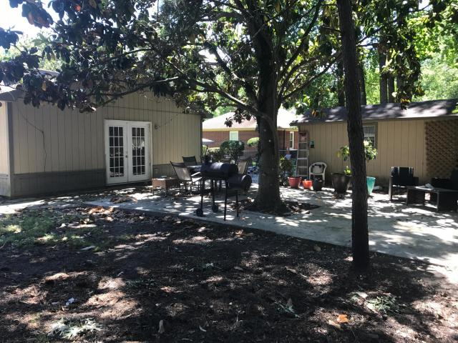
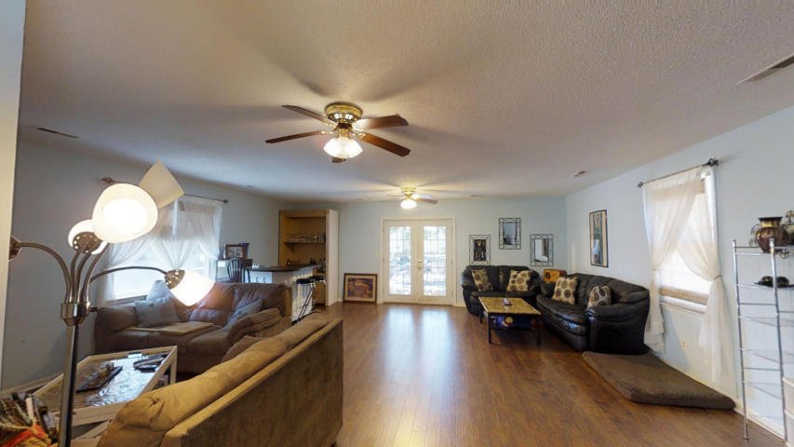
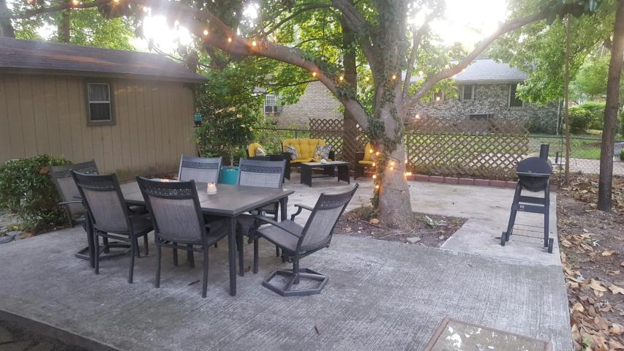

New Roof & Price Drop
4 BR West Ashley Home!
723 Corral Drive
Ponderosa ~ Charleston, SC 29414
MLS# 17013173 ~ $199,900 ~ 2,271sf
Unbeatable Value for this 4 bedroom home in West Ashley!
NEW ROOF with 30 year architectural shingles being installed this week! PLUS the seller dropped the price to an unbelievable $199,900! Seller says it is time to close- and you can be in for Christmas! This home would be ideal for anyone who needs a true four bedroom OR an investor! This would generate nice monthly income as a rental.
The home has new wood floors in the large family room addition off the rear of the house, updated bathrooms, wood and tile floors. The back yard is AWESOME! Great for entertaining and for families, this is the time to make your move!
3D Walk thru tour on mls or go to
https://my.matterport.com/show/?m=Rvf5eJaUhvL
Ellen O'Neil
Broker/Owner
Ellen O'Neil Realty
ABR, e-PRO, CNE
Charleston Realtor of Distinction
(843)300-8530
http://EllenONeilRealty.com

