Slide 1

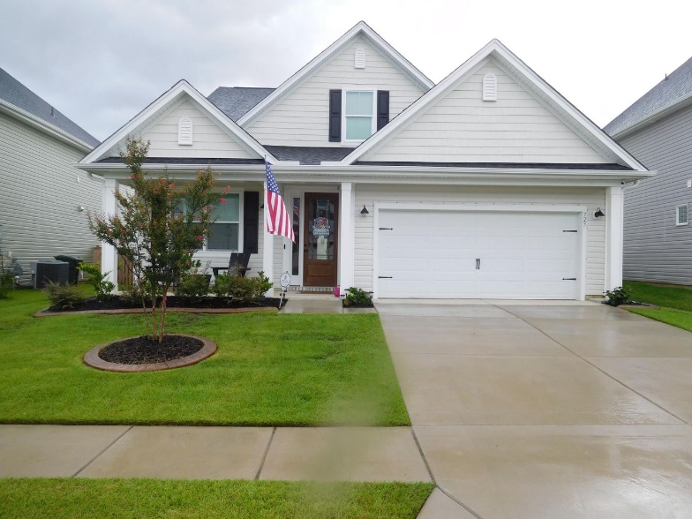
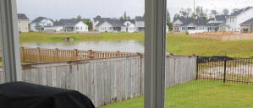
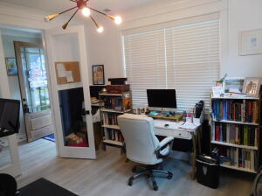
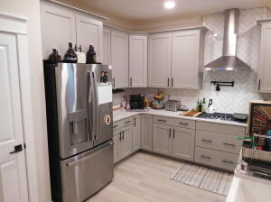
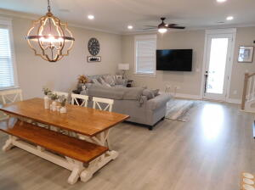
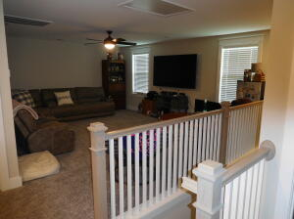
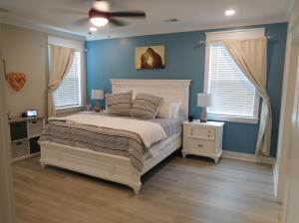
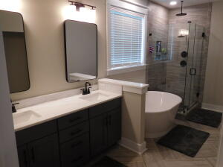
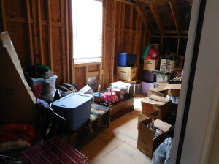
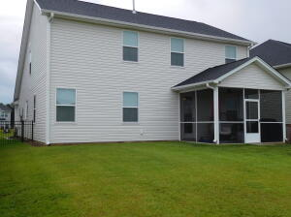
Don C. Mason, CIAS, CNE
(843) 364-9090 nibsc@aol.com
Open House Sunday
July 17th - 2:00 to 5:00
723 Sportsman Road
Foxbank Plantation
Moncks Corner, SC 29461
MLS# 22017864 ~ $449,000
Property Subtypes: Executive Suites, Office Building
Building Size (RSF): 2,400 SF
Sale Price: $379,000
Cooperation Compensation: 3%
Property Use Type: Investment/Professional Office
Usable Size (USF): 2,400
Sale Terms: Cash to Seller
Agency Type: Exclusive Right to Sell/Lease
Don't compare apples to oranges. less than 2-years-old. Immaculate 4 bedroom 2.5 bathrooms 2,765 sq.ft home with a fenced yard on a pond in the very popular Foxbank Plantation. Why wait for new construction. This move in ready home can be yours now. Schedule your showing now to be WOWED! Large open farmhouse style kitchen with stainless appliances including a vent hood and gas range and subway backsplash. Farmhouse sink and pot filer. Large kitchen island with quartz countertops and surrounded in shiplap. Spacious open concept living and dining room with Sonos speakers hardwired into the ceiling. Tucked away downstairs is the master bedroom that can easily fit a king size bedroom suit. Master bathroom with his and hers marble countertop vanity. A garden tub and a frameless glass shower featuring a pebble floor and a rain shower faucet. Upstairs has a huge open loft. Additional 3 bedrooms and a full bathroom. Hardwoods up the stairway. Extra soft padding and carpet in loft and bedrooms. There is a very large unfinished room off of one of the bedrooms. Could be a man cave, mother in law suit. Very nice sc reen porch out back to enjoy pond views.
Real Estate Advocates LC
3356 Billings Street | Mt. Pleasant, S.C. 29466 www.realestateadvocates.com

