Slide 1
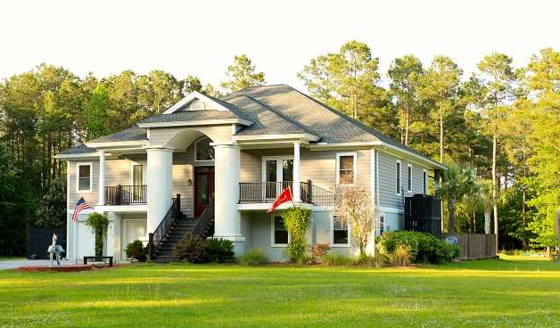
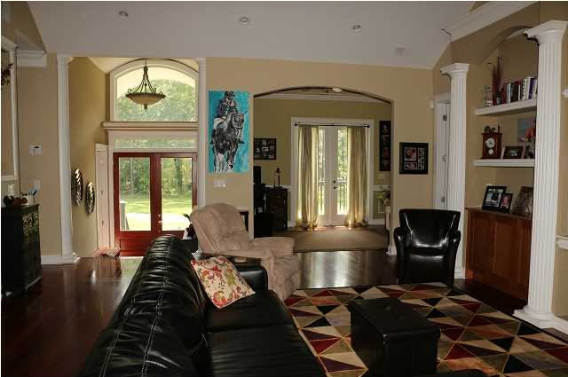
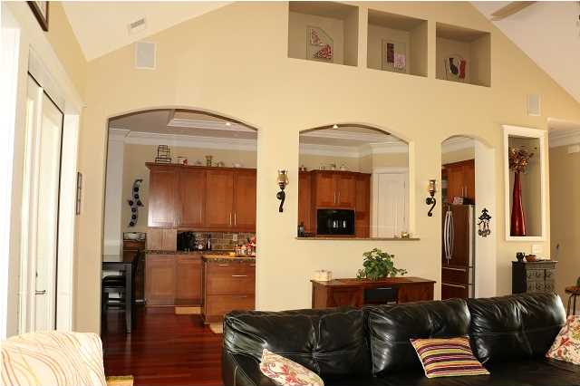
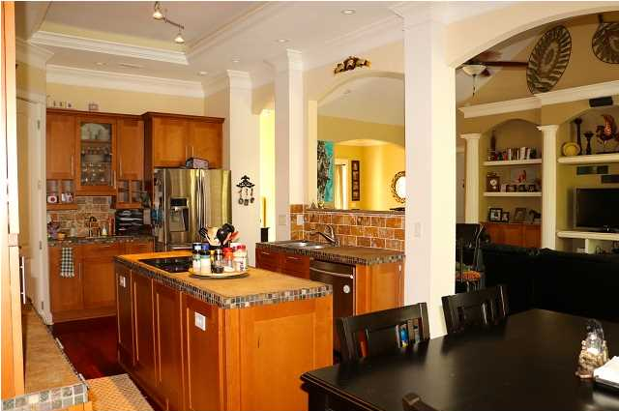
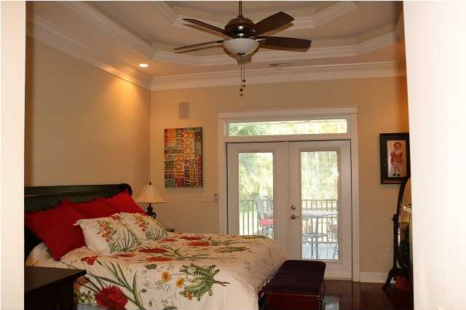
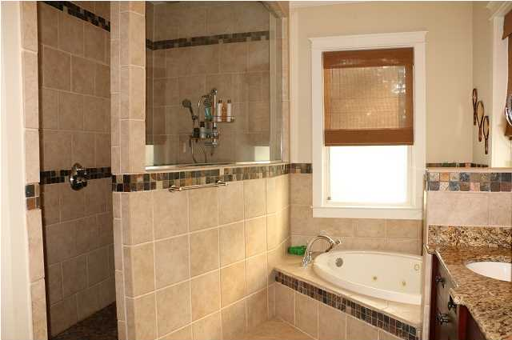
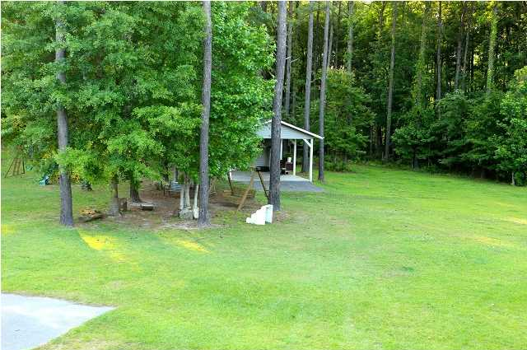
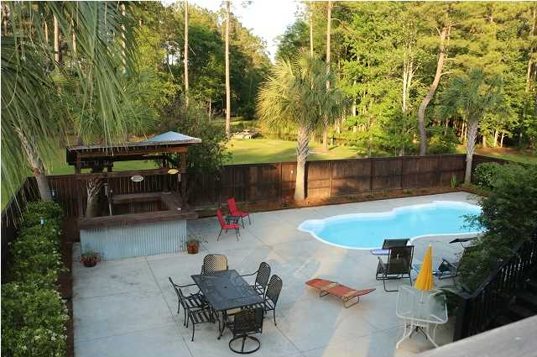
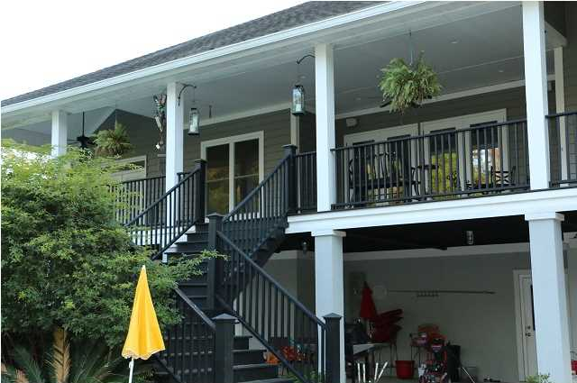
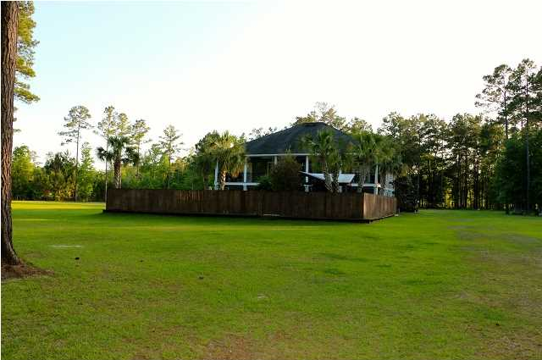


7246 Highway 165 Ravenel, SC MLS# 1413592 $640,000
Welcome to this beautiful executive custom built home in a peaceful and private 10.00 acre setting. Over 7 acres cleared and total property is fenced in. Property also has a 1/2 acre pond with dock already in place. Property is very private and has an electric security gate out at front of property. The beautiful brazilian cherry floors throughout the first floor. 17ft ceilings in the great room. The great room is open to the custom gourmet kitchen and also open to a formal dining room. The dining room has 8ft french doors that open to the front porch. From the living room double french doors onto the huge covered back porch that overlooks the property and the in ground pool area complete with Tiki Hut Bar. There is also a covered outdoor shower and grill area-all protected from the weather. The master bedroom is impressive with tray ceiling and another french door that provides access to the back porch. The master bathroom is designed to welcome and excite anyone. It has an over-sized walk in shower with overhead rain head faucet. There is also a corner soaking tub and custom his and her vanities. The other bedrooms on this floor both have their own full baths. The laundry room is located on the first floor for your convenience. The kitchen has a center island, canac cabinets and top of the line counter tops and appliances to include double oven/convection microwave oven. Downstairs you will see family/game room with 12x19 movie screen, custom bar, a full bath and there is plenty space to add another bedroom. The home has a 2 plus car garage with workshop area and a detached carport/workshop for storing equipment and/or recreation vehicles. Only 4 miles to HWY 17 and about 35 minutes to downtown historic Charleston. You can live and enjoy in your 10 acres private dream house in a country and yet close to historic downtown Charleston. In last two years the following improvements were made. New Security System(8 cameras/DVR. New Stainless Refrigerator and Dish Washer. New Septic Pump. New Pool Pump. New Pool Vacuum. Thank you for showing.
Cathy Rosenblum
843-817-7869
crosenblum@comcast.net

