Slide 1
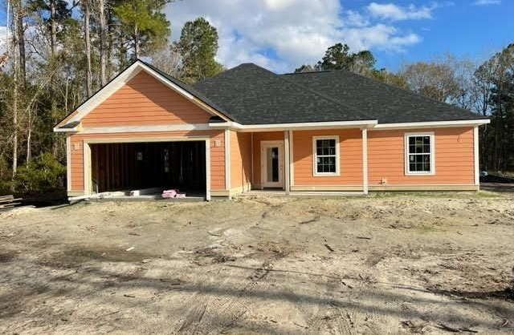
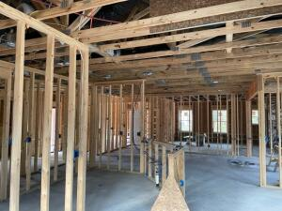
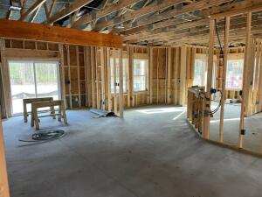
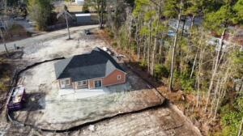
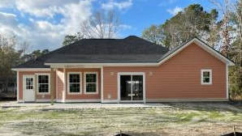


7246 Raw Dew Drive Awendaw, SC 29429 | MLS# 21033170 | $525,000
NEW CONSTRUCTION READY IN MARCH
NOW’S YOUR CHANCE TO PICK THE FINISHES
CHOOSE EXTERIOR PAINT COLOR WITH RATIFIED CONTRACT IN THE NEXT 45 DAYS. Highly sought after new construction on 1.48 acres on a private street in Awendaw is located less than 15 miles from Roper Hospital, Wando High School, and Mt. Pleasant shopping. Approximately 5 miles from Buck Hall Boat ramp and approximately 8 miles from Garris Landing Boat Ramp. This single family home offers 9' ceilings, solid surface countertops, stainless steal appliances, and luxury tile flooring throughout. Split bedroom design maximizes privacy; walk in closet off master bedroom; large rear concrete patio, 2 car garage.
Anticipated completion date March 2022.
Jill Beasenburg 843-259-4633
jill.beasenburg@carolinaone.com
Carolina One Real Estate
1503 Palm Blvd
Isle of Palms, SC 29451-2280

