Slide 1
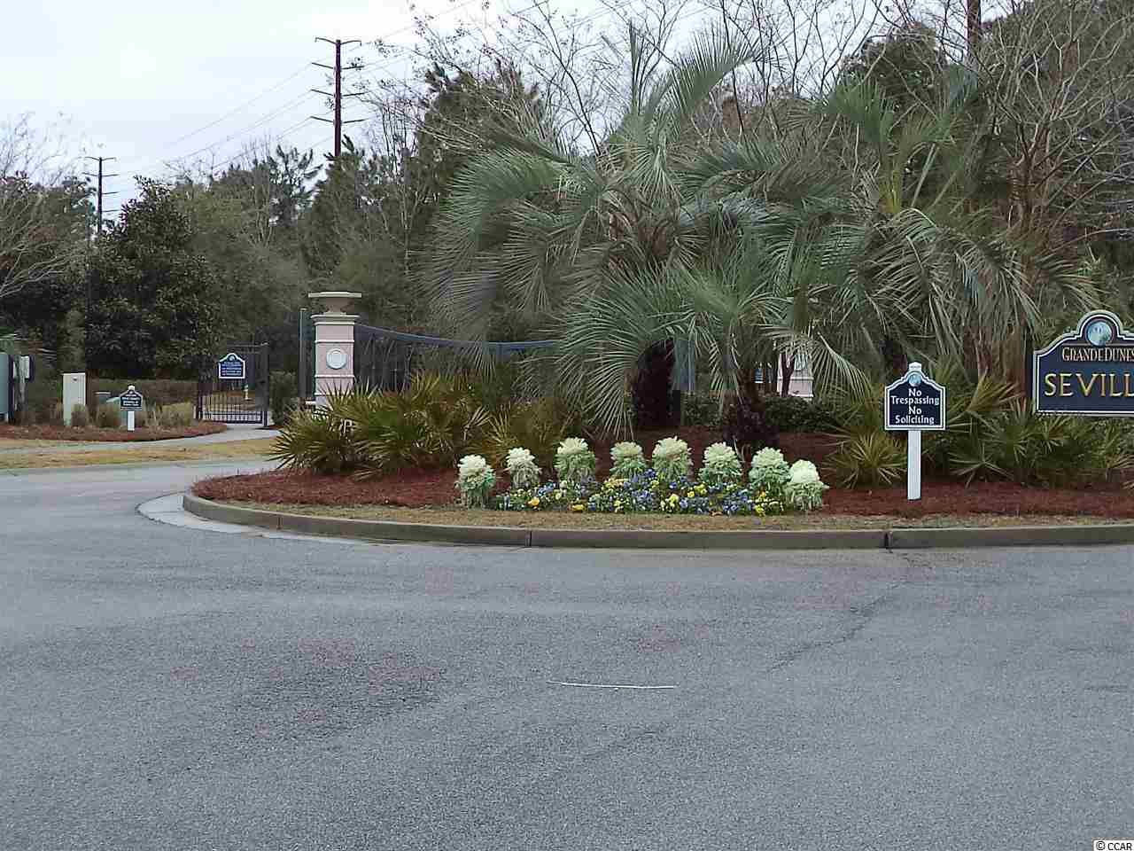
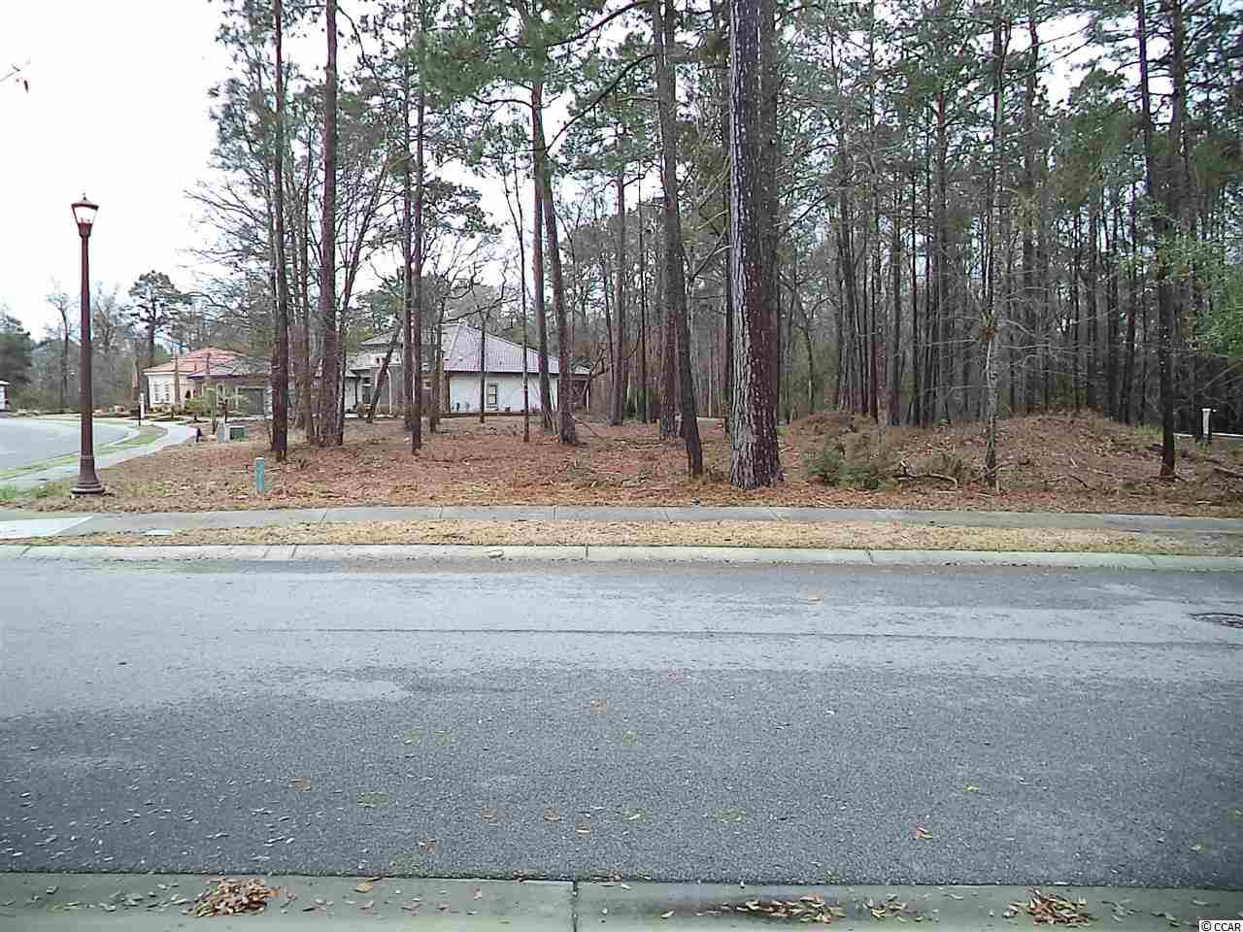
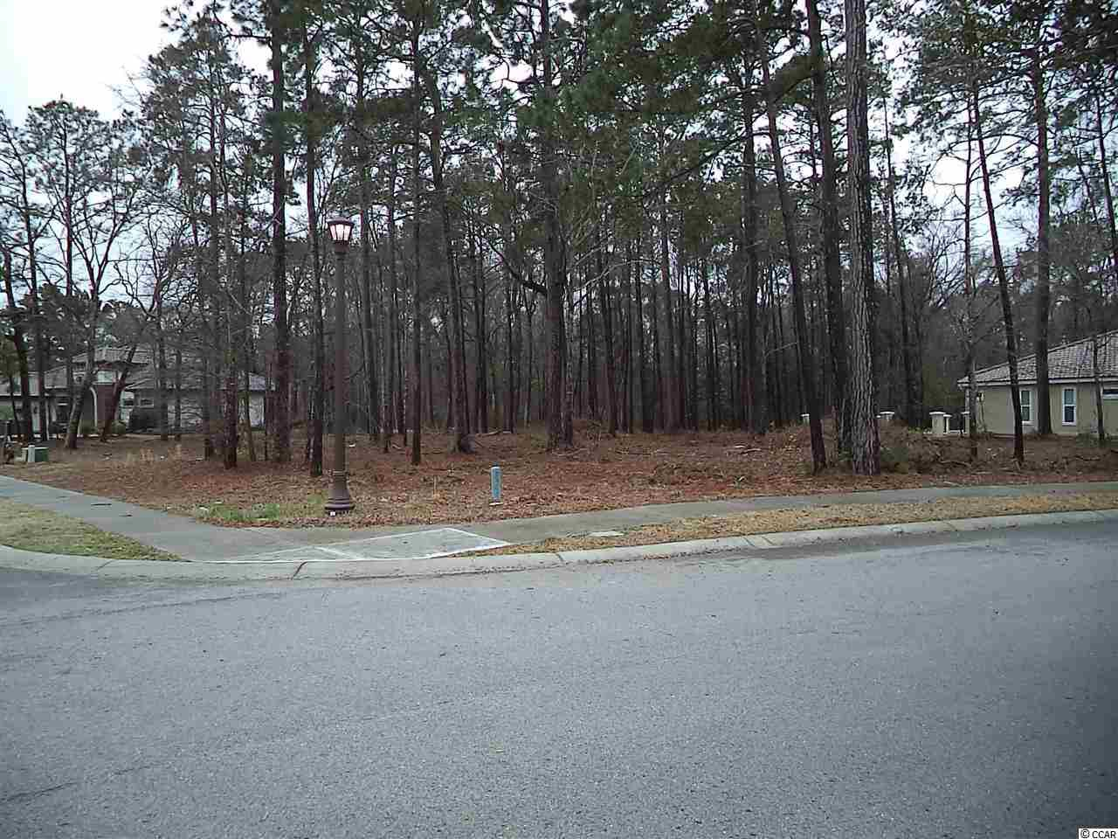

7260 Catena Ln
Myrtle Beach, SC 29572 ~ MLS# 1402806 ~ Asking $124,900
Grand Dunes
Corner Lot
$599,900
Reduced $5,000
Beautiful corner lot at the intersection of Seville and Catena.
The only available homesite in the beautiful gated community of Grande Dunes Seville. Choose your own builder with no time frame to build.
Ownership includes membership to the exclusive Grande Dunes Ocean Club.
M.A. Peedin | builderpeedin@wmconnect.com | 843-385-3931
Wilkinson & Associates ERA Powered , 9652 North Kings Highway, Myrtle Beach, SC, 29572

