Slide 1
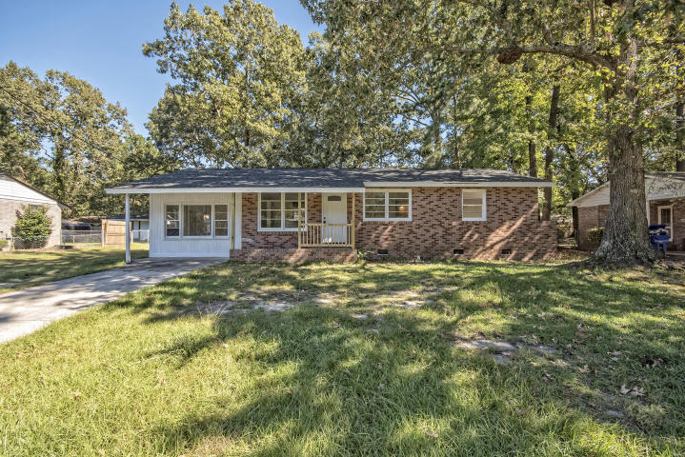
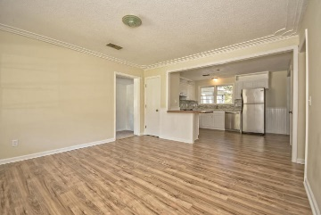
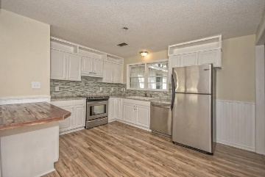
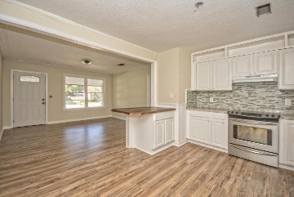
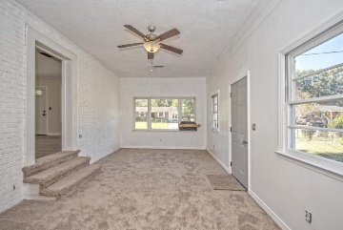
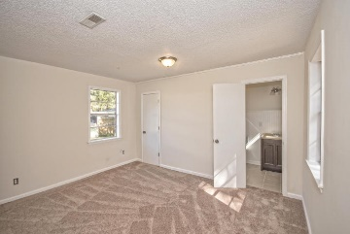
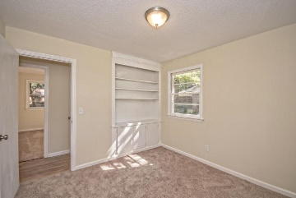
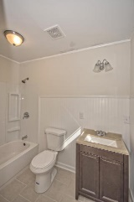
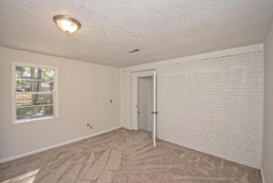
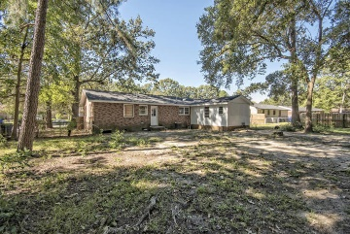



726 Cartwright Drive ~ Ponderosa
BACK ON THE MARKET!
Buyer Financing Fell Through! ~ 4% Agent Commission
REDUCED PRICE - $163,500
Don't miss this steal, just reduced in price! Great location to all of West Ashley, Johns Island via Main Road, and 526. Come check out this newly remodeled 4BR home with a private Master Suite! Brand new roof, nice stainless appliances, new front windows, updated kitchen and bathrooms, new laminate hardwood floors, new carpet, freshly painted, and a large back yard as well!
MLS# 15026743
$163,500
Haynes Johnson
Greater Charleston Properties Team
Mobile - (843) 864-8159
haynes.charlestonproperties@gmail.com
The Boulevard Company, LLC | 35 Broad Street | Charleston, SC 29401 | haynes.charlestonrealestate.properties

