Slide 1
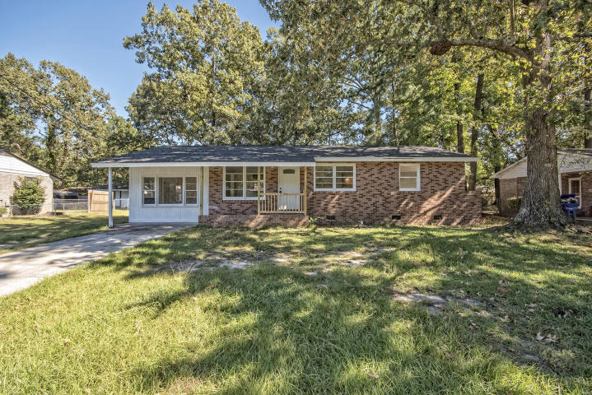
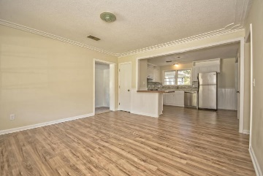
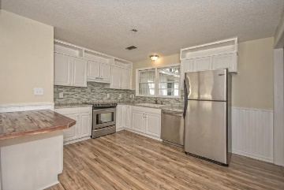
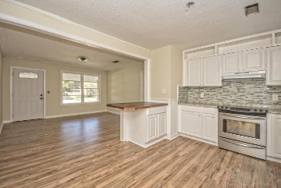
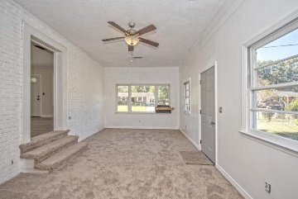
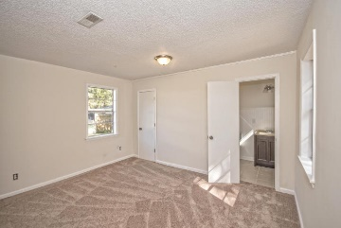
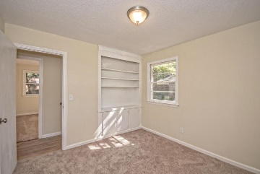
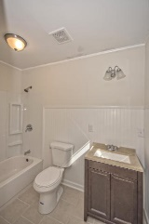
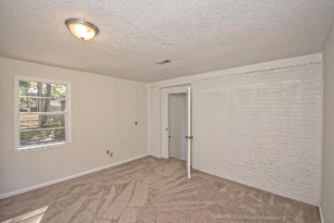
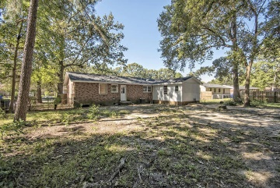


726 Cartwright Drive ~ Ponderosa
Renovated 4BR/2BA home with Master On-Suite in West Ashley!
Newly remodeled 4BR home with a private Master Suite on the opposite side of the home! Brand new roof, stainless appliances, totally updated kitchen and bathrooms, new laminate hardwood floors, new carpet, freshly painted, and a large back yard as well! Great location to all of West Ashley, Main Road, and 526.
MLS# 15026743
$179,900
Haynes Johnson
Mobile - (843) 864-8159
haynes.charlestonproperties@gmail.com
The Boulevard Company, LLC | 35 Broad Street | Charleston, SC 29401 | haynes.charlestonrealestate.properties

